Slide 1
Variational Inference for Acceleration of SN Ia Photometric Distance Estimation with BayeSN
Ana Sofia Uzsoy
with Stephen Thorp, Matt Grayling & Kaisey Mandel

Slide 2
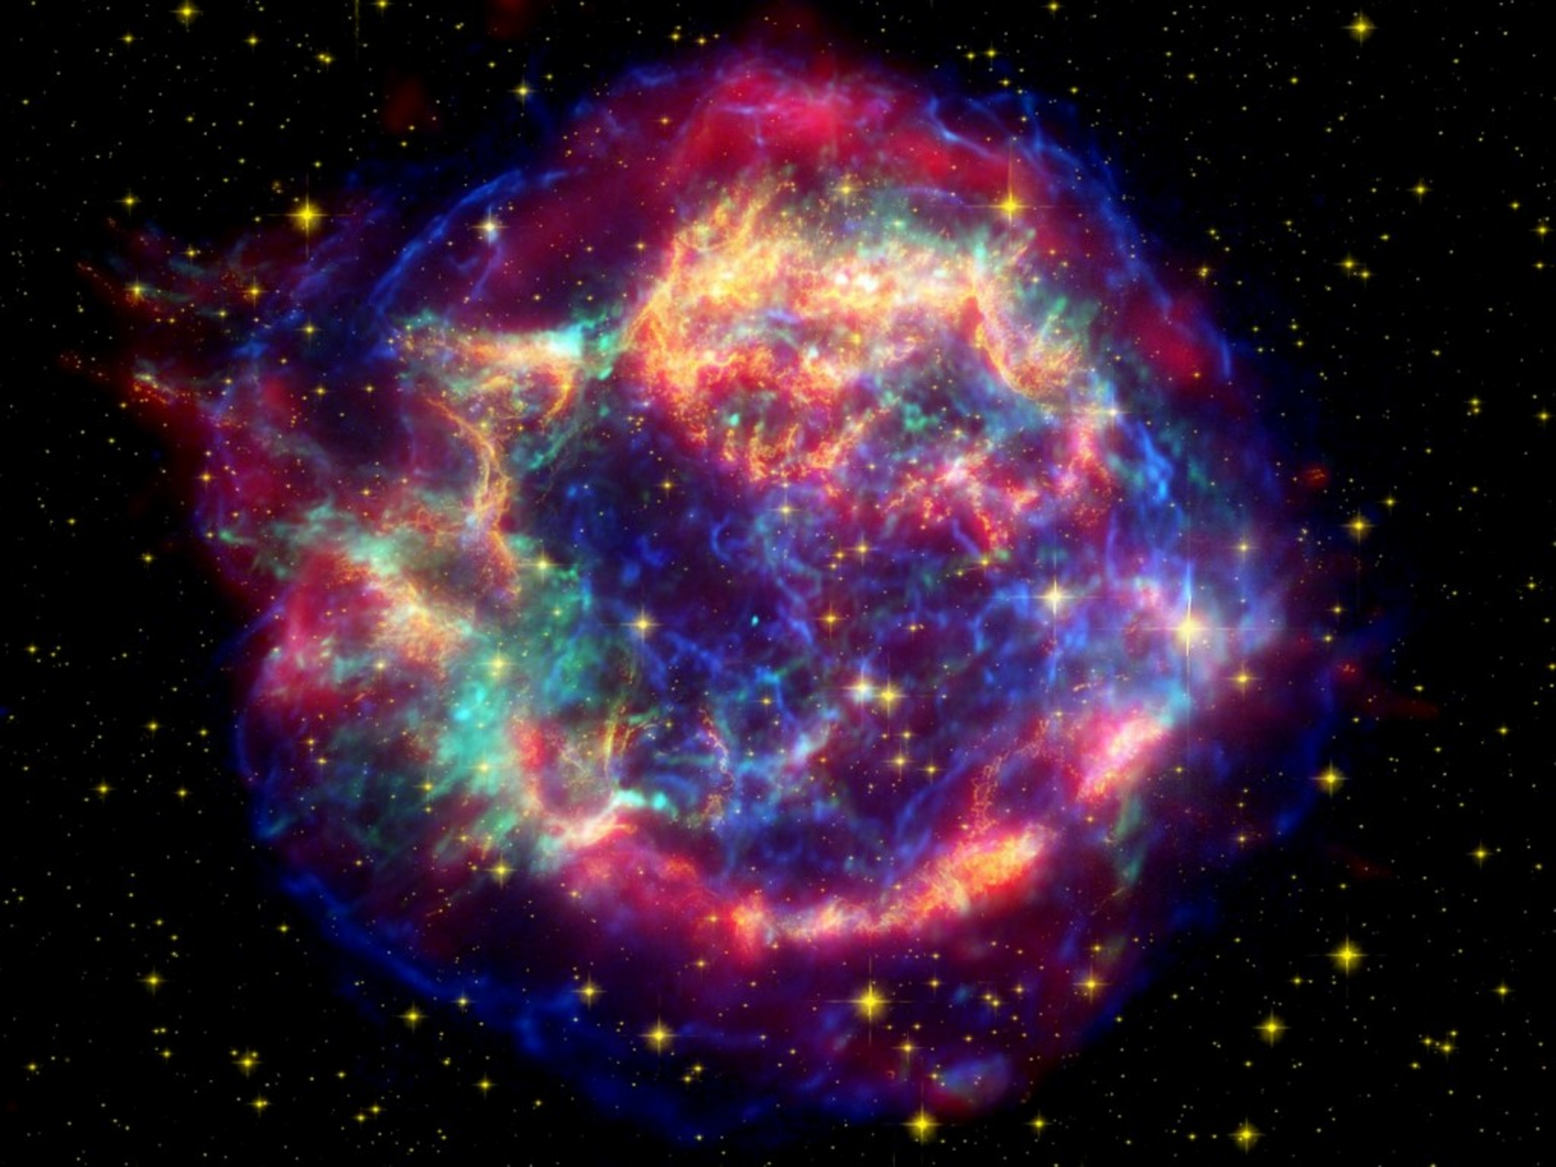
Background
Supernovae are stellar explosions.
Type Ia Supernovae (SN Ia) are standard candles.
Precisely determining the distances to SN Ia is critical for precision cosmology.
Image: https://cdn.techgyd.com/cassiopeia-supernova-wallpaper.jpg

Slide 3
How we observe SNe Ia
Spectral Energy Distribution (SED)
3 dimensions- flux, wavelength, and time
Flux is measured with bandpass filters
Wavelength (Å)

Slide 4
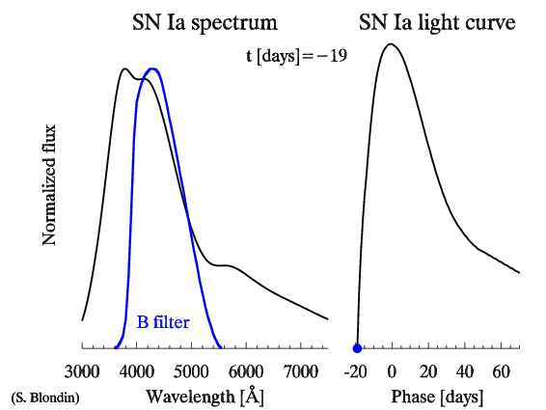
SN Ia flux is measured in filters.

Slide 5
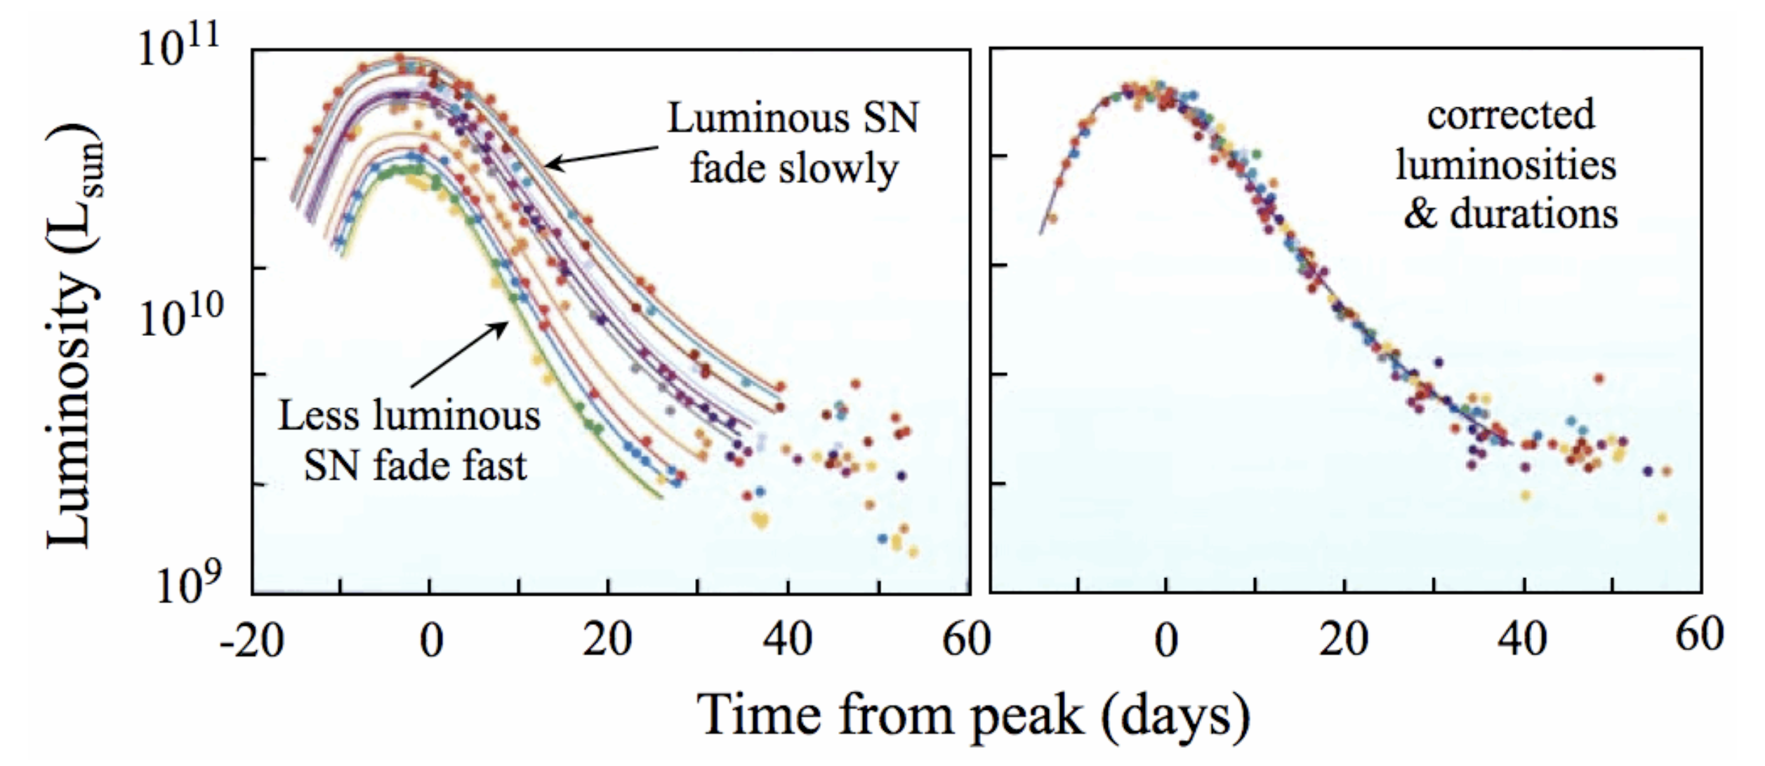
SN Ia are standard candles.
Figure: Durham University Department of Physics

Slide 6
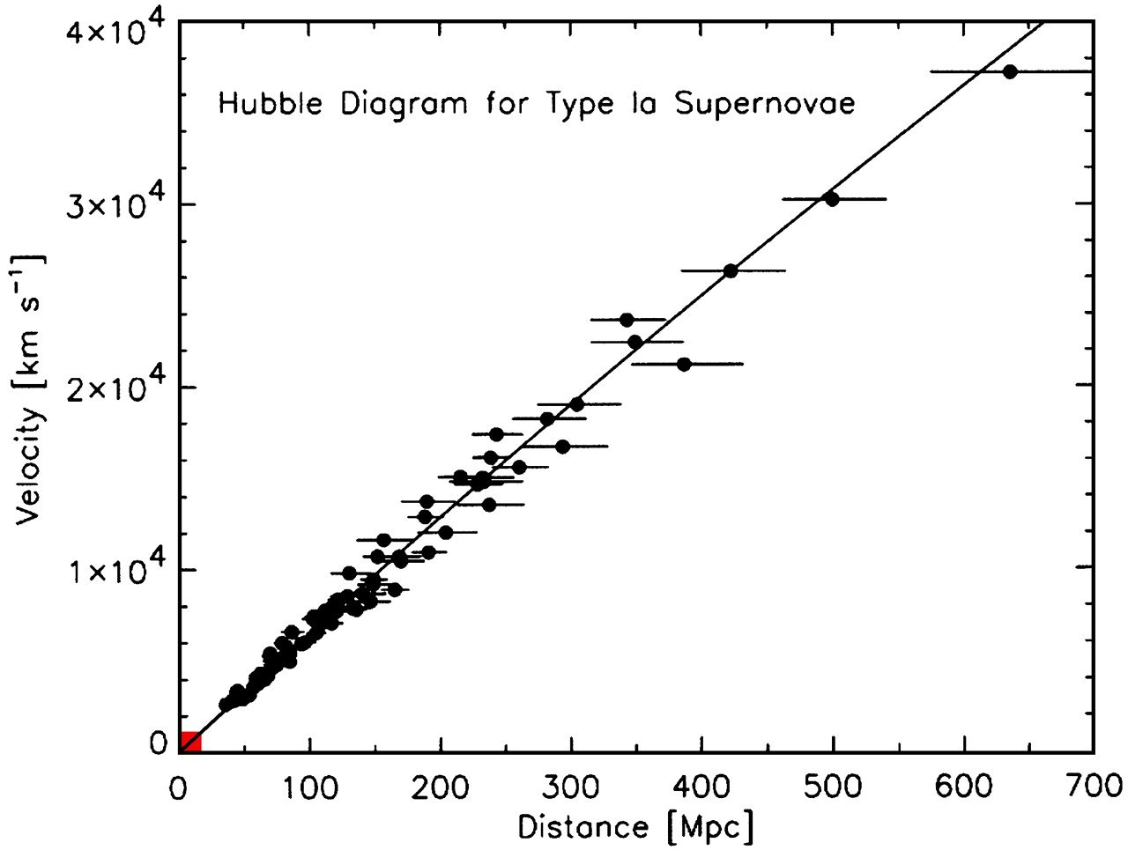
SNe Ia for precision cosmology
“Hubble diagram”: recessional velocity vs. distance
Probes expansion of the universe and Hubble constant
“ tension”
Jha (2002)

Slide 7
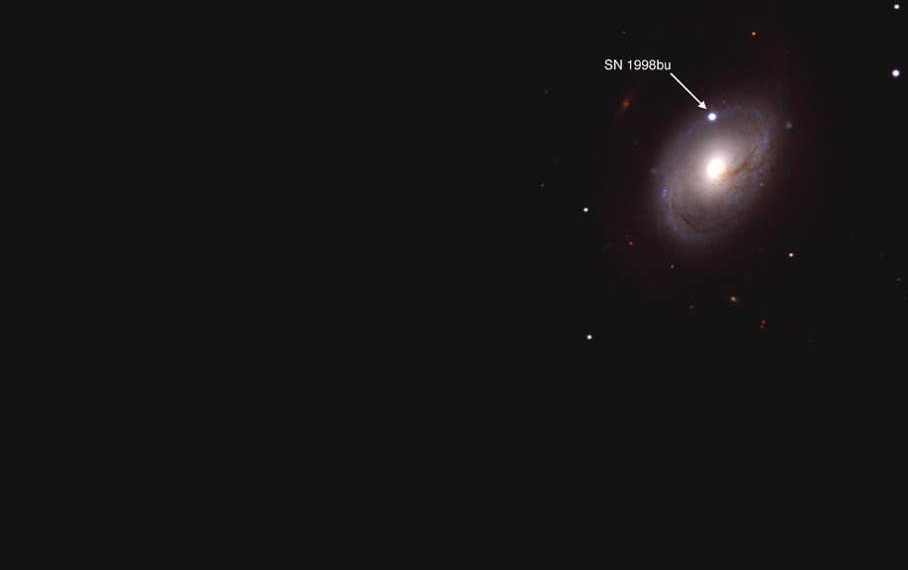
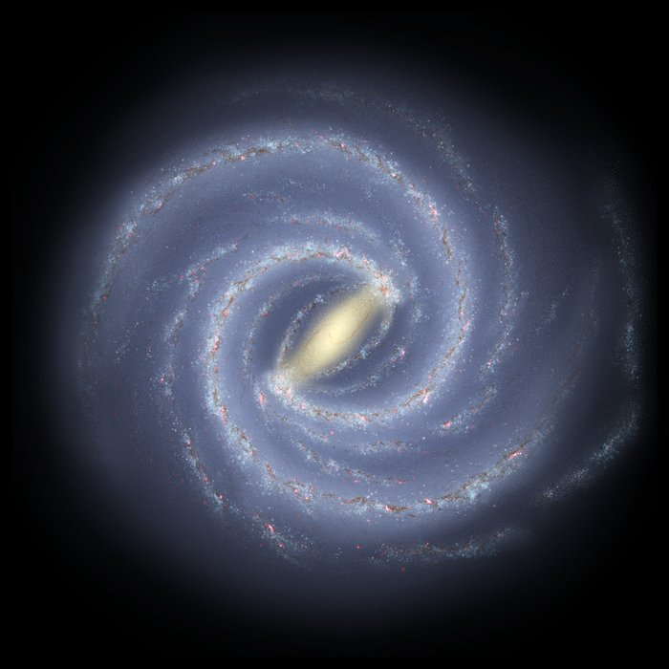
Types of Dust
Host Galaxy Dust → Potentially large effect on SN color and brightness, must be dealt with probabilistically
SN 1998bu
Intergalactic Dust
Milky Way Dust → Can be corrected with reddening map (e.g. Schlafly + Finkbeiner 11)
Earth
NASA/JPL-Caltech/ESO/R. Hurt, Nicholas B. Suntzeff
Slide credit: S. Thorp

Slide 8
Dust extinction depends on wavelength.
Extinction
Notes:
Determining distances is hard because it’s degenerate due to dust extinction
Dust has a differential effect as a function of wavelength (dims different bands at different amounts, more at bluer wavelengths, less at redder wavelengths)
Two key parameters, AV (total amount of extinction in the V band (crossover point in the diagram)), RV controls how steep it is
Extinction/dimming on y axis at a given wavelength (AV = 1, varying RV)

Slide 9
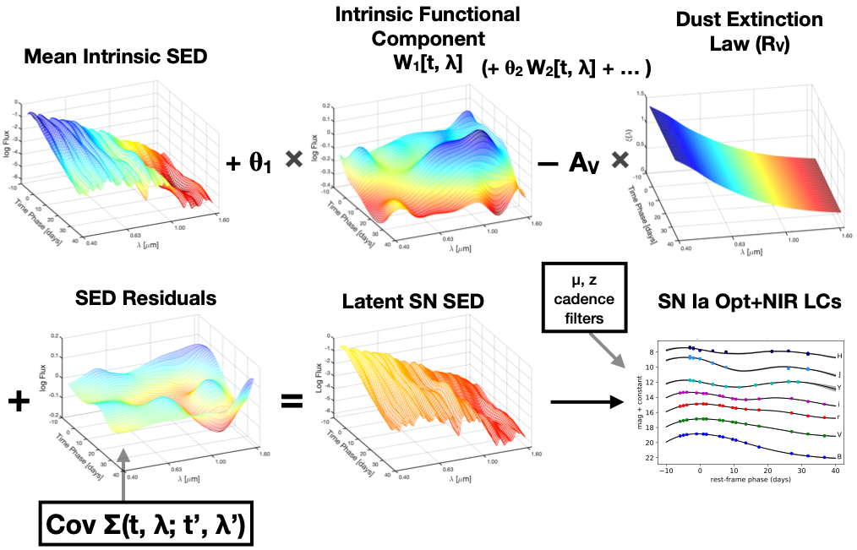
Overview of BayeSN
Mandel et al. (2020)

Slide 10
Overview of BayeSN
Mandel et al. (2020)

Slide 11
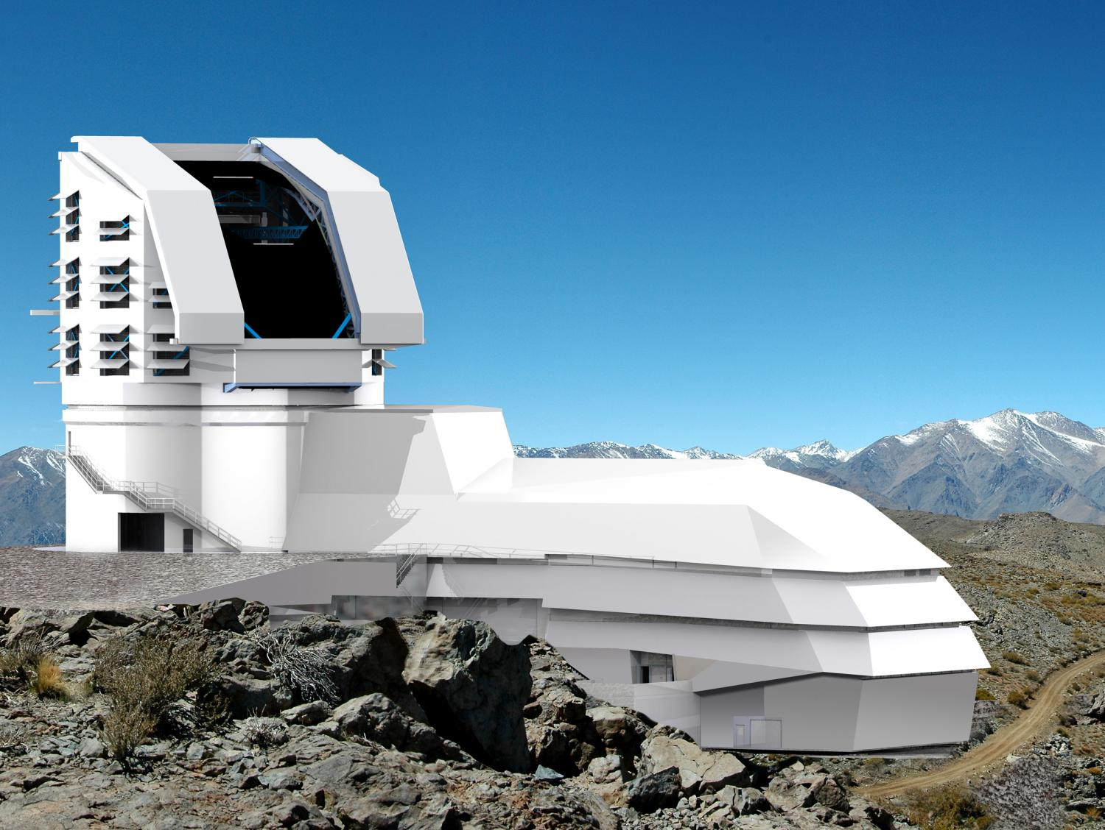
Why Variational Inference?
Posterior is currently fit using Hamiltonian Monte Carlo
VI provides:
  Computational speedup
  Analytical form of posterior
Looking forward:
  LSST & Roman will provide significant quantities of data
  Need scalable analyses!
Image: https://phys.org/news/2015-05-large-synoptic-survey-telescope-secrets.html

Slide 12
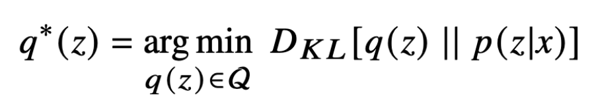
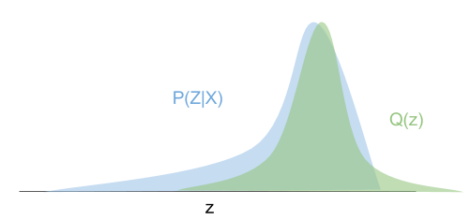
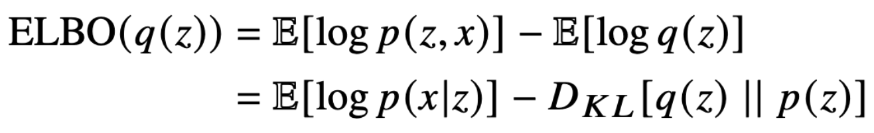
VI Overview
Aim to approximate posterior by optimizing parameters of a given functional form
In practice, our loss function is the Evidence Lower Bound (ELBO) :

Slide 13
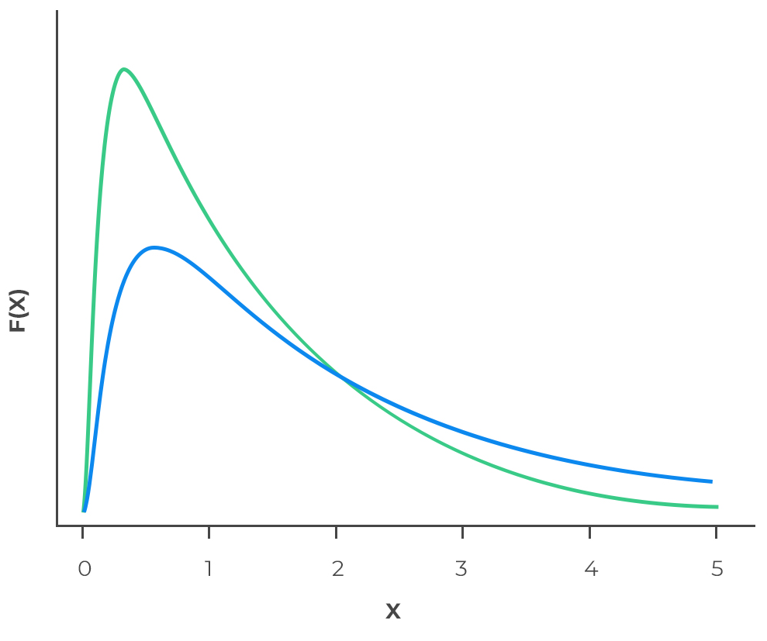
Fitting is tricky!
Currently using exponential prior on
  Leads to log-normal form in posterior
We want a posterior form that:
  Constrains to be positive
  Allows nonzero density negligibly close to zero
  Has a full rank covariance matrix
Log-normal distribution
Image: https://analystprep.com/cfa-level-1-exam/wp-content/uploads/2019/10/page-134.jpg

Slide 14
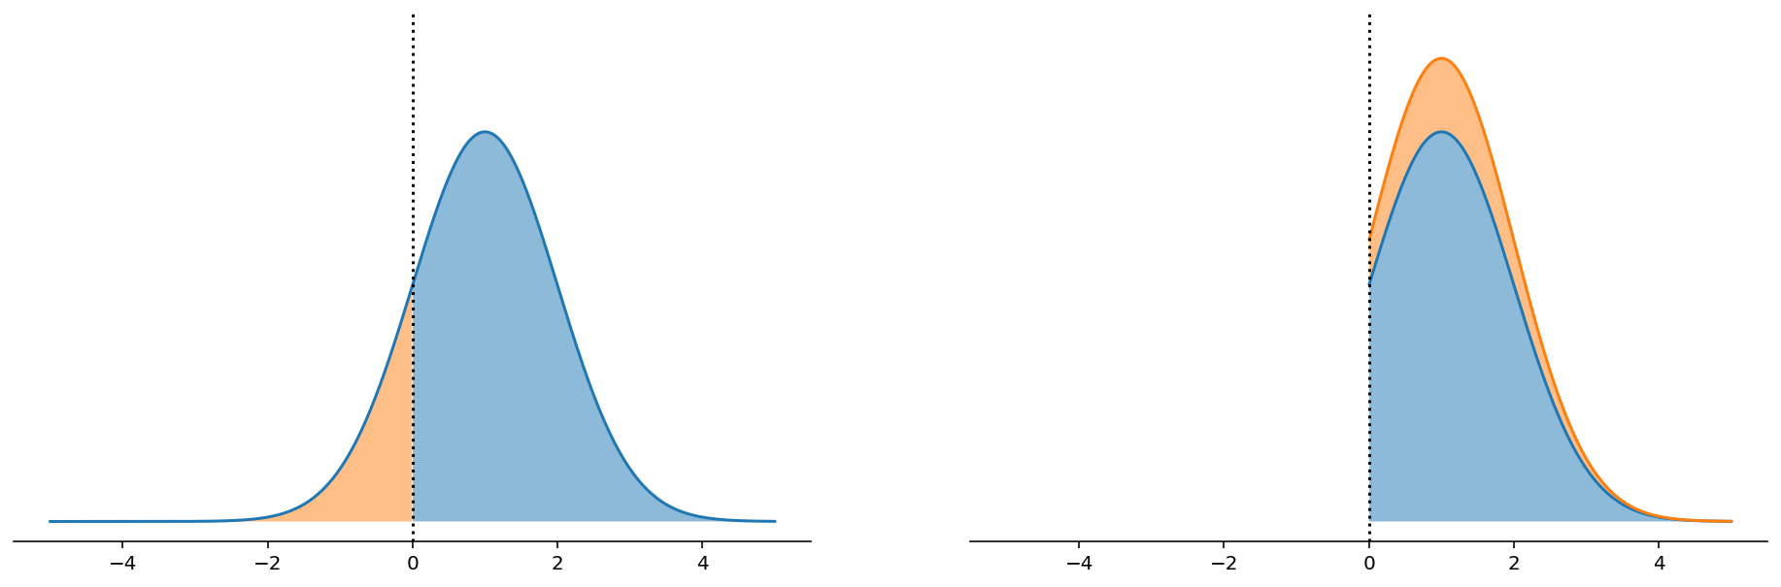
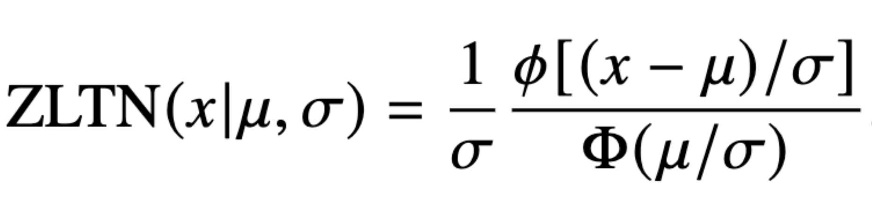
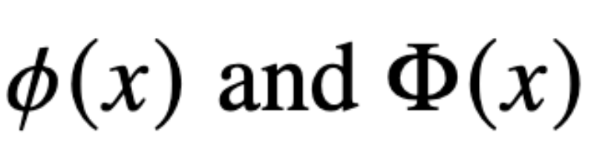
Zero-lower-truncated normal (ZLTN) distribution
: standard normal PDF
: standard normal CDF
Image: https://num.pyro.ai/en/stable/tutorials/truncated_distributions.html

Slide 15
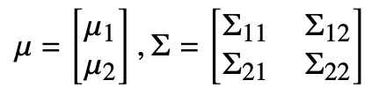


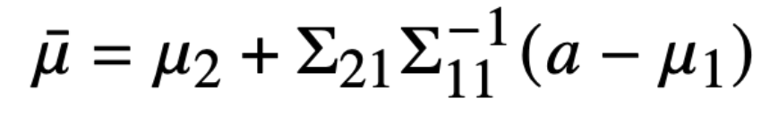
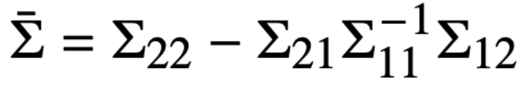
Multivariate ZLTN distribution
Partition the mean vector and covariance matrix:
Sample truncated parameter:
Calculate conditional probability of all other parameters:
where and
Calculate joint probability
Eaton (1983)

Slide 16
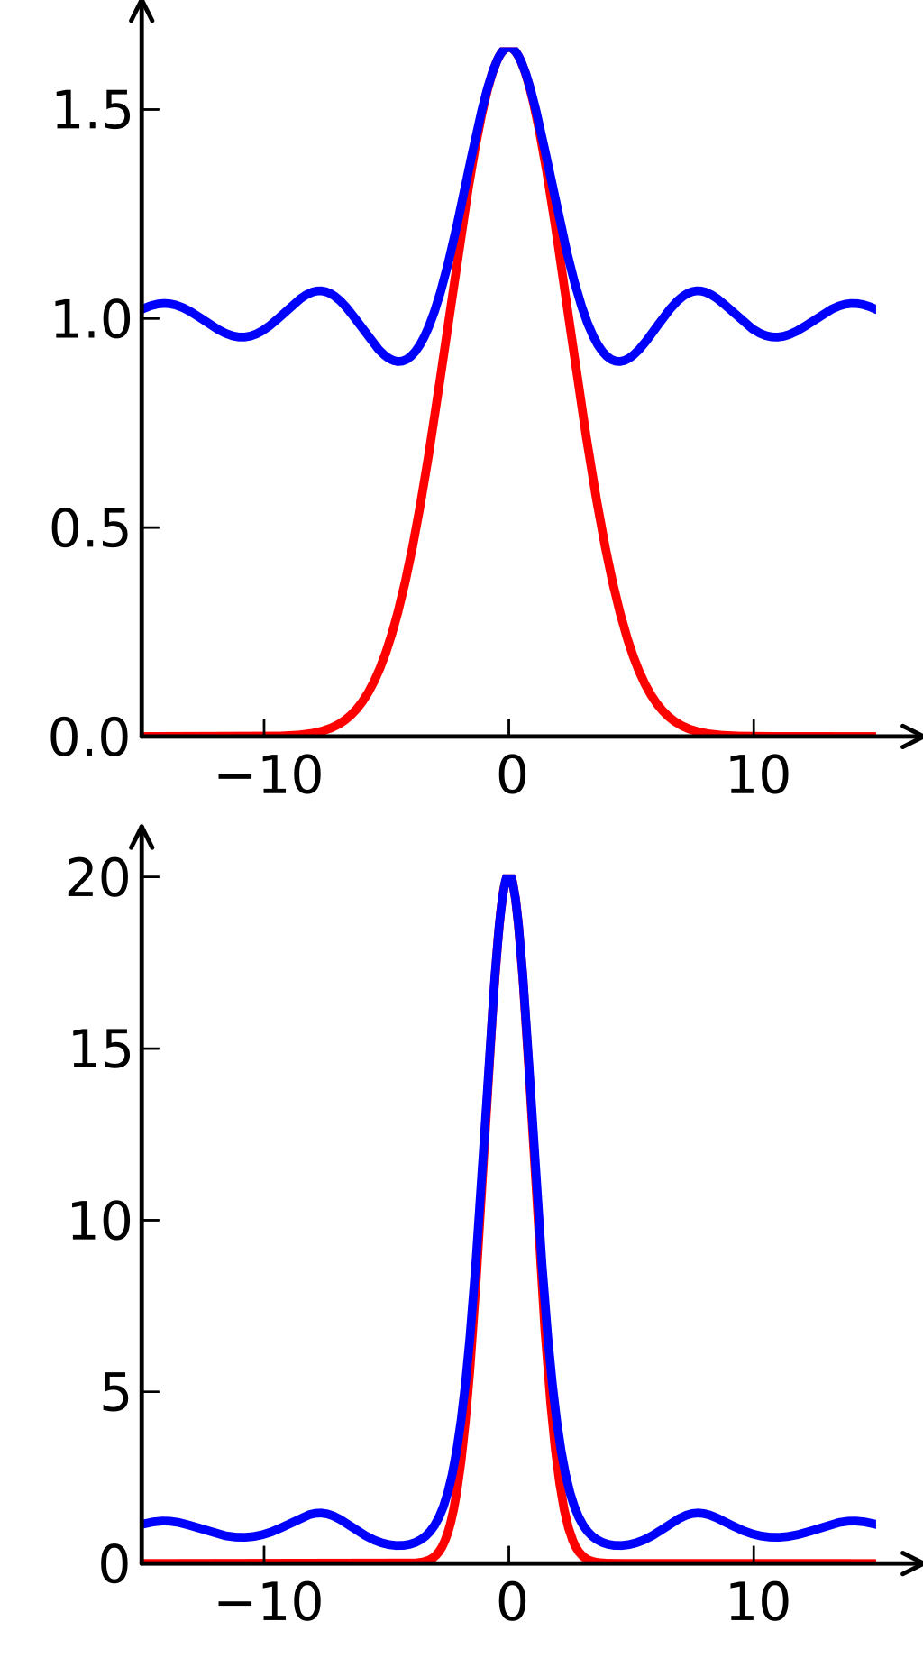
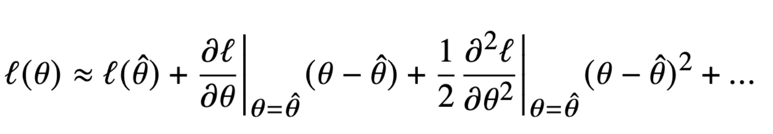
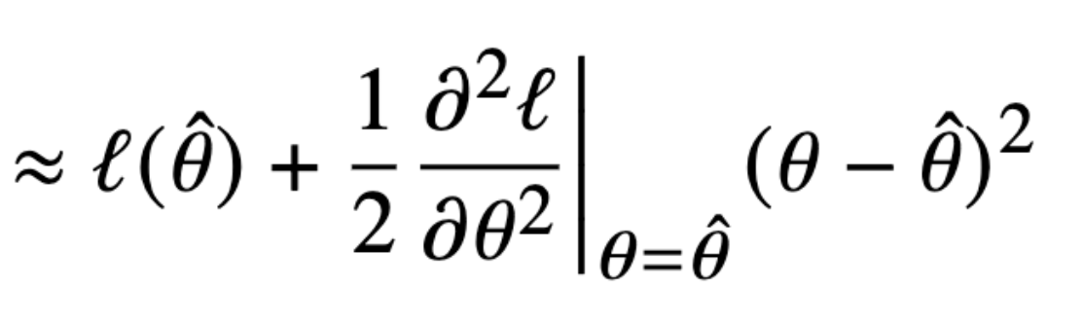
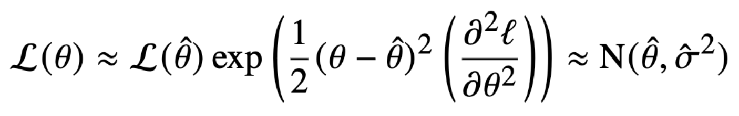
Laplace Approximation
Taylor expand log-likelihood about MLE estimate :
Approximates likelihood as Gaussian centered at MLE:
Image: https://en.wikipedia.org/wiki/Laplace%27s_method

Slide 17


VI Implementation Details
NumPyro- probabilistic programming language that interfaces with PyTorch and Jax
Jax for just-in-time (JIT) compilation & vectorization
Comparing 4 types of posterior:
  MCMC
  Laplace Approximation
  ZLTN (initialized on Laplace Approximation)
  Multivariate Normal (initialized on Laplace Approximation)
Grayling et al. (2024)
Notes:
Fit for some number of epochs and save the final loss and sometimes save the best loss (and we’ll come back to that later)

Slide 18
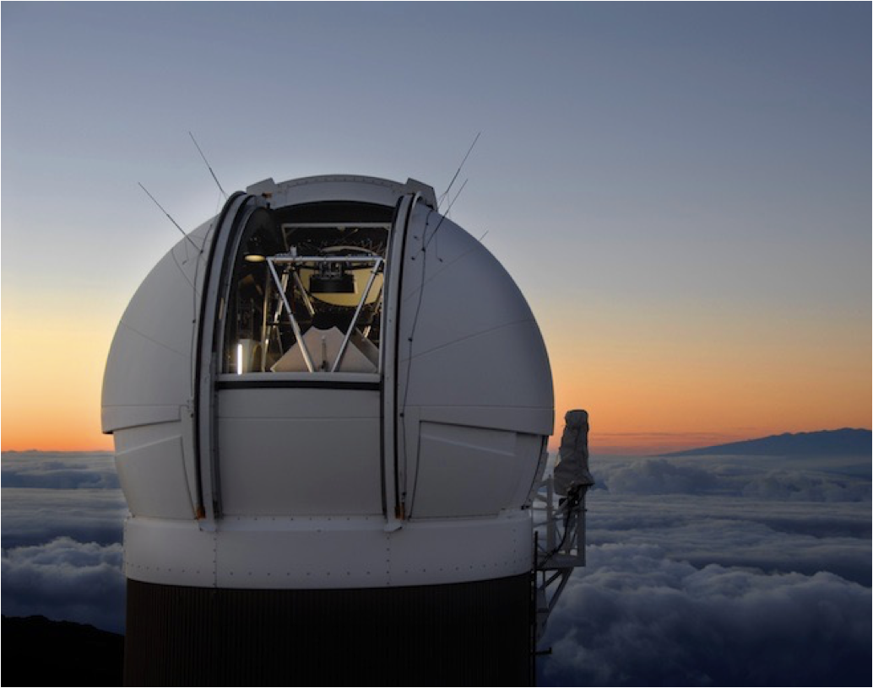
Data overview
Foundation dataset
  157 Type SNe Ia with z < 0.08
  griz bands (3500-9000 Å)
  Pan-STARRS telescope
Simulated dataset
  500 simulated SNe Ia
  Parameters sampled from BayeSN priors
Image: R. Ratkowski

Slide 19
Results

Slide 20
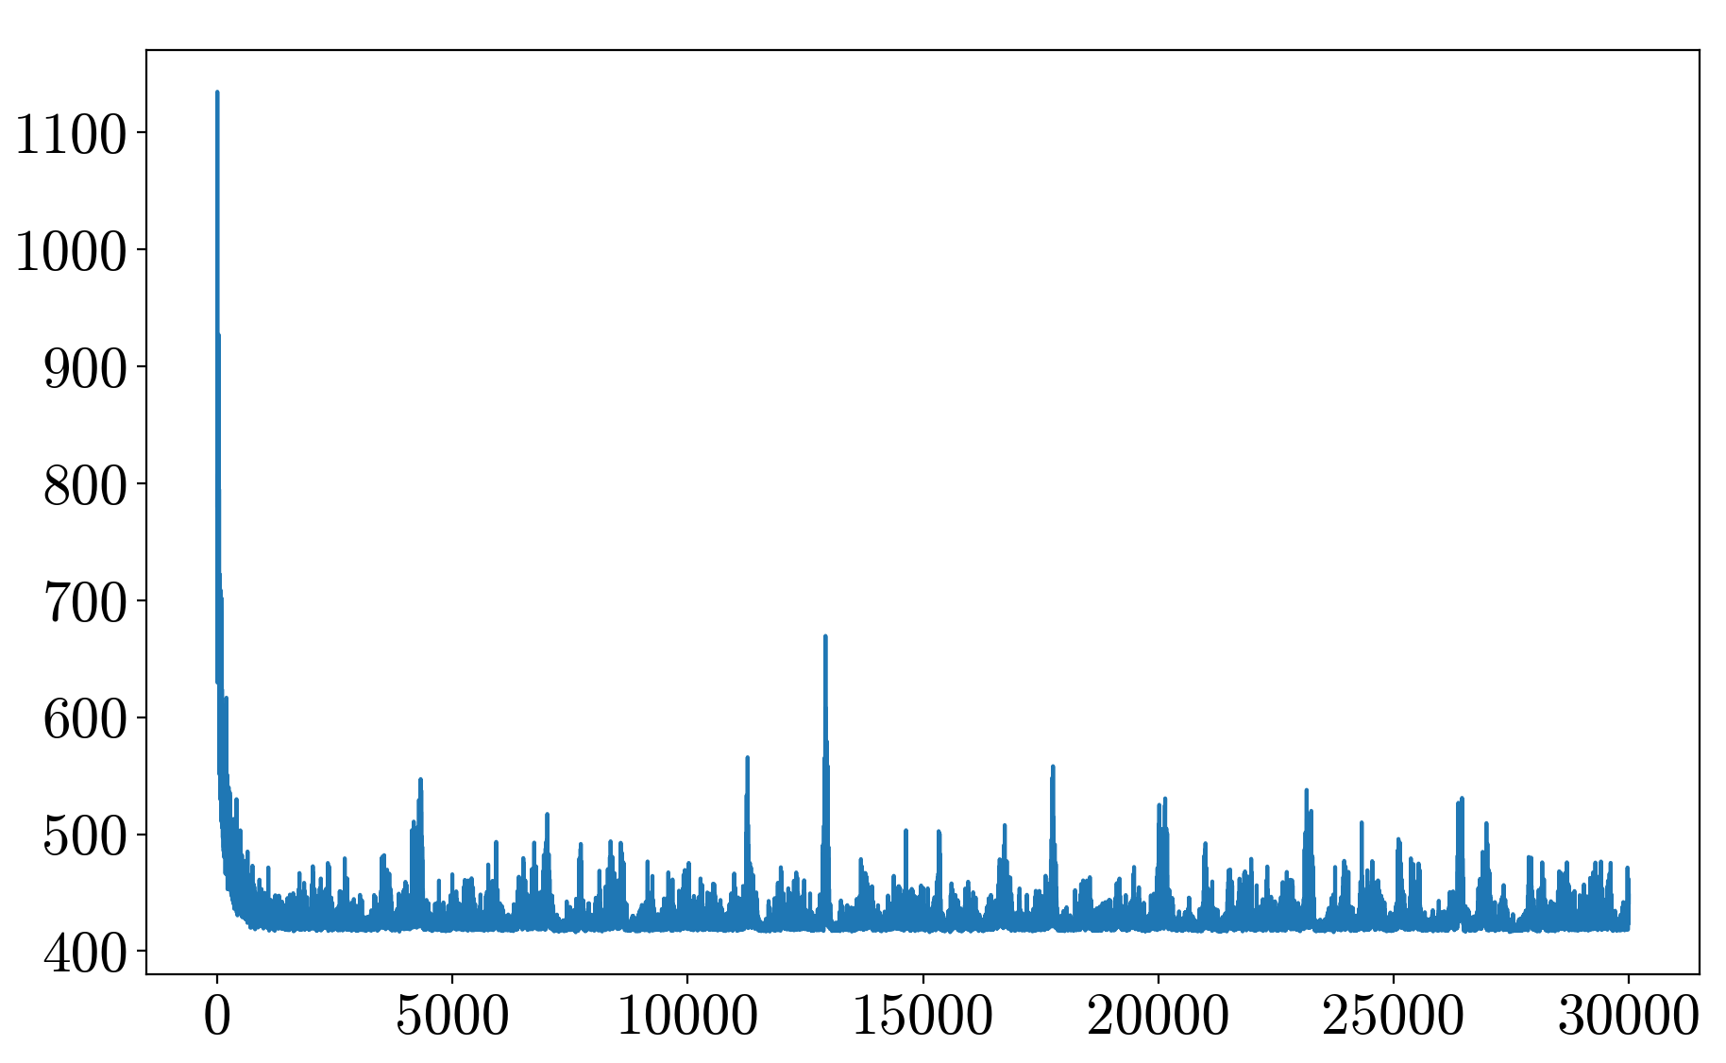
Training parameters
MCMC
  250 warmup samples, 250 additional samples across 4 chains
Laplace Approximation
  NumPyro AutoGuide, 15,000 iterations
ZLTN
  Custom AutoGuide, 30,000 iterations after initialization on Laplace
Multivariate Normal
  NumPyro AutoGuide, 30,000 iterations after initialization on Laplace
Loss
Training epoch
Notes:
Mention that I’m using stochastic gradient descent

Slide 21
High & low fits
SN2017cjv
ASASSN-16ay

Slide 22
Zooming in on marginal

Slide 23
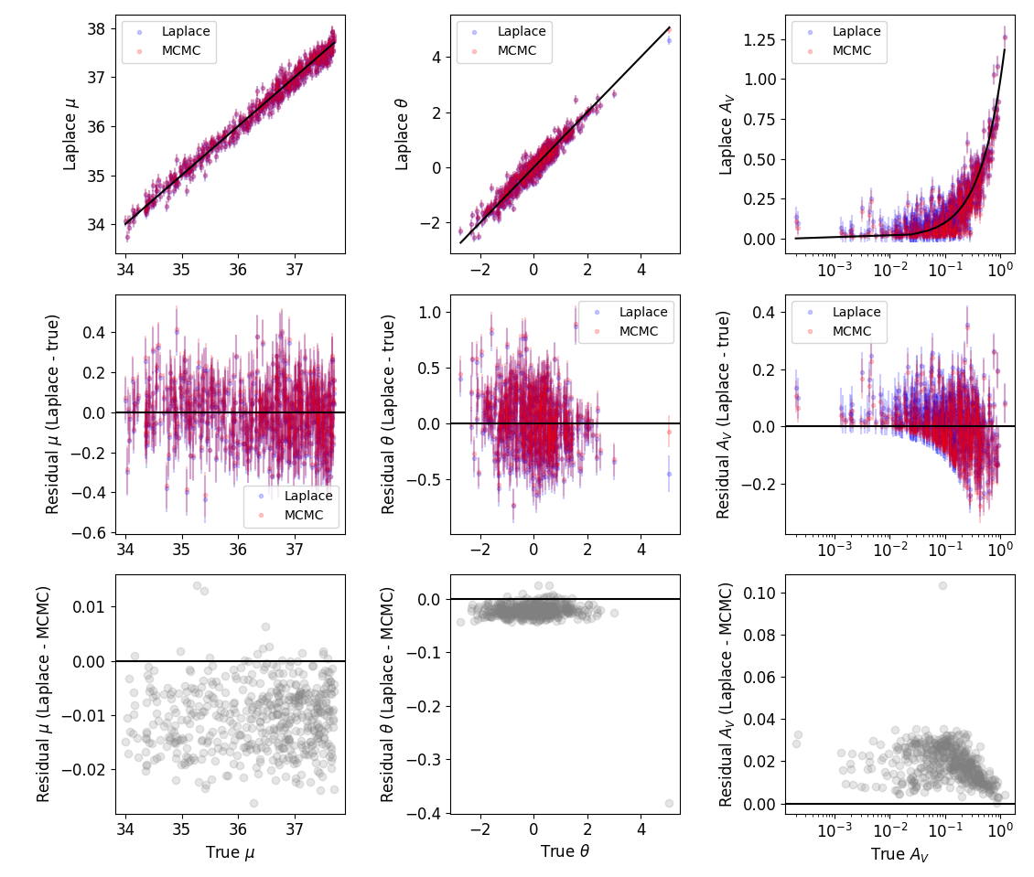
Results on simulated SNe population – Laplace

Slide 24
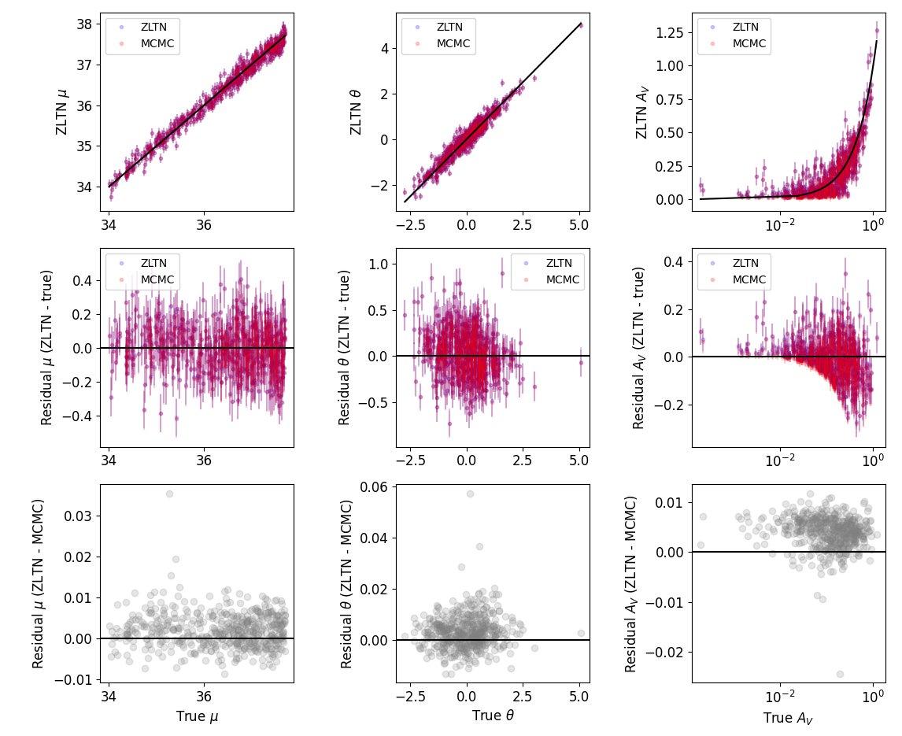
Results on simulated SNe population - ZLTN

Slide 25
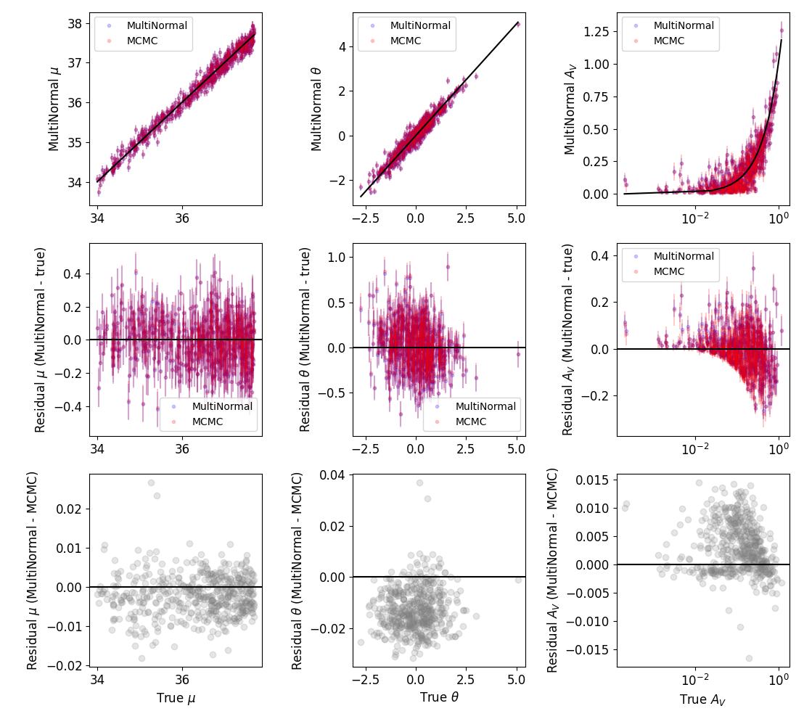
Results on simulated SNe population – Multivariate Normal

Slide 26
Results on Foundation Dataset

Slide 27
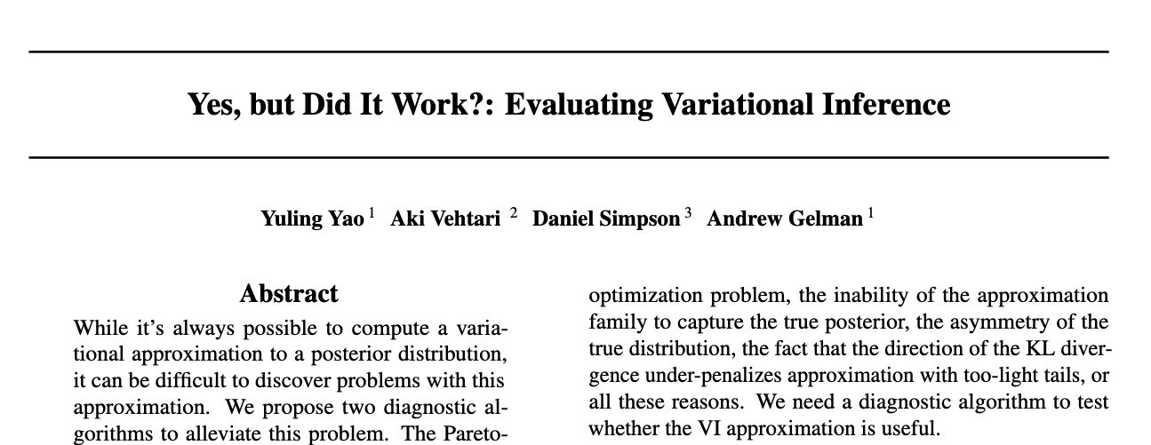
How do we evaluate our VI approximation?

Slide 28
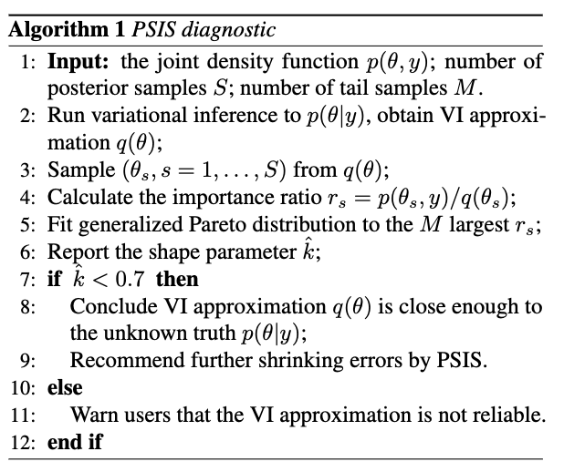
Pareto-Smoothed Importance Sampling (PSIS)
Calculate importance ratio
for each posterior sample
Fit generalized Pareto distribution with shape parameter to
: VI approximation is good enough
Yao et al. (2018)

Slide 29
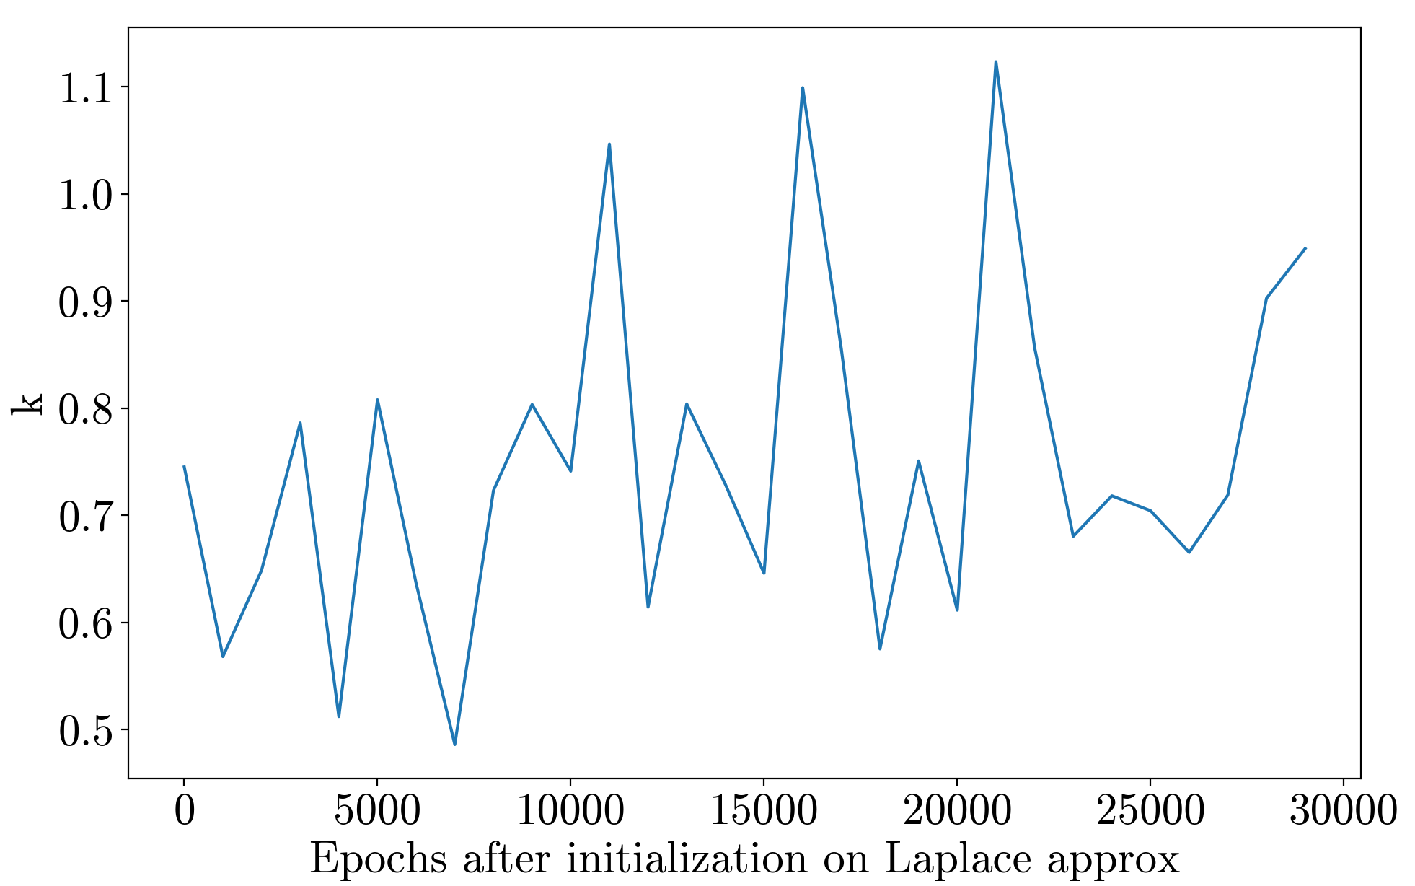
Weird behavior from PSIS …

Slide 30
Comparing values from “best” vs. last set of parameters

Slide 31
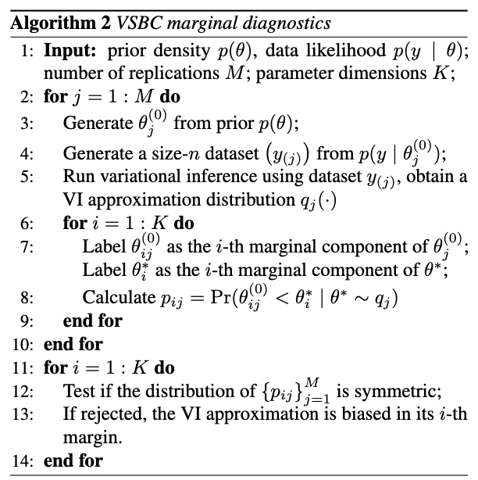
Variational Simulation-Based Calibration (VSBC)
Generate simulated SNe with “true” parameter values drawn from priors
Fit simulations with VI & generate samples
Calculate the probability of the variational approximation samples being less than the “true” value
Evaluates bias in marginal distributions
Yao et al. (2018)

Slide 32
VSBC
Results

Slide 33
Conclusions
We fit Type Ia supernovae with VI with several posterior forms
ZLTN distribution is an option to better model dust extinction
Good “middle ground”: scalable but still interpretable
VI is a promising method to fit posterior distribution using less computational time & resources
Notes:
Use MCMC for complicated posterior forms (i.e. multimodal)
We are looking at an especially difficulit case but in general VI does quite well.

