Slide 1
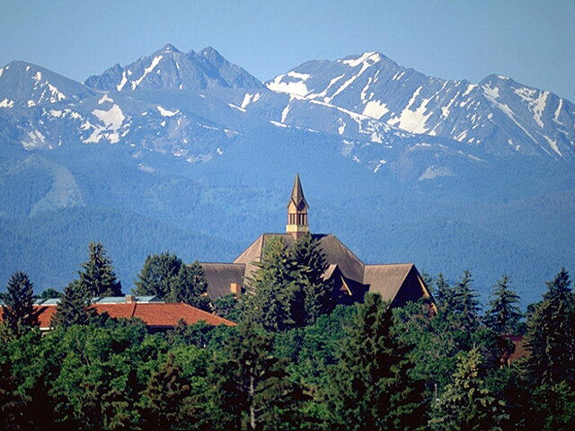
Content-based Image Retrieval for Solar Physics
Piet Martens
Montana State University
Harvard-Smithsonian Center for Astrophysics

Slide 2
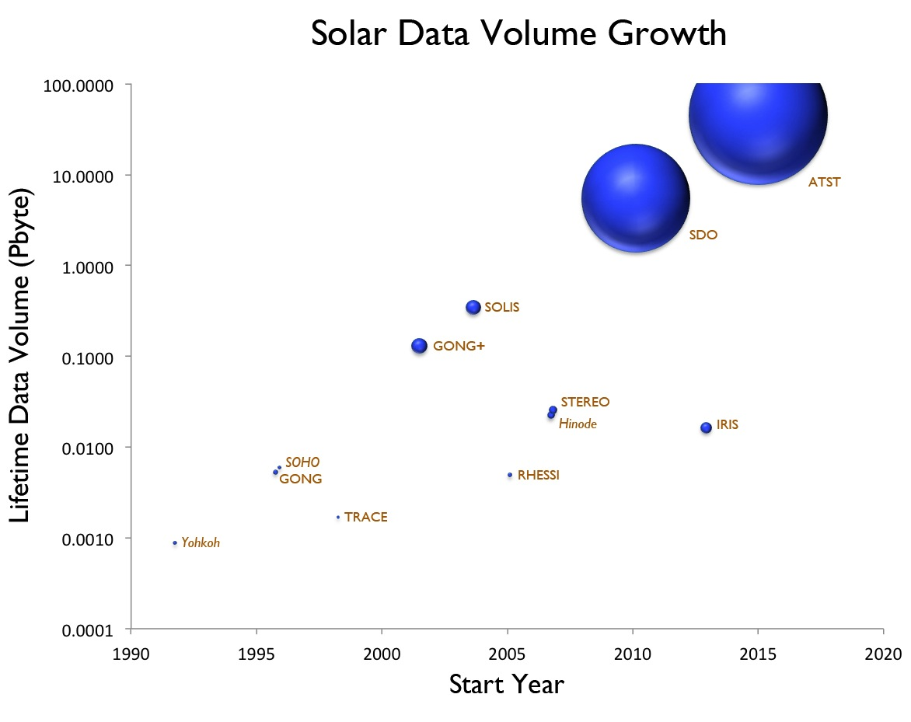
The Peta-byte Challenge

Slide 3
SDO Computer Vision Project
Overview: Feature Finding Team (FFT) is producing 16 software modules that detect, analyze, and track solar features and events, most in near real time (“pipeline”)
Why? 1) SDO data stream is overwhelming. 2) Solar Physics needs to move from analysis of single events to sets of events and features.
Who? International team, seven institutions in the US, five in Europe, data center at SAO, PI at MSU.
How? Separate, robust and efficient software modules, standardized interface protocols
Output: FFT delivers metadata: real-time space weather alerts, VOEvent formatted catalogs and annotated images, available on-line via the Virtual Solar Observatory (VSO)
This Presentation: 1) Overview and first results. 2) More detailed presentation of general purpose, trainable, feature detection module.

Slide 4
A Computer Science Approach to Image Recognition
Angryk*, Martens, Banda*, Schuh*, Karthik*, Engell, Scott. All at MSU, * are computer scientists.
Conundrum: We can teach an undergraduate in ten minutes what a filament, sunspot, sigmoid, or bright point looks like, and have them build a catalog from a set of images. Yet, teaching a computer the same is a very time consuming job – plus it remains just as demanding for every new feature.
Inference: Humans have fantastic generic feature recognition capabilities. (One reason we survived the plains of East Africa!).
Challenge: Can we design a computer program that has similar “human” generic feature recognition capabilities?
Answer: This has been done, with considerable success, in interactive diagnosis of mammograms, as an aid in early detection of breast cancer.
So, let’s try this for Solar Physics image recognition!

Slide 5
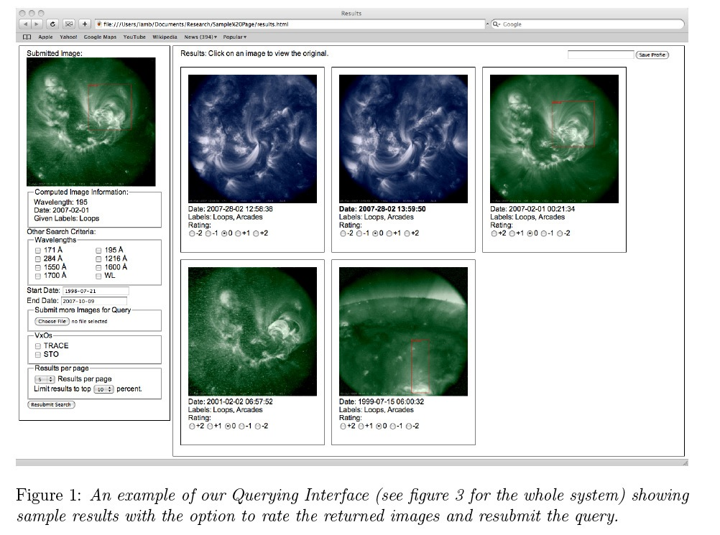
“Trainable” Module for Solar Imagery
Method: Human user points out (point and click) instances of features in a number of images, e.g. sunspots, arcades, filaments. Module searches assigned database for images with similar texture parameters. User can recursively refine search, define accuracy. Module returns final list of matches.
Key Point: Research is done on image texture catalog, 0.1% in size of image archive. Can do research on a couple of months of SDO data with your laptop

Slide 6
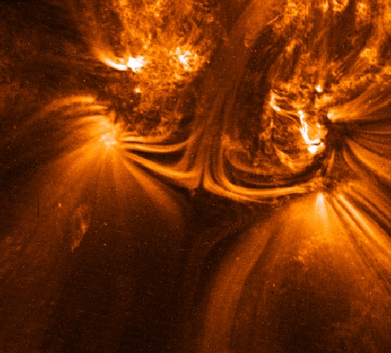
Use of “Trainable” Module
Detect features for which we have no dedicated codes: loops, arcades, plumes, anemones, key-holes, faculae, surges, arch filaments, delta-spots, cusps, etc. Save a lot of money!
Detect features that we have not discovered yet, like sigmoids were in the pre-Yohkoh era. (No need to reprocess all SDO images!)
Cross-comparisons with the dedicated feature recognition codes, to quantify accuracy and precision.
Observe a feature for which we have no clear definition yet, and find features “just like it”. E.g. the TRACE image right, with a magnetic null-type geometry.

Slide 7
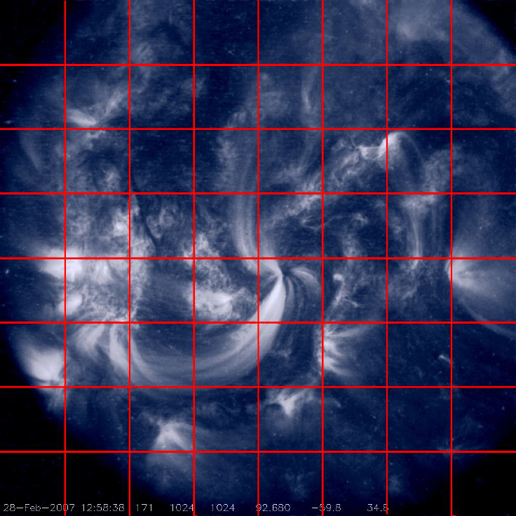
Image Segmentation / Feature Extraction
Optimal texture parameters
Image 1 - Cell 1,1 | Value
Entropy | 0.1231
Mean | 0.2552
Standard Deviation | 0.1723
3rd Moment (skewness) | 0.1873
4th Moment (kurtosis) | 0.1825
Uniformity | 0.5671
Relative Smoothness (RS) | 0.1245
Fractal Dimension | 0.1525
Tamura Directionality | 0.2837
Tamura Contrast | 0.3645
32 by 32 grid segmentation for AIA (128 x 128 pixels per cell)

Slide 8
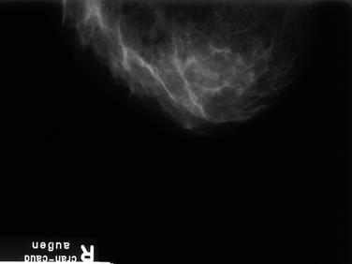
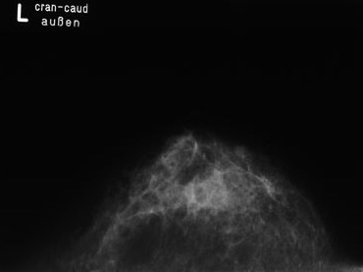
Why would we believe this could work?
Answer: Method has been applied with success in the medical field for detection of breast cancer. Similarity with solar imagery.

Slide 9
Computing Times
Image Parameter Extraction Times for 1,600 Images

Slide 10

Why would we believe this could work?
Answer: Our brain works this way!
Specifically: brain remembers images from information -- deduced and stored in different regions of the brain – on color, depth, form, size, etc.
A “remembered” image is a combination of input parameters from these different brain centers.

Slide 11
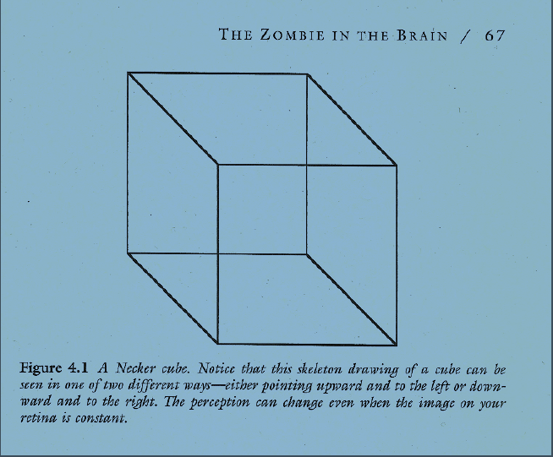
Brain image processing, e.g. the Necker cube

Slide 12
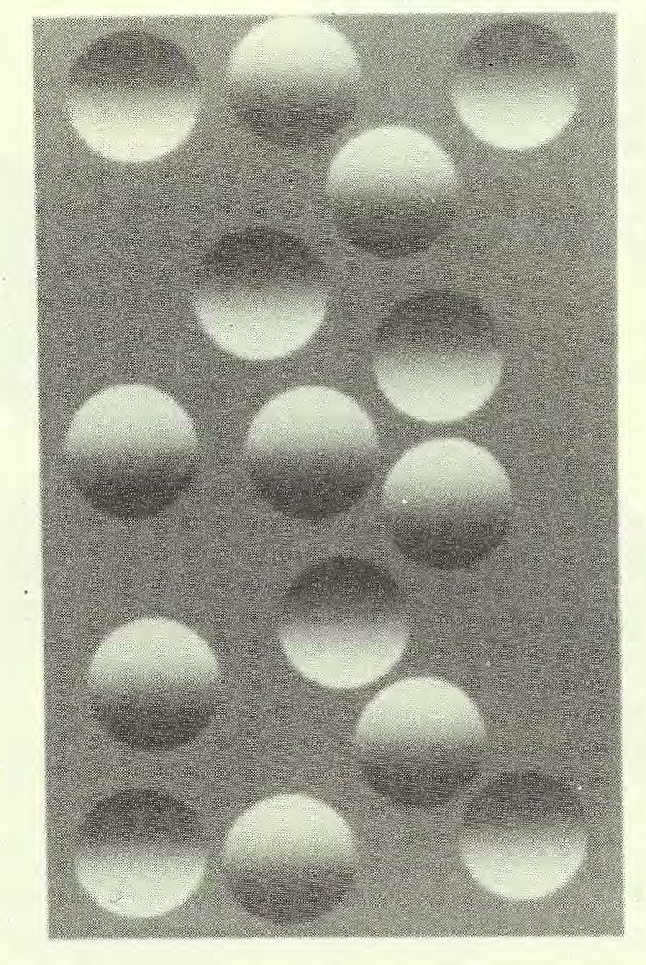
Brain image processing; the Sun is above….
What you remember is not what you see…

Slide 13

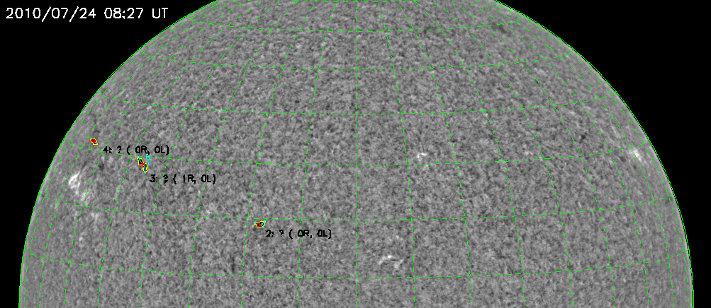
Filament Tracking (Bernasconi)
Automated tracking of the origin, evolution, and disappearance (eruption) of all filaments. Outlines contours, determines chirality, tracks individual filaments, handles mergers and splitting.
)

Slide 14
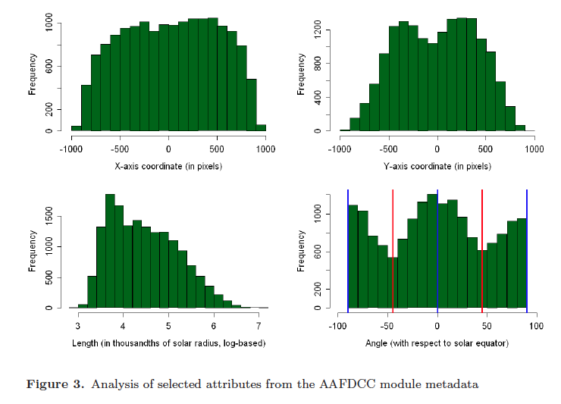
What would one use this for? Example
Statistical Analysis of Two Years of Filament Metadata

Slide 15
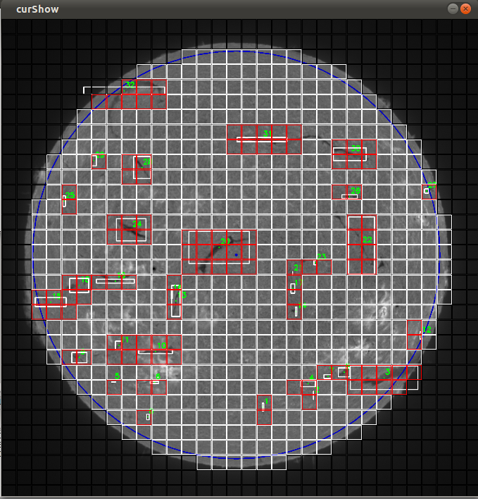
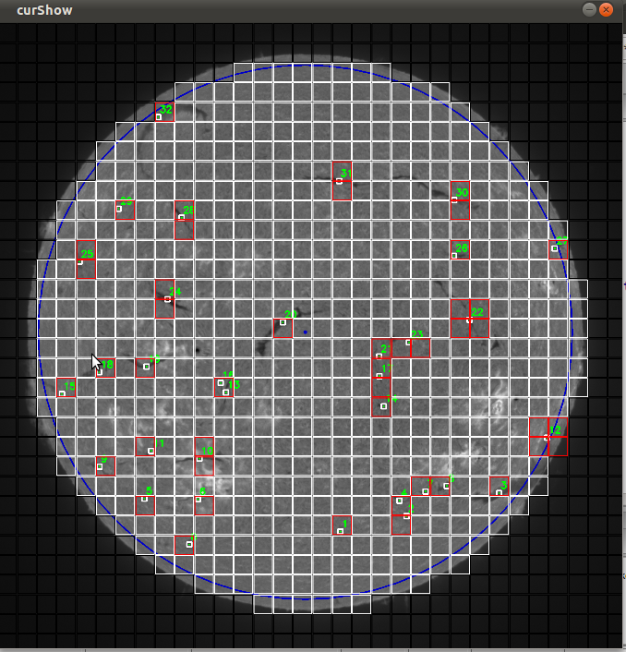
Cross-comparison with Other Modules – First Step: Filaments
Arthur Clarke's third law: "Any sufficiently advanced technology is indistinguishable from magic.”

Slide 16
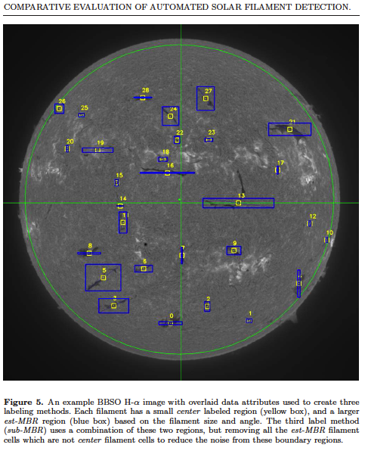
More Filament Results
A curious miss..

Slide 17
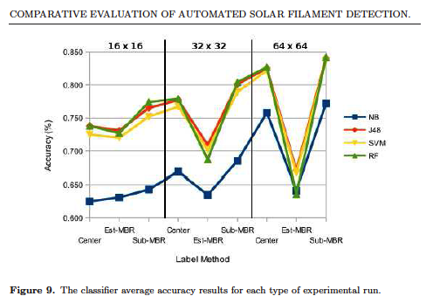
Filament Results: Overlap with Dedicated Code
Overlap as a function of grid size, labeling method, and classifier algorithm.

Slide 18
“Trainable” Module: Current Status
Module has been tested on TRACE and H-alpha data.
We get up to 85% agreement with task-specific filament code.
We have found our optimal texture parameters, 10 per sub-image.
We are focusing on optimizing storage requirements, and hence search speed. We can reduce 640 dimensional TRACE vector to ~ 40-70 relevant dimensions, 90% reduction. That would lead to 0.5 GB storage per day for SDO imagery, very manageable.

Slide 19
Application in Astrophysics
Detection of QSOs from a massive data-base of about 40 million light curves (Kim, Alcock et al. 2011, at CfA)
Defined 11 time series features, e.g. color, period, autocorrelation, cumulative sum, etc.
Trained SVM classifier (which we also use) with known QSOs from the MACHO dataset
Found 1620 QSO candidates out of ~ 40 million light curves
False positive rate is below 26 %
Same module also classifies RR Lyrae, Cepheids, and eclipsing binaries at the 100% rate, and long-period variables, microlensing events, and Be stars at ~ 80% accuracy!

Slide 20
General Conclusions
Our task-specific feature finding modules will be applicable not only to SDO data, but to all solar physics data. We won a grant to analyze ALL solar physics data (SDO alone = 90%, so 90% → 100%).
For SDO we will use the trainable feature finding module for a) quantitative cross-comparison with task-specific modules, b) create catalogs for solar phenomena not covered (e.g. delta spots), c) discover new phenomena.
The general trainable feature finding module has potential applicability to ANY large image data set which is well described by texture parameters.
We are beginning to build image recognition techniques that are “brain”-like.

Slide 21
Take Home Thought…….
Arthur Clarke's third law:
"Any sufficiently advanced technology is indistinguishable from magic.”

