Slide 1



Standard DEM:
Consider a imaging instrument with M EUV filters (for the EUVI Fe bands M = 3). The measured intensity in one image pixel is given by
filter
index
bandpass fcn
plasma emission fcn
DEM (LOS integrated)
“sensitivity” fcn

Slide 2
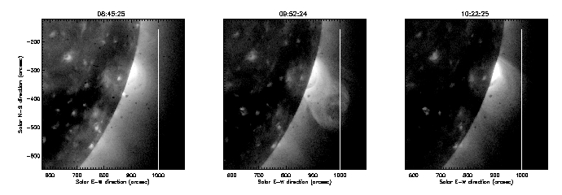
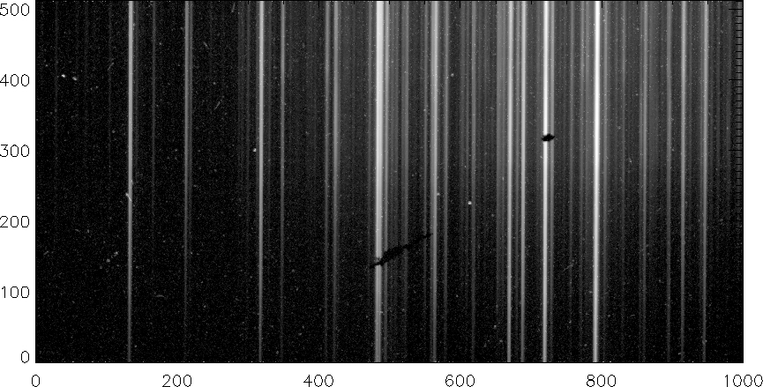
Available data
Before
During
After
MONOCHROMATIC IMAGES:
SOHO (Extreme UV)
Hinode (X-ray)
STEREO (Extreme UV)
EIS slit direction
HIGH RESOLUTION SPECTRA:
Hinode/EIS (Extreme UV)
Wavelength direction

Slide 3
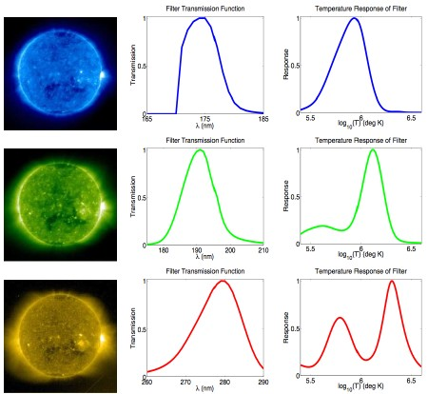

Slide 4

Standard DEM (con’t):
The DEM D(T) is a measure of the amount of electron density (N) as a function of T along the LOS and is given by
[In contrast, the new DEMT method produces a local DEM that is only integrated over a short line segment instead of the full LOS.]

Slide 5
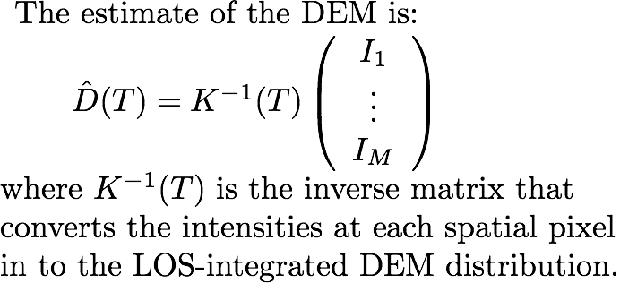
Standard DEM (con’t):
incl. bandpasses, atomic physics

Slide 6
EUV Rotational Tomography (DEMT)

Slide 7
Introduction to DEMT:
What is DEMT?
Differential Emission Measure Tomography
Allows global determination of density, temperature and more in the corona (1.01 – 1.3 Rs)
Limitations:
  Only a few spectral bands
  time resolution of several weeks

Slide 8
Input:
  2-4 week time series of full-disk EUV images (EIT, EUVI, AIA, XRT) in multiple bands
  Output:
  3D emissivity, local DEM N^2(r,T), irregularity factor <N^2(r)>/<N(r)>^2

Slide 9
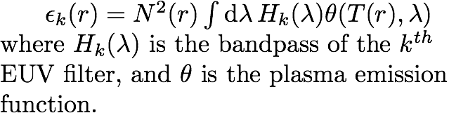
DEMT, Stage 1:
Take a time series of EUV images in each of the M filters (M=3 for EUVI Fe bands). Full disk coverage will require 21 days of data when the spacecraft are separated by 90 deg.
Use tomographic processing to find the (wavelength integrated) 3D emissivity ε(r), which is related to N via:

Slide 10
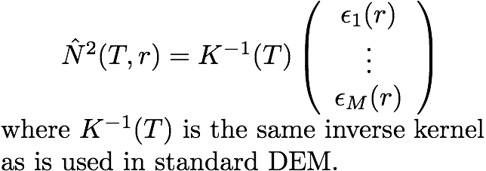
DEMT, Stage 2:
In each pixel (centered at r), one performs a standard DEM inversion to get the temperature profile. The local DEM estimate is given by:

Slide 11
Results
We used STEREO A and B 171, 195 and 284 images to cover CR2069 (2008-4-16 to 5-13). Since A and B were separated by ~50 deg, we needed 23 d of data instead of 27.5. EIT was not used since it hasn’t been calibrated since 2005.
We used a 2 hr image cadence binned by 3 into 6 hour bins. This was a very comprehensive data set with no holes.
We fit a Gaussians to the tomographically determined emissivities to model the local DEM (LDEM).

Slide 12
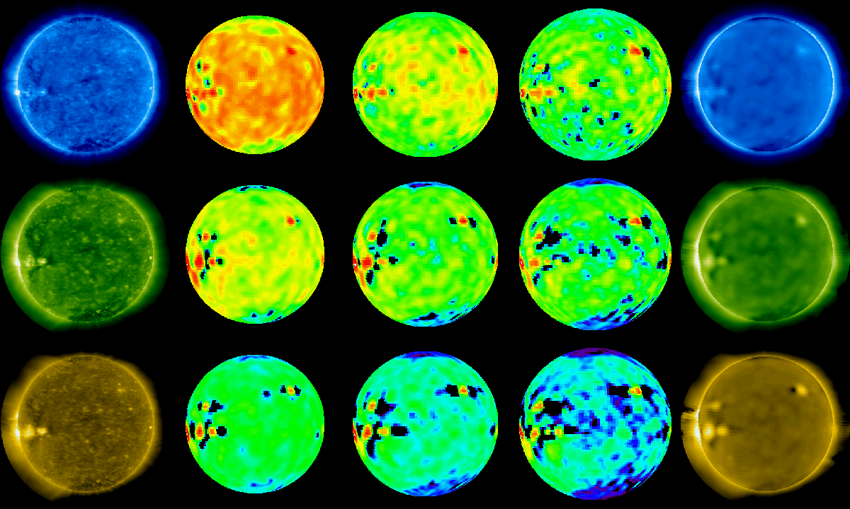
Movies!!!
original
1.035
1.085
1.135
synthetic

Slide 13
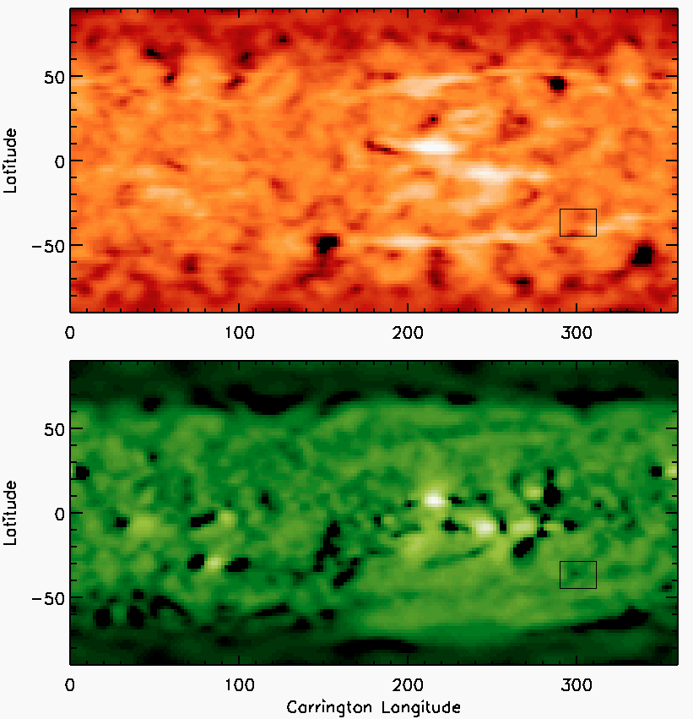
304 map
1.45 Rs
195map
1.085 Rs

Slide 14
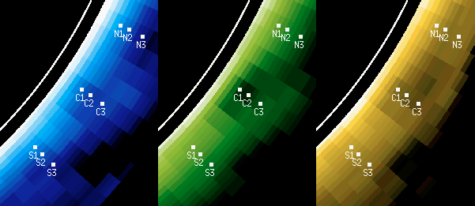

Slide 15
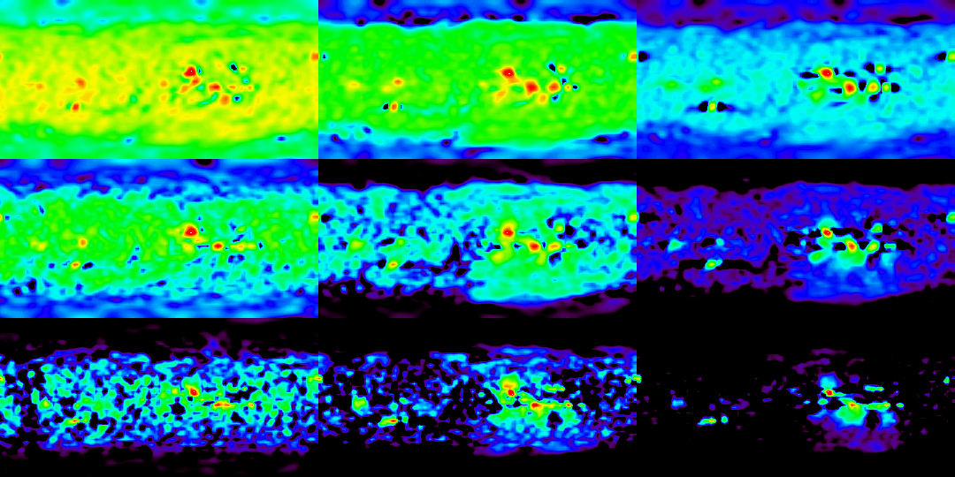
171, 195, 284 @ 1.01, 1.07, 1.15 Rs

Slide 16
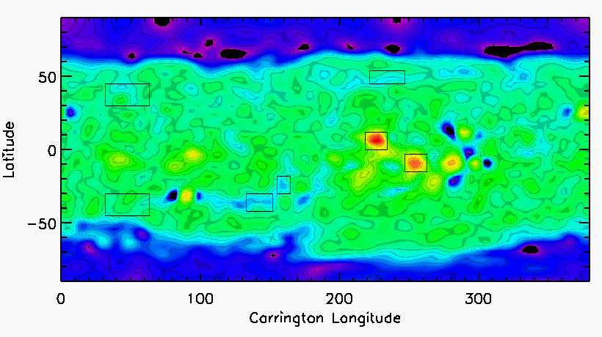
Region Selection (171 slice, 1.03 Rs)
A
C
G
B
E
F
D

Slide 17
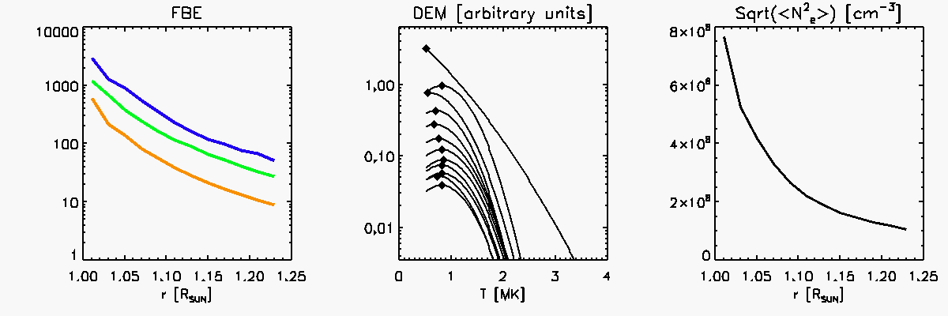
A

Slide 18
Newly Discovered Global Temperature Structures in the Solar Minimum Quiet Sun
(submitted to ApJL)
Richard Frazin, Zhenguang Huang, Enrico Landi,
W.B. Manchester IV, Tamas Gombosi
University of Michigan
Alberto M. Vasquez
University of Buenos Aires

Slide 19
First Analysis of QS loops
Quiet Sun (QS) loops have not been analyzed because they cannot be seen as distinct entities
This is not good because the QS can cover most of the Sun’s surface and due to its relatively quiescent nature should pose a more simple modeling problem than active region (AR) loops

Slide 20
The MLDT
(Michigan Loop Diagnostic Technique)
Perform DEMT ➔ global N, T
Perform PFSSM ➔ global B
Trace the field lines through the tomographic grid, obtaining N, T at points along the field line
Repeat for thousands of field lines

Slide 21
Up and Down Loops
After T is determined for all of the loops, we perform a fit: , where
k is the voxel subscript and a,b are free
If a > 0, it called a “Up” loop, and if a <0 it is called an “down” loop.
Only loops with quality factor > .5 were considered

Slide 22
Typical Low Quality Fit

Slide 23
The spatial distribution of up and down loops at 1.075 $R_\odot$\ with $R^2 > .5$ for
the linear temperature fit. The blue regions are threaded by down loops while the
orange and dark red regions are threaded by up loops. Dark blue and dark red represent
regions threaded by loops with apexes above 1.2 $\Rsun$, while light blue and orange
represent loops with apexes below 1.2 $\Rsun$. The solid black line represents the
boundary between open and closed field according to the PFSSM.

Slide 24
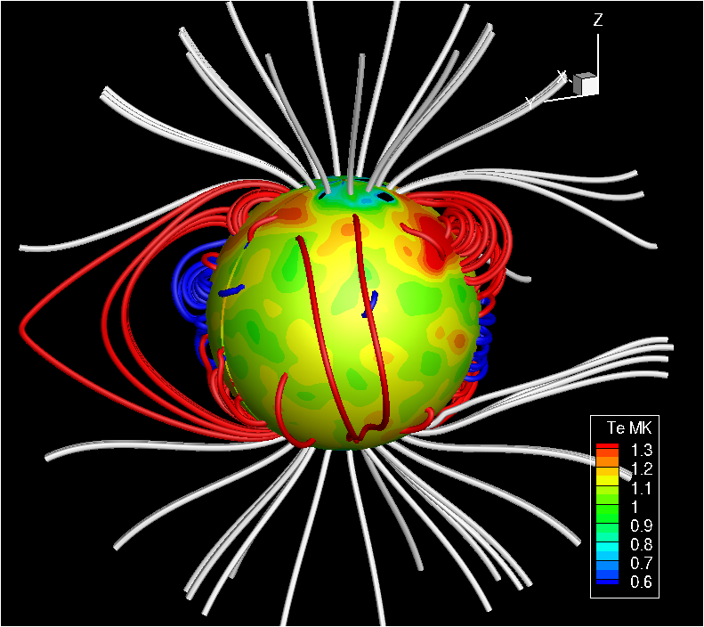
A 3D representation of the up and down loop geometry, with red and blue depicting
up and down loops, respectively. The spherical surface has a radius at 1.035 Rsun and
shows the LDEM electron temperature $T_m$\ according to the color scale.

Slide 25
Loop Length Histogram

Slide 26
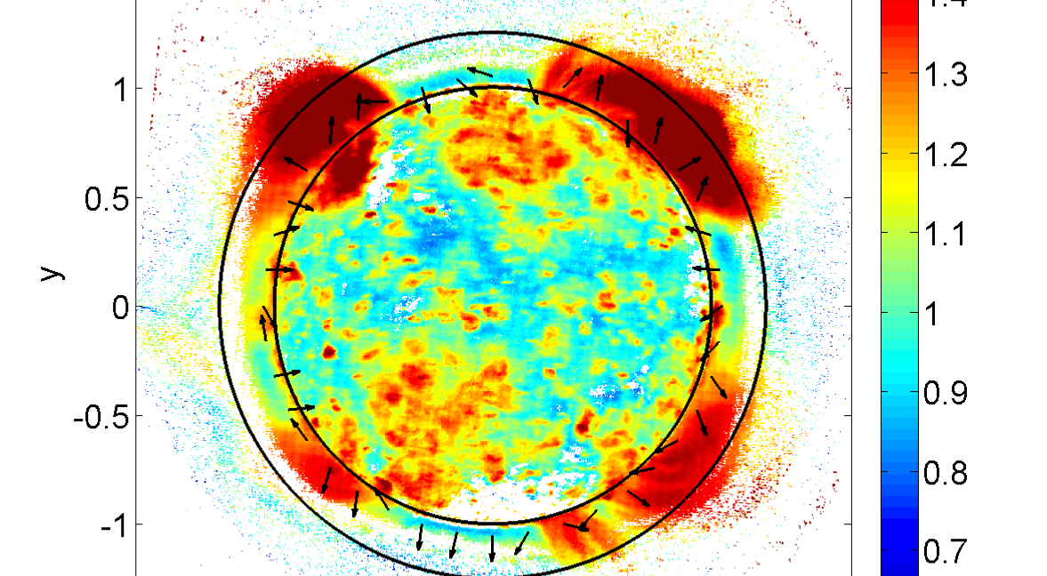
Complimentary DEM Analysis

Slide 27
Scale Height Analysis
The gas pressure can be determined everywhere along the loop:
The pressure scale height can then be found:

Slide 28
Similarly, the density scale height can be found from only the density values:
The agreement (or lack thereof) of these two scale heights is a test of the assumptions under which these laws were derived.

Slide 31
Comparison of Up/Down Scale Height Differences

