Slide 1
Astro-Statistics:
What is it good for?
2014-Sep-02
Aneta Siemiginowska and Vinay Kashyap
Harvard-Smithsonian Center for Astrophysics
ICHASC

Slide 2
Astro-Statistics
DvD: “Statistics applied to Astronomy”
Astro perspective: develop algorithms to infer astronomical truth
Keep astronomers from fooling themselves
Astronomical data are generally cleaner – there is less uncorrectable bias
Loads of BIG data
Some unique circumstances like well-defined calibration
One-shot experiments that require Bayesian analyses
High-energy datasets doubly simpler, being recordings of a Poisson point process

Slide 3
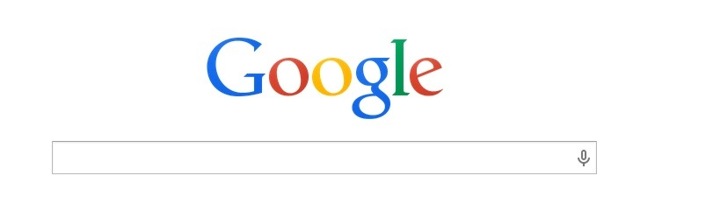
Astronomy

Slide 4
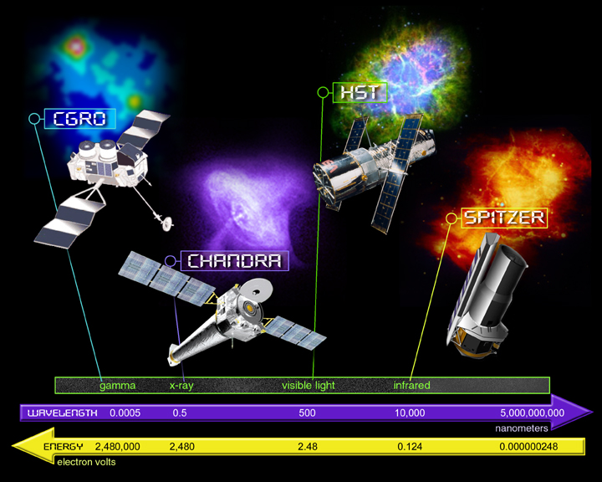
High-Energy Astrophysics
X-rays and Gamma-rays < 10⁻⁶ cm or > 2x10¹⁶ Hz
Not visible from the ground - Space-based observations
Fermi

Slide 5
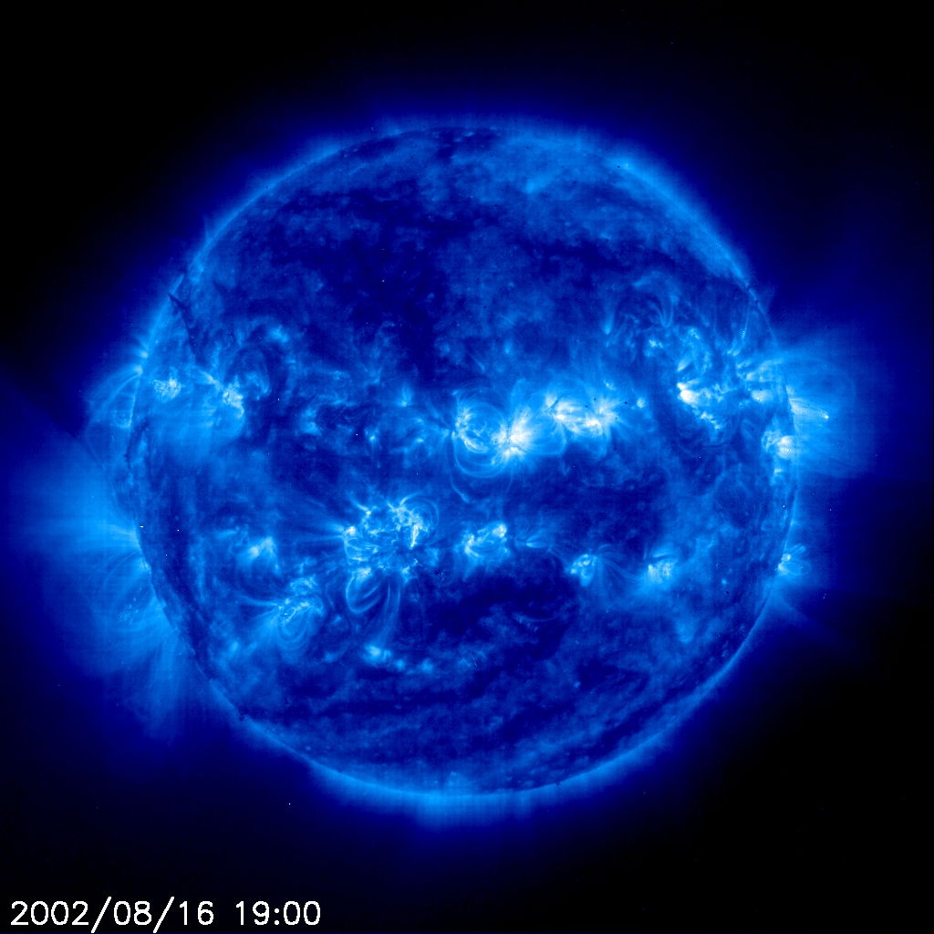
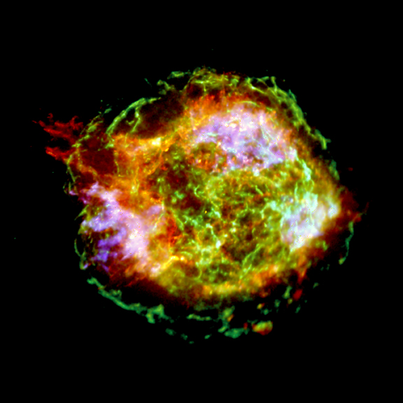
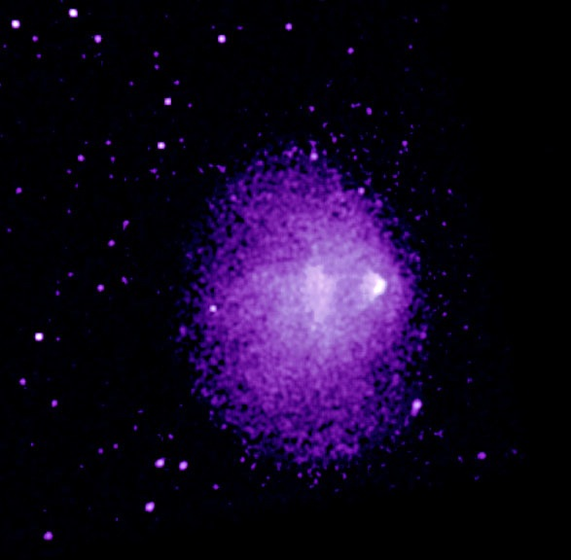
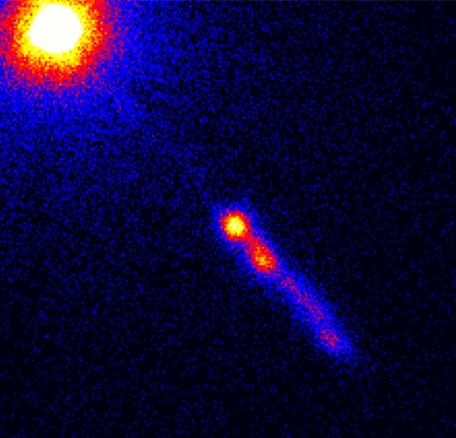
Sources of High-Energy Radiation
Stellar Coronae
Supernova remnants
Galactic outflows
Clusters of galaxies
Compact objects:
neutron stars,
accreting black holes,
supermassive black holes
Relativistic jets
GRBs
etc…

Slide 6
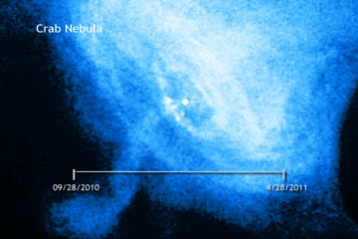
Data in High-Energy Astrophysics
X-ray and γ-ray data count photons => Poisson in nature
Complex physics and data collection
Data may exhibit Spectral, Temporal and Spatial variations
Crab Nebula - variations during 6 month of snap-shot observations with Chandra X-ray Observatory

Slide 7
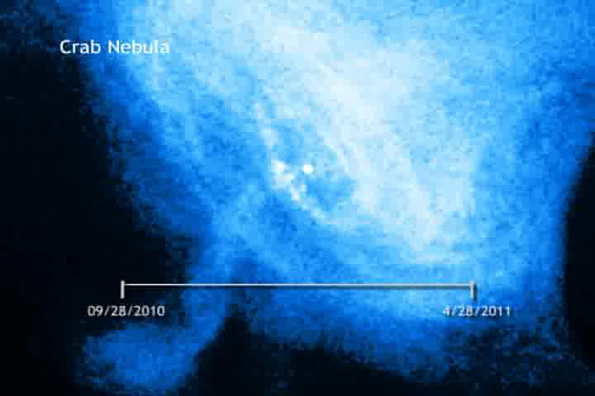
Data in High-Energy Astrophysics
X-ray and γ-ray data count photons => Poisson in nature
Complex physics and data collection
Data may exhibit Spectral, Temporal and Spatial variations
Crab Nebula - variations during 6 month of snap-shot observations with Chandra X-ray Observatory

Slide 8
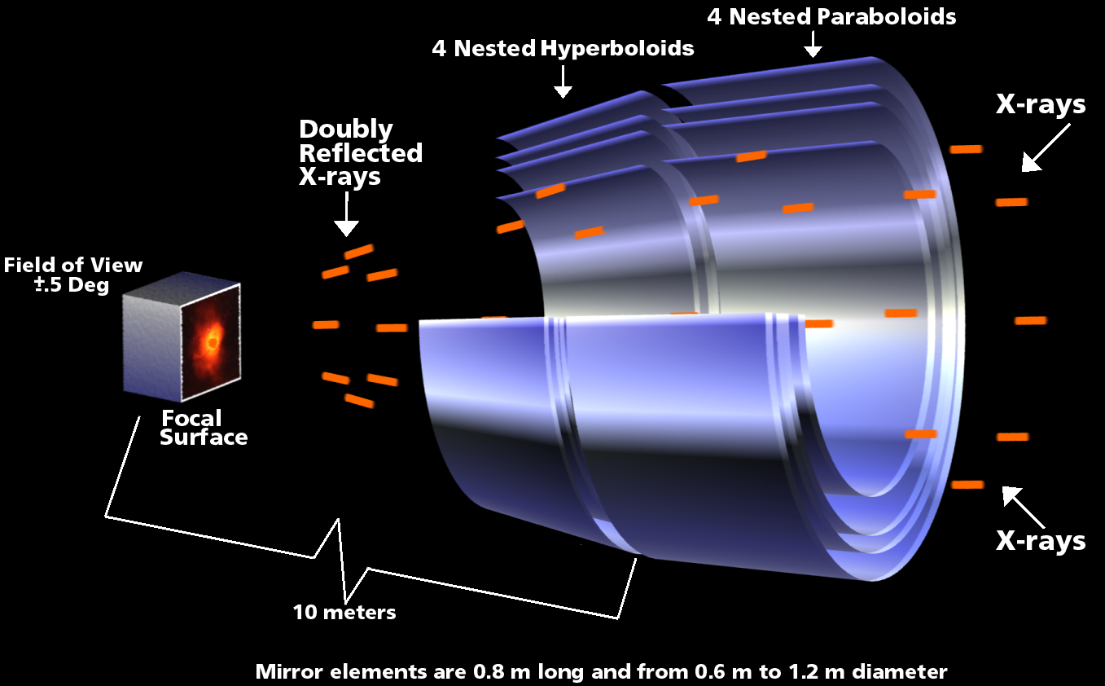
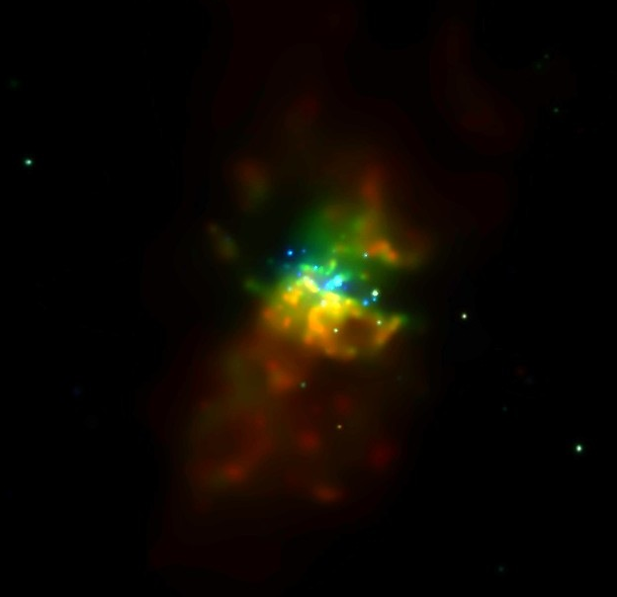
Data Collection in Space
Chandra X-ray Observatory
Telescope + Detectors
Interstellar Medium
Astronomical Object
Measurement Process
Inefficient data collection Process
Instrument characteristics
Instrument Calibration
Loss of signal
but also imprints
information
Physics

Slide 9
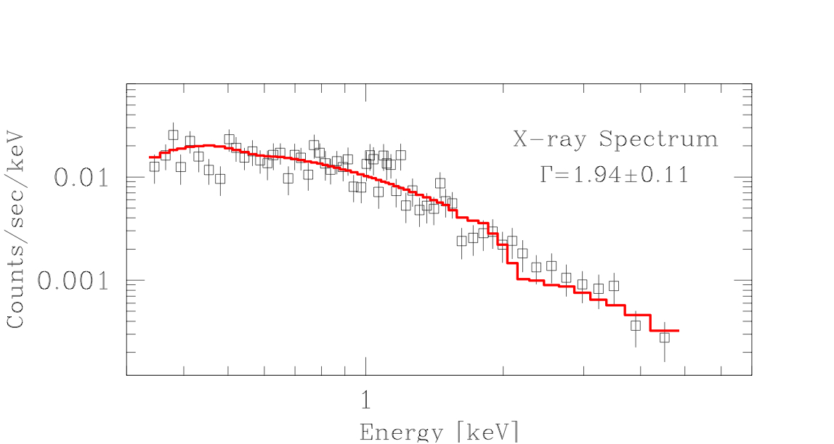
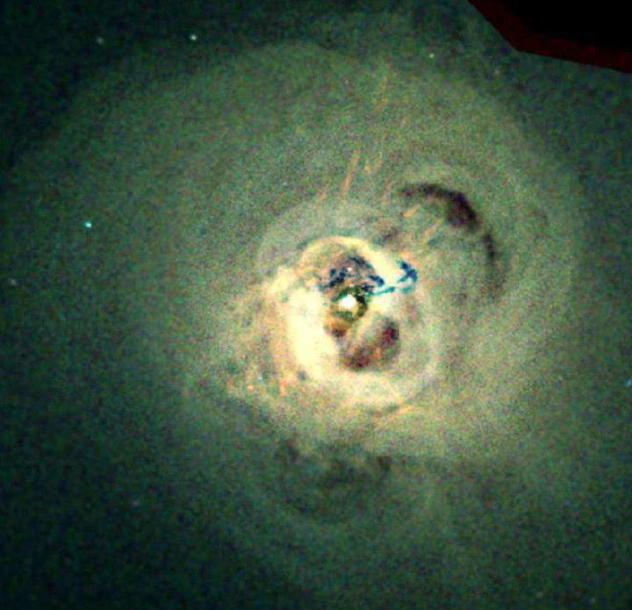
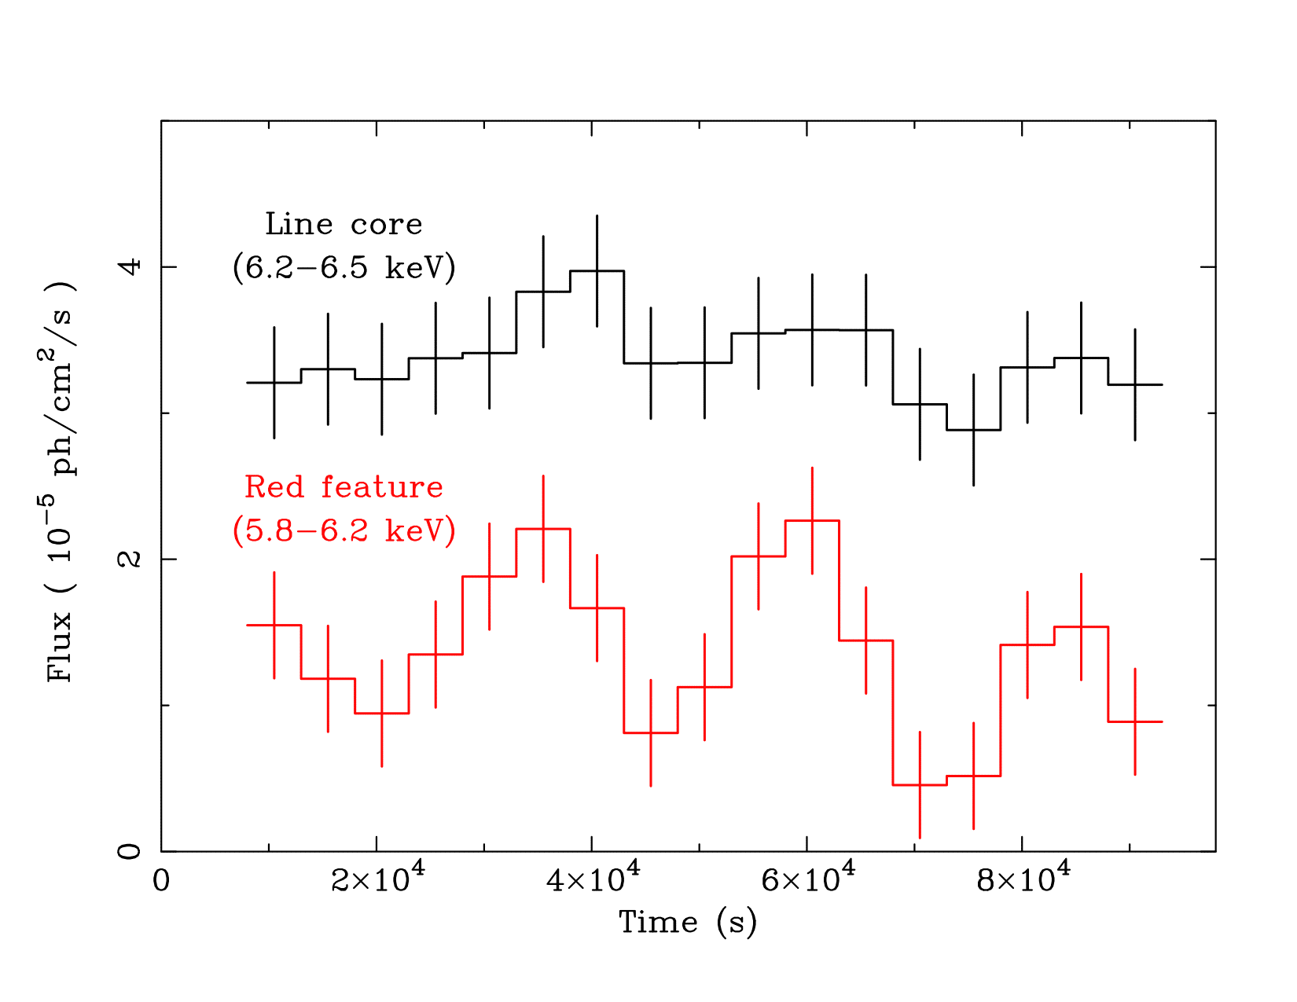
Data Collection
Energy Spectra 1D
Data are recorded for each arriving photon:
the (2-dimensional) location - sky coordinates
the photon energy
the arrival time
All variables are discrete
High resolution -> finer discretization,
e.g., 4096 x 4096 spatial or up to 16384 spectral bins
Table with photon counts for:
Spectral analysis - 1D
Spatial analysis - 2D
Timing analysis - 1D
Chandra X-ray Image

Slide 10

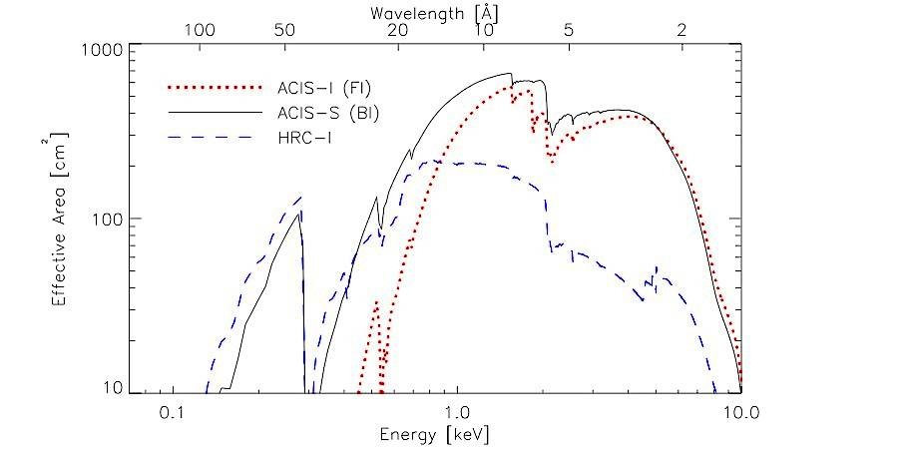
Instrumental Effects:
Recording inefficiency
Image:
exposure map
“sensitivity to photons per area”
Spectrum:
effective area (ARF)
“sensitivity to photons per energy”

Slide 11
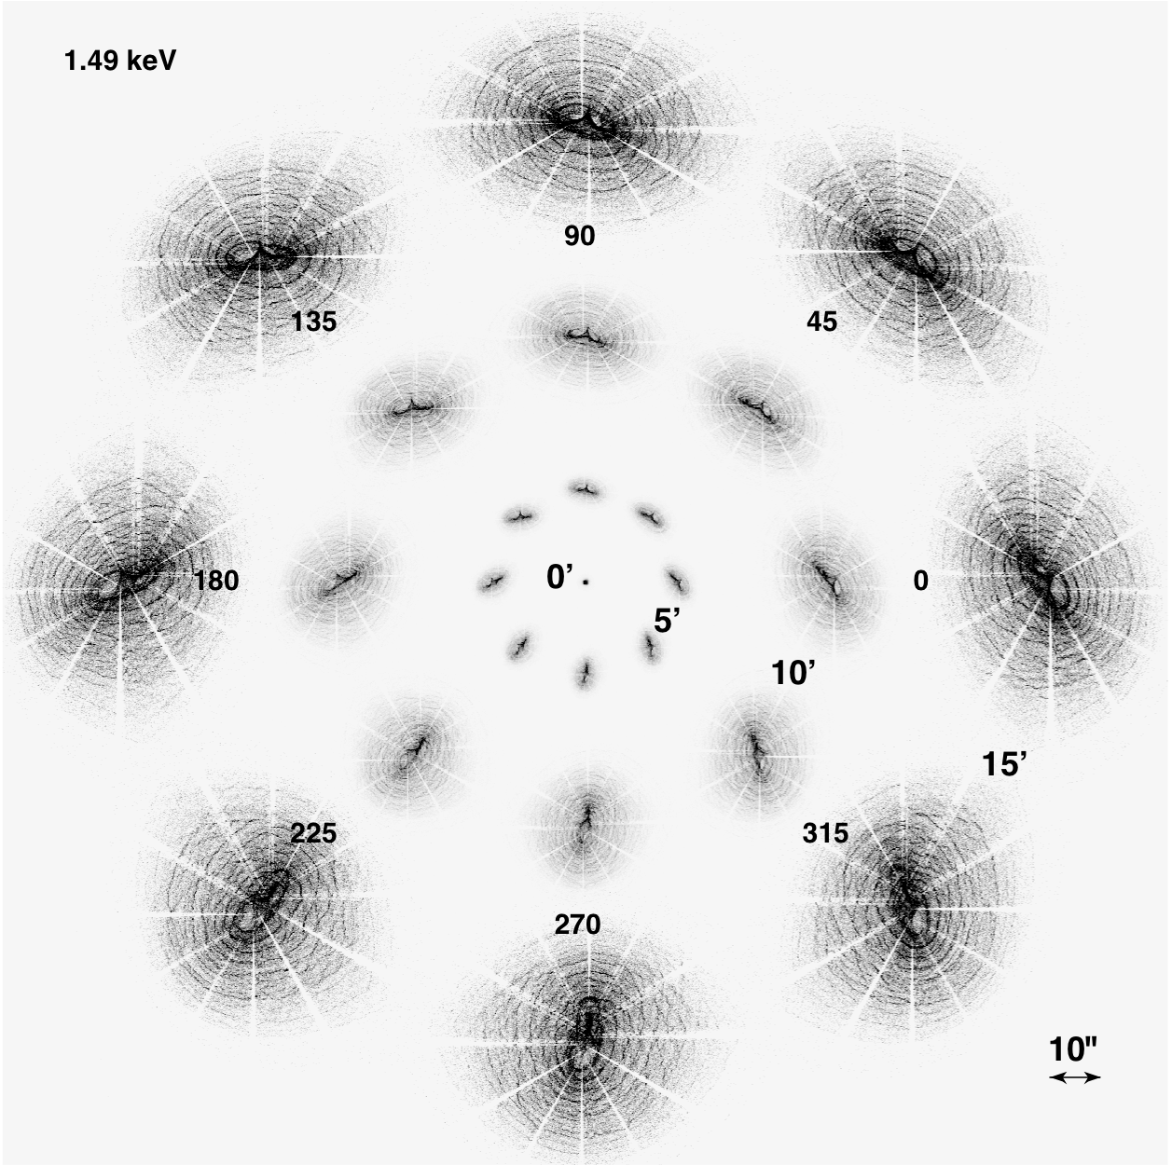
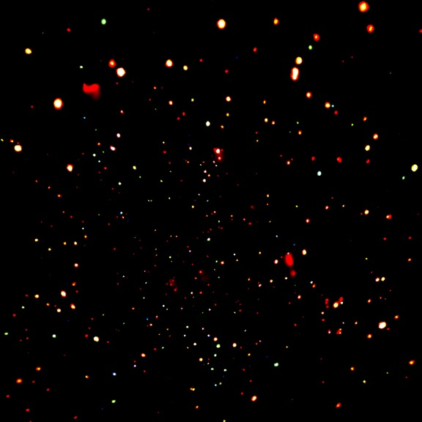
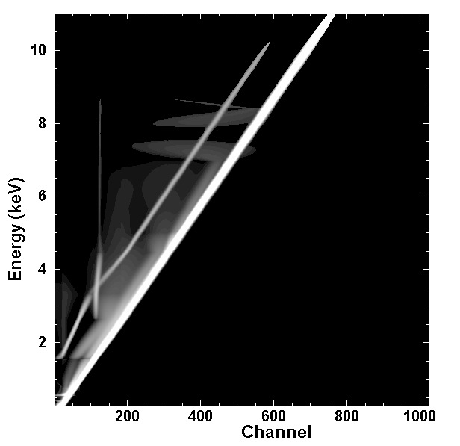
Instrumental Effects:
Blurring
PSF Simulated
Images
Image
point source observed size
depends on the source location on the detector
“blurring” is described by a point spread function (PSF)
Spectrum
photon energy is “blurred”
probability of detecting photon at given energy in given detector channel is described by a redistribution matrix (RMF)
Energy
RMF
Detector channels

Slide 12
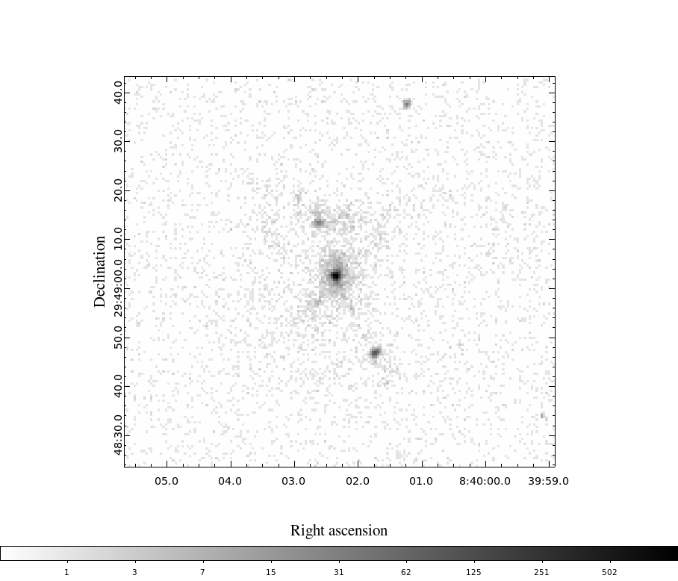
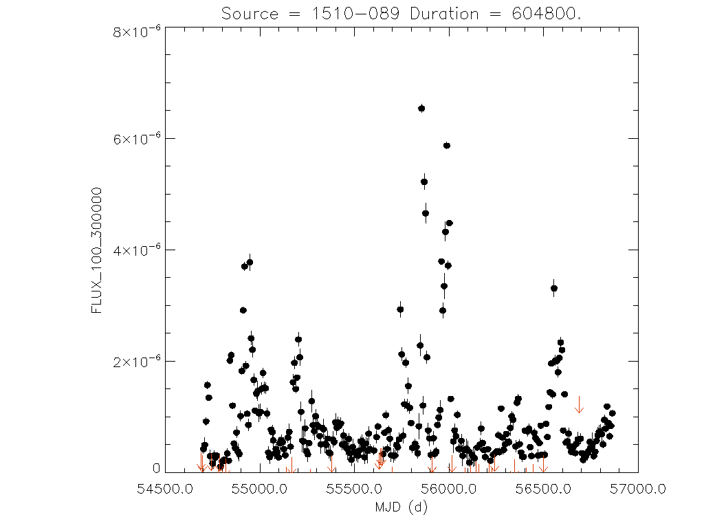
Challenges
Sparse, locally saturating, Poisson data
Instrumental effects
Source Detection in Deep Images
Irregular extended structures
Source boundaries
Complex physical models
Non-periodic, stochastic variability
Fermi LAT
Chandra X-ray Observatory

Slide 13
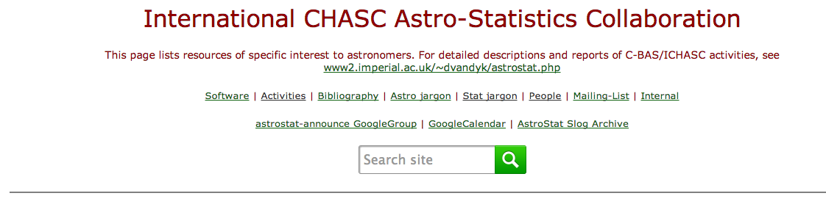
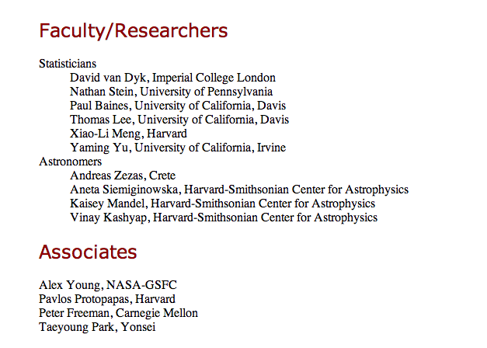



CHASC was founded in 1997

Slide 14
Statistical Paradigm
Model Building:
Model source spectra, image, and/or time series
Model the data collection process
Background contamination
Instrumental effects (effective area, response, psf)
Results in a highly structured hierarchical model
Model-Based Statistical Inference
Bayesian posterior probability distribution
Maximum likelihood estimation
Sophisticated Statistical Computation Methods are Required
Goals: computational stability and astronomer- friendly implementation
Emphasize natural link with models: The Method of Data Augmentation

Slide 15
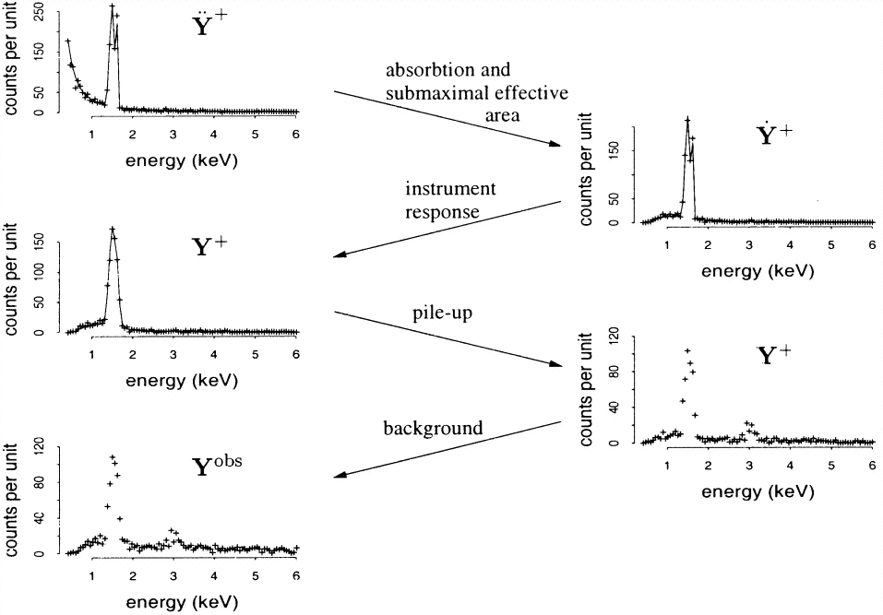
BLoCXS
CJ Shen / Chris Hans / Rostislav Protassov / Yaming Yu / Taeyoung Park / Hyunsook Lee / Jin Xu / Shandong Min
van Dyk, D. A., Connors, A., Kashyap, V. L., Siemiginowska, A. (2001)
Analysis of Energy Spectra with Low Photon Counts via Bayesian Posterior Simulation.
The Astrophysical Journal , 548, 224-243.

Slide 16
Highly Structured Statistical Models
Model directly the source and data collection, and include statistical procedure to fit the resulting highly structured models and address the substantial scientific questions
Emitted Spectrum
Observed
Loss of information
van Dyk et al. 2001

Slide 17

Bayesian Inference
Complex data collection needs to be included in the statistical model:
Physical Source
Model
Expected
photon
count
Non-homogenous
stochastic censoring
* from calibration
Background
Contamination
* from separate observation
Instrumental
“blurring”
* from calibration
Observed counts are modeled as independent Poisson variables with λ mean

Slide 18
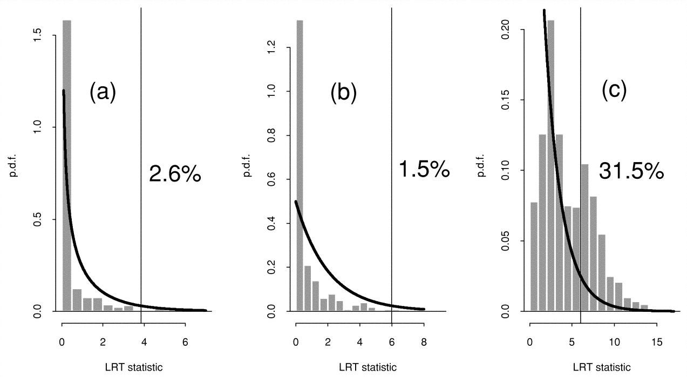
BLoCXS / ppp
Rostislav Protassov / Yaming Yu / Taeyoung Park
Protassov LRT
- plot of LRT distributions
line detection
F-test was being commonly misused in astro analyses
because of a lack of appreciation
of the asymptotic conditions under which it was valid.
posterior predictive p-values for LRTs
Protassov+ 2002, became our most famous paper
has been cited 301 times
Protassov, R., van Dyk, D. A., Connors, A., Kashyap, V. L. and Siemiginowska, A. (2002). Statistics: Handle with Care, Detecting Multiple Model Components with the Likelihood Ratio Test. ApJ, 571, 545-559.
Park, T. van Dyk, Siemiginowska, A. (2008) -Searching for Narrow Emission Lines in X-ray Spectra: Computation and Methods, ApJ. 688, 807

Slide 19
LRT
Assumptions of the Likelihood Ratio Test statistics:
The null hypothesis must be a special case of the alternative
The parameter space of the null must be interior of the alternative parameter space.
The second assumption fails when testing for a spectral emission line:
When there is no line, the line intensity is zero, it may not be negative.
The line locations and width of the line do not exist when there is no line. They have no values.

Slide 20
LRT
IMPORTANT! We do not know the true distribution of the test statistics.
Unknown location of the line
Fixed width
Absorption line
Narrow line
at fixed location
5% false positive rates
For the nominal distribution
Simulated
False positive rates
LRT distribution histograms
χ²distribution solid line
Results of three tests compared to the nominal χ² distribution
Protassov et al. (2002)

Slide 21
pyBLoCXS / Calibration
Yaming Yu / Taeyoung Park / Hyunsook Lee / Jin Xu
Foundations of Astronomical inference:
Measurement
Significance
Calibration
Calibration is not perfect, it has known statistical and systematic errors, and unknown errors that are only guessed at.
Drake, J.J., et al. 2006, "Monte Carlo processes for including Chandra instrument response uncertainties in parameter estimation studies", SPIE Proc. 6270, 49
Kashyap, V.L., et al. 2008, "How to handle calibration uncertainties in high-energy astrophysics", SPIE Proc. 7016, 21
Lee, H., et al. 2011, "Accounting for Calibration Uncertainties in X-ray Analysis: Effective Areas in Spectral Fitting", ApJ, 731, 126
Xu, J., et al. 2014, "A Fully Bayesian Method for Jointly Fitting Instrumental Calibration and X-ray Spectral Models", ApJ, in press

Slide 22
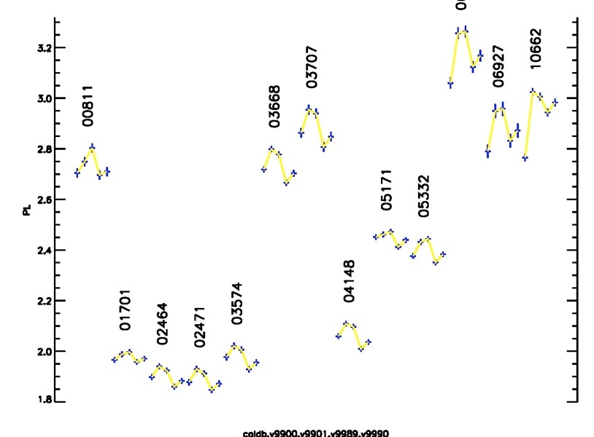

Slide 23
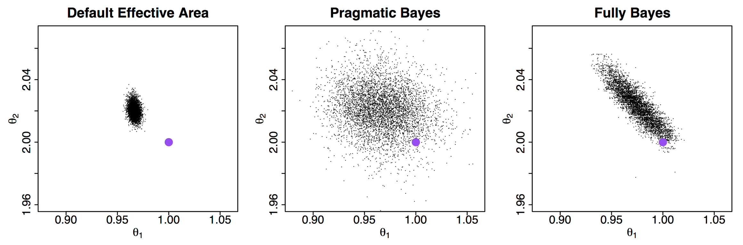
pyBLoCXS / Calibration
Yaming Yu / Taeyoung Park / Hyunsook Lee / Jin Xu / Shandong Min
fitting to simulated data
f(ε;θ) = θ₃ ε^{–θ₁} e^{–θ₂ σ(ε)}
p(θ|D,A₀)
p(A) p(θ|D,A)
p(A,θ|D)
p(θ|D,Ai)
p(A(θ’),θ|D)

Slide 24
pyBLoCXS / Bayes Factors
Shandong Min
Bayes Factors fail miserably when inference is dominated by priors. So take it one step further, use them to determine what kind of priors make sense.

Slide 25
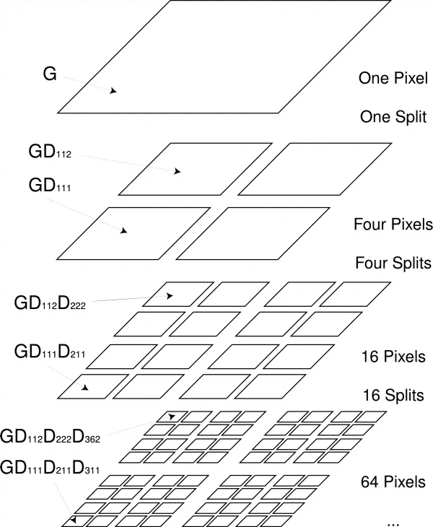
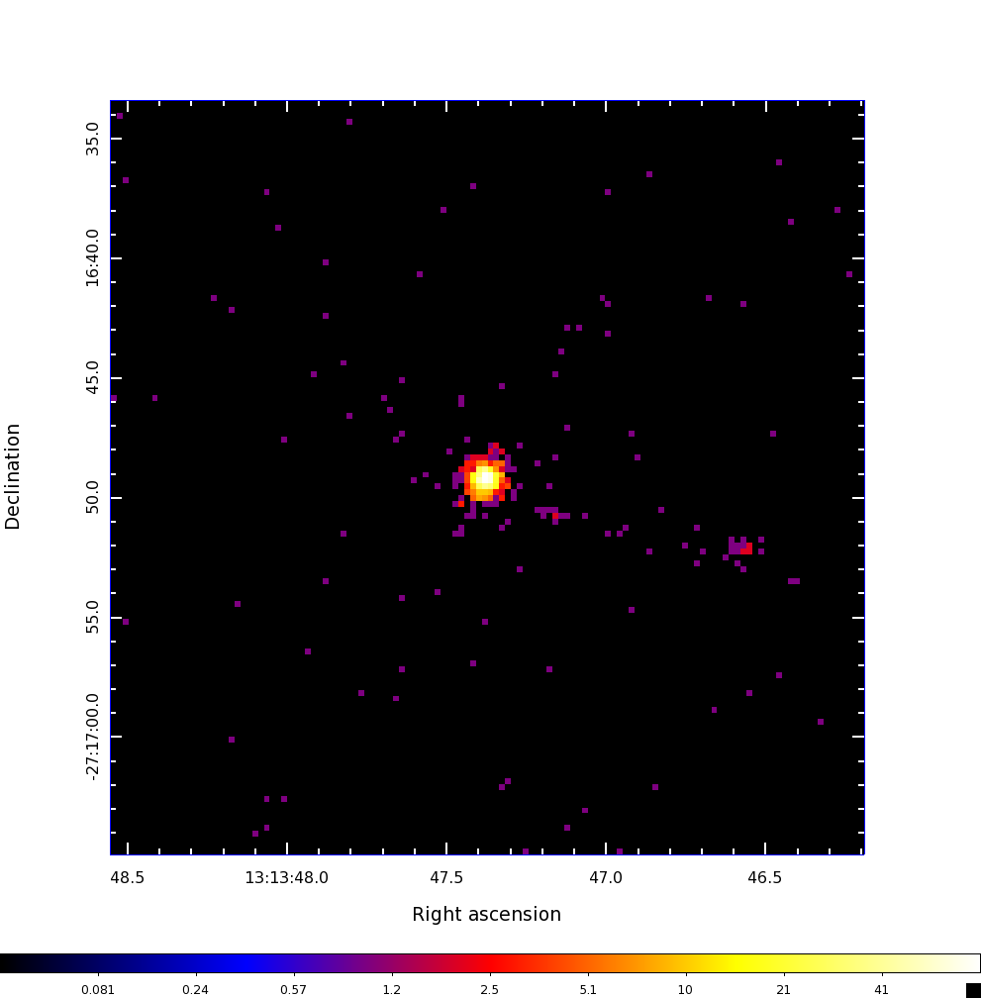
EMC2
David Esch
Bayesian Multi-scale reconstruction of low-counts images
Esch, D.N., Connors, A., Karovska, M., & van Dyk, D.A., 2004,
An Image Restoration Technique with Error Estimates ApJ, 610

Slide 26
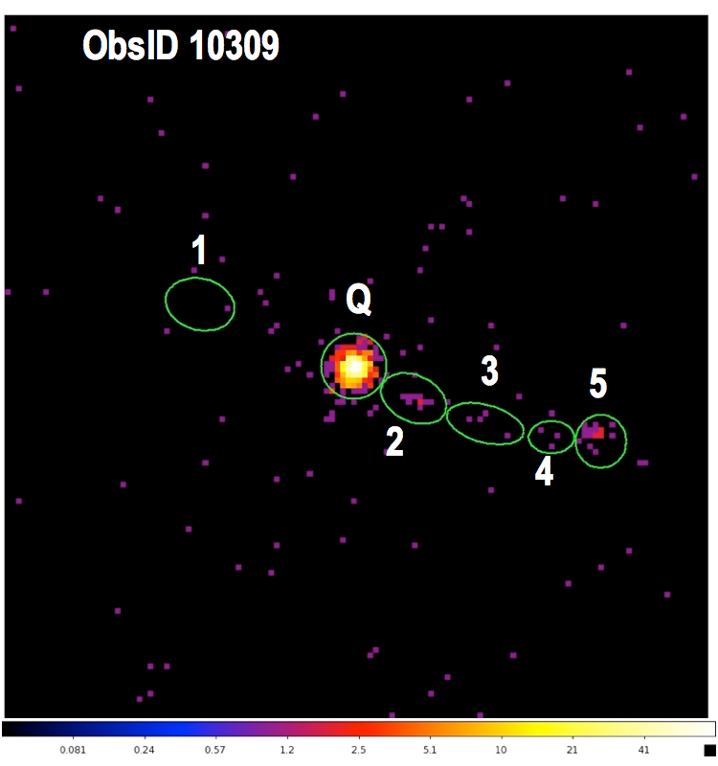
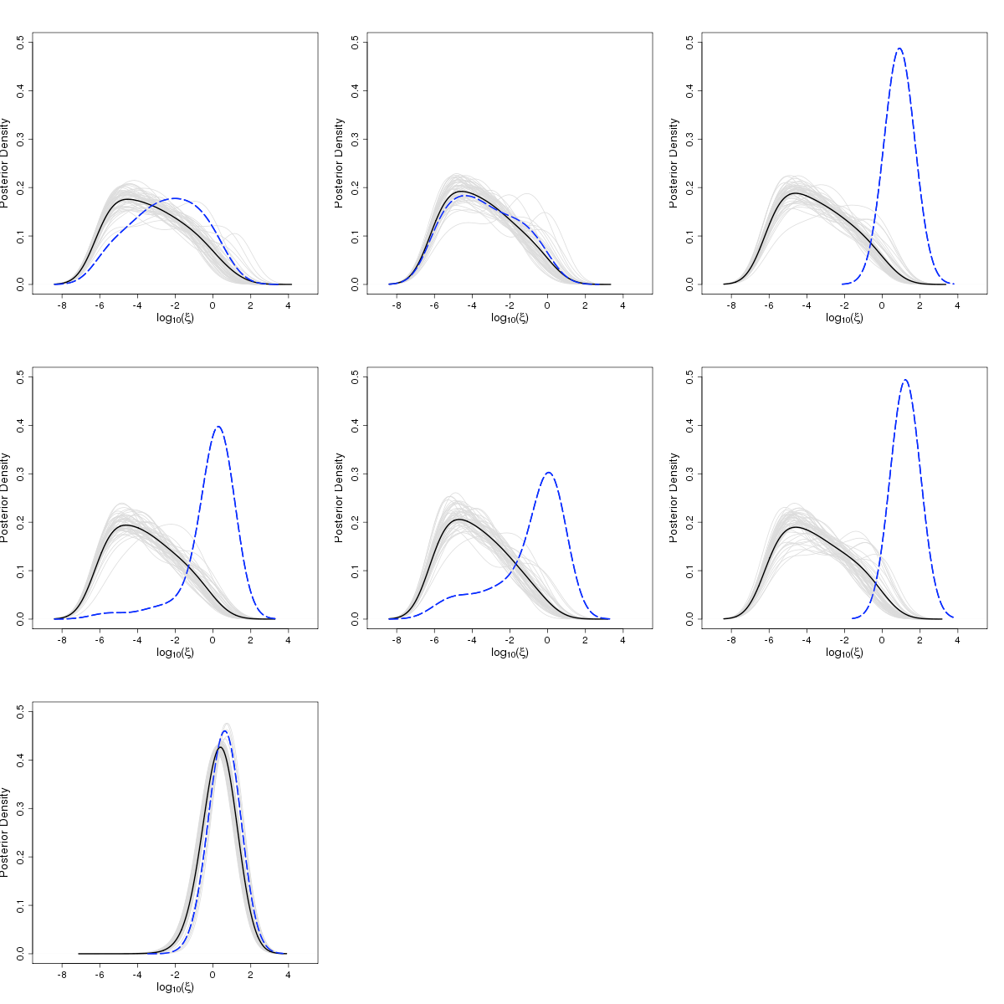
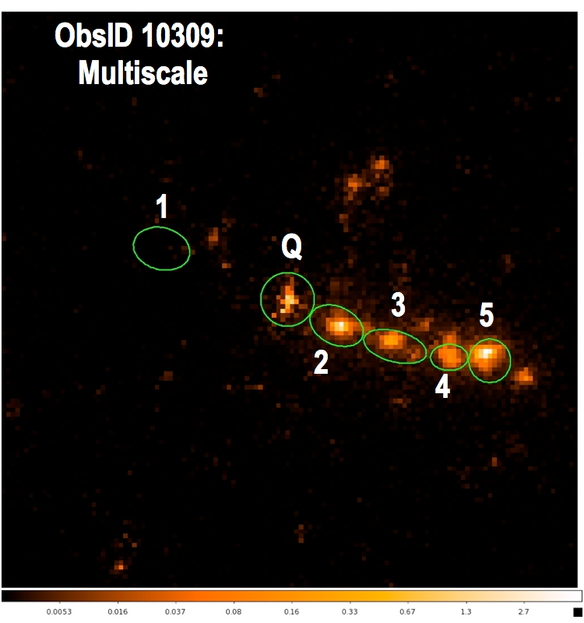
LIRA
Nathan Stein / Katy McKeough
Significance of irregular structure
McKeough +2014, Stein+ 2014

Slide 27
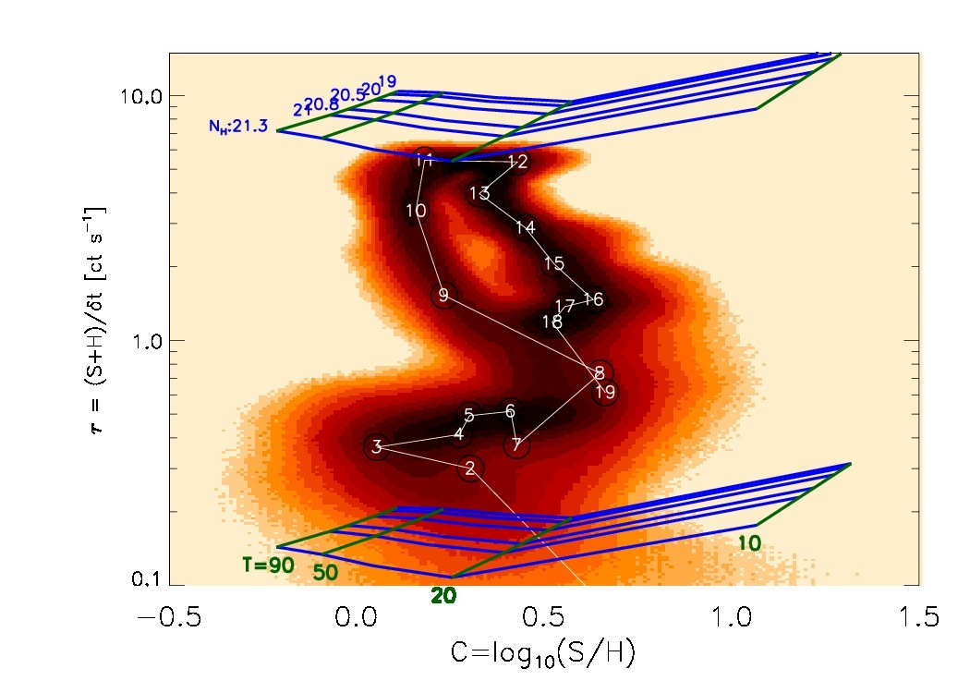
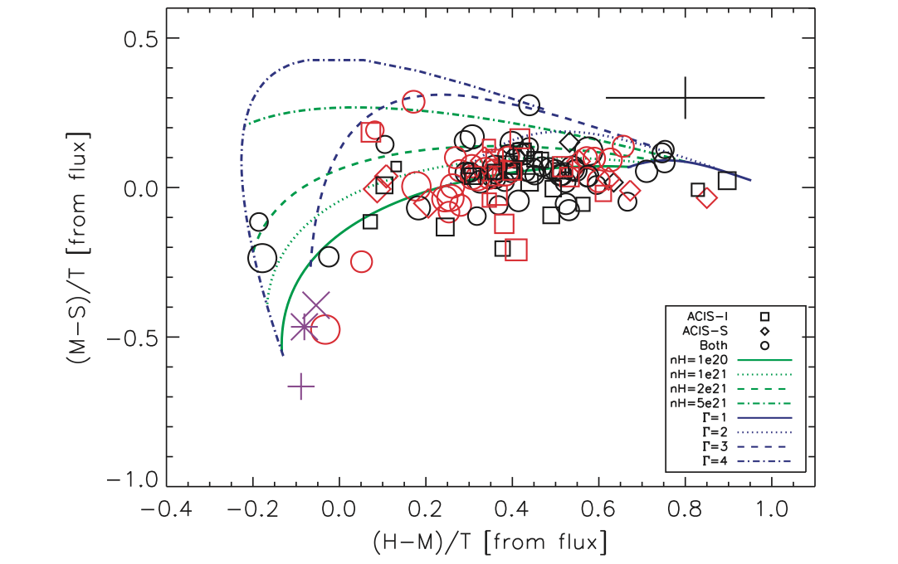
Hardness Ratios
Chris Hans / Yue Wu / Taeyoung Park
Simplest measure of shape of a spectrum.
Use counts in passbands, Ci ~ Pois(aiλi + bi), to compute
p(R=λ₁/λ₂ | Ci)
p(HR=(λ₁–λ₂)/(λ₁ + λ₂) | Ci)
p(C=log(R) | Ci)
Wargelin
et al. 2008
Posson-Brown et al. 2009
Park, T., et al. 2006, “Bayesian Estimation of Hardness Ratios: Modeling and Computations”, ApJ, 652, 610

Slide 28
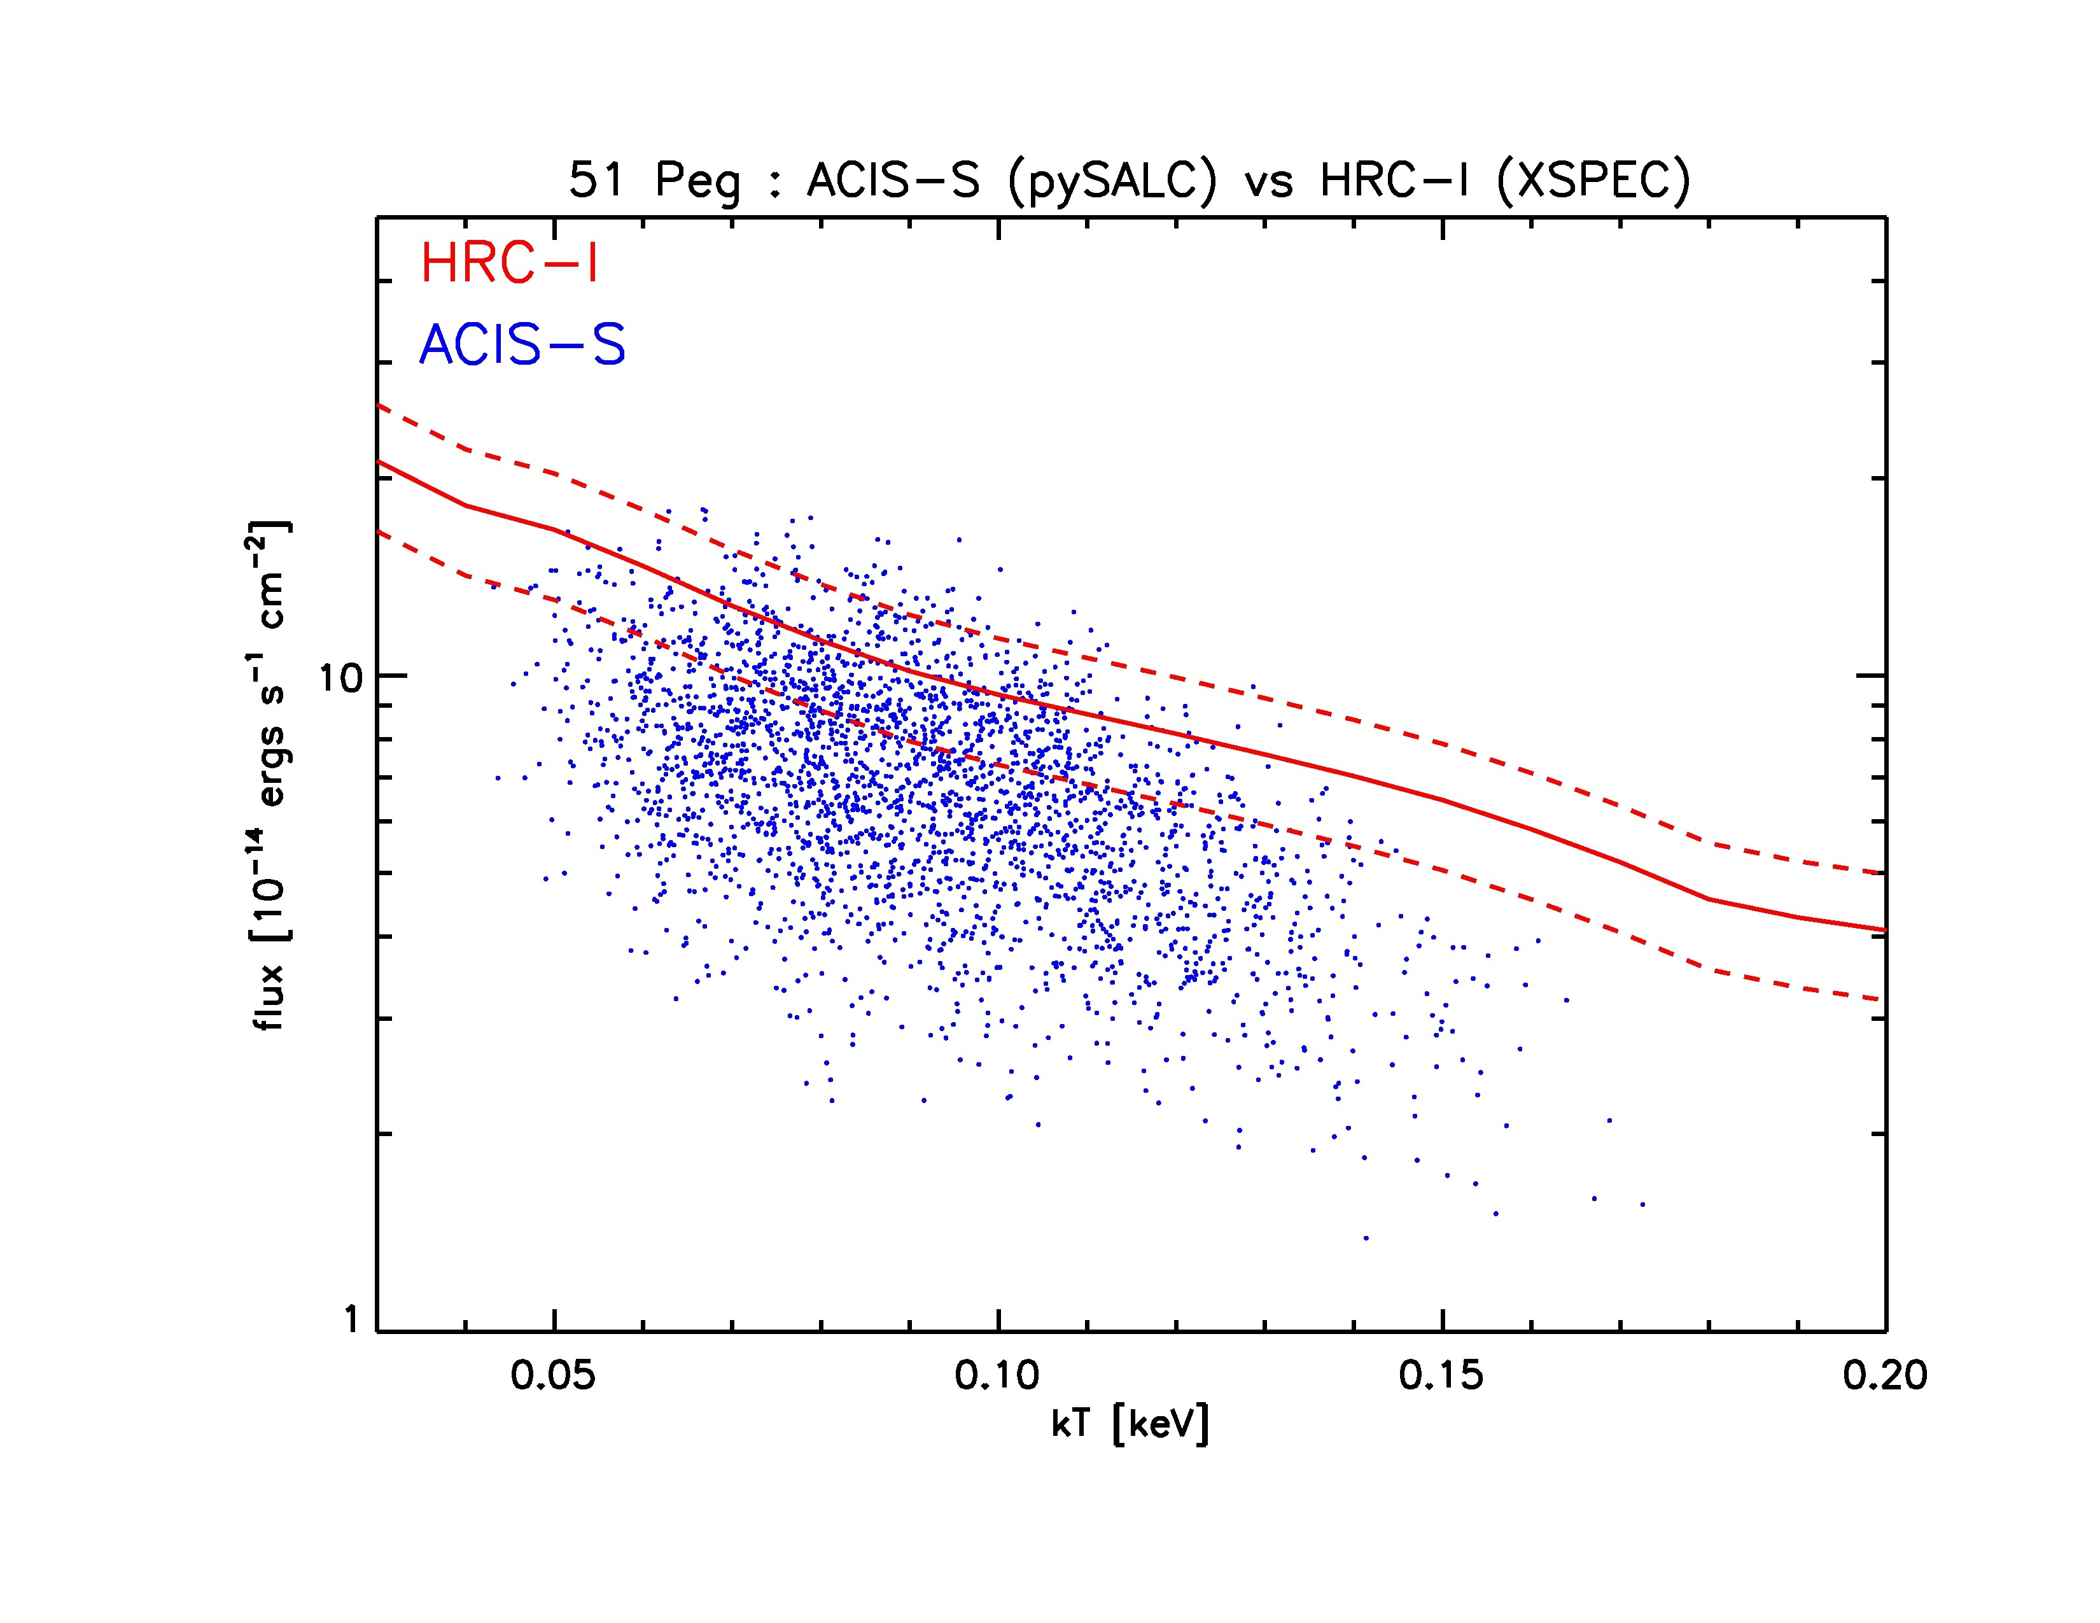
Hardness Ratios
Taeyoung Park
BEHR is used in the Chandra Source Catalog
Next step: pySALC – infer spectral model parameters directly

Slide 29
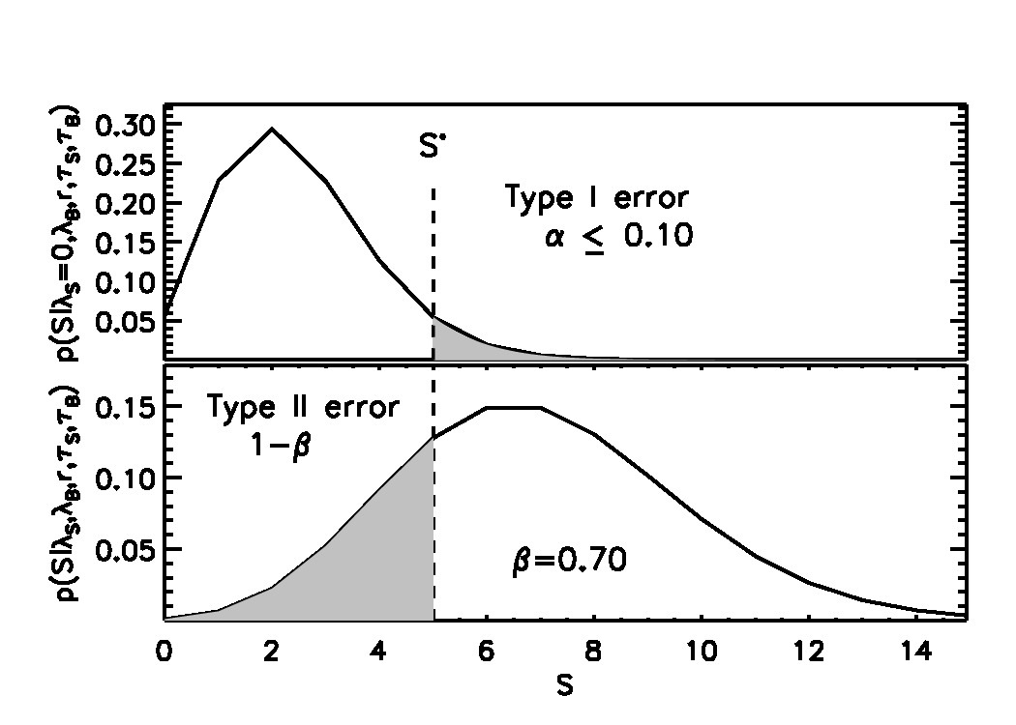
Upper Limits
Jin Xu
Bounds or Limits?
Bounds: Confidence/Credible range estimates on parameters
Limits: You make an observation, find nothing, and ask at what brightness would the source have been detected, and conclude it must be dimmer than that.
Kashyap, V.L., et al. 2010, “On Computing Upper Limits to Source Intensities”, ApJ, 719, 900

Slide 30
Differential Emission Measure
Hosung Kang / Viktoria Liublinska / Nathan Stein
DEM(T)
ful;λ = ∫ dlogT Gul;λ(T,ne) AZ ne² dV/dlogT
Kashyap, V. & Drake, J.J., 1998, “Markov-Chain Monte Carlo Reconstruction of Emission Measure Distributions: Application to Solar Extreme-Ultraviolet Spectra”, ApJ, 503, 450
Kang, H., et al., 2003, “A Response Matrix Approach to the Reconstruction of Differential Emission Measure”, AAS/SPD 34, 02.01, BAAS 35, p807
Kang, H., et al. 2004, “Reconstructing Stellar DEMs from X-ray Spectra”, AAS/HEAD 8.0501
Kang, H, et al. 2005, “Incorporating Atomic Data Errors in Stellar DEM Reconstruction", in X-Ray Diagnostics of Astrophysical PlasmasL Theory, Experiment, and Observation, AIP Conf. Proc., v774, p373

Slide 31
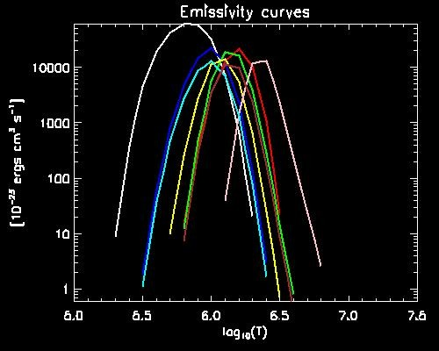
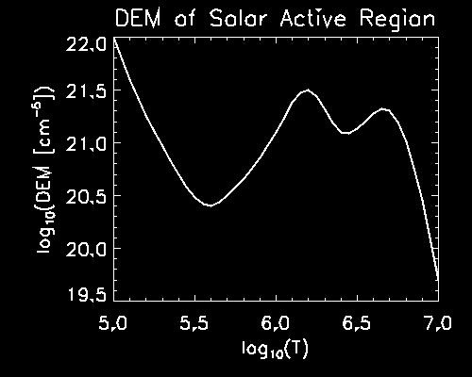
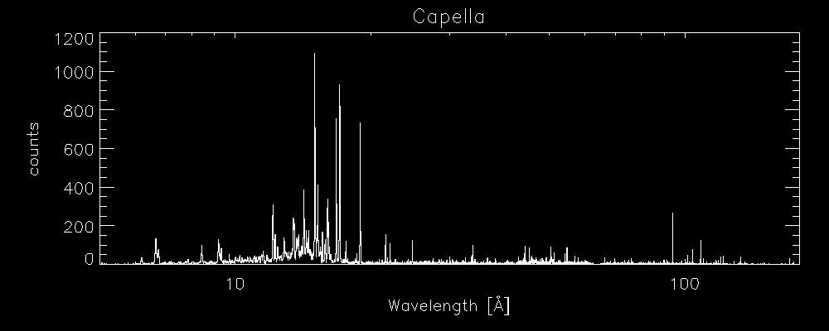
DEM(T)
ful;λ = ∫ dlogT Gul;λ(T,ne) AZ ne² dV/dlogT

Slide 32
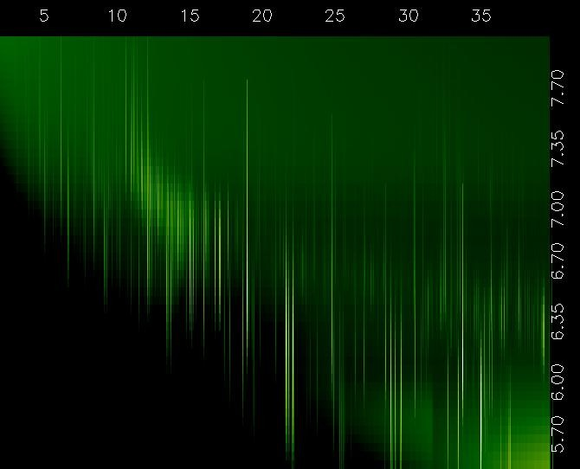
Gul;λ(T,ne)

Slide 33
Solar DEMs
Nathan Stein
Unlike stellar gratings data, Solar data have high spatial resolution, low spectral and temporal resolutions. Also, high data rate. Large images in multiple filters at ≈12 sec cadence.
Bypass DEM generation and compute thermal segmentation directly from the data.
Stein, N.M., et al. 2012, “H-means Image Segmentation to Identify Solar Thermal Features”, In IEEE International Conference on Image Processing (ICIP). (student paper award finalist)
Stein, N.M., 2014, “Detecting Thermal Features in Massive Streams of Solar Images”, in Big Data in Astro Statistics, Section on Statistical Learning and Data Mining, JSM

Slide 36
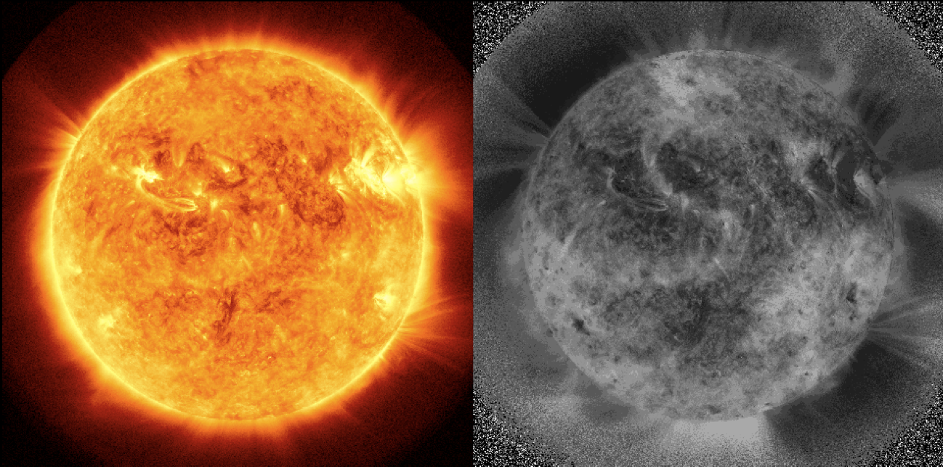
SDO/AIA 2010 Oct 2 05:57

Slide 37
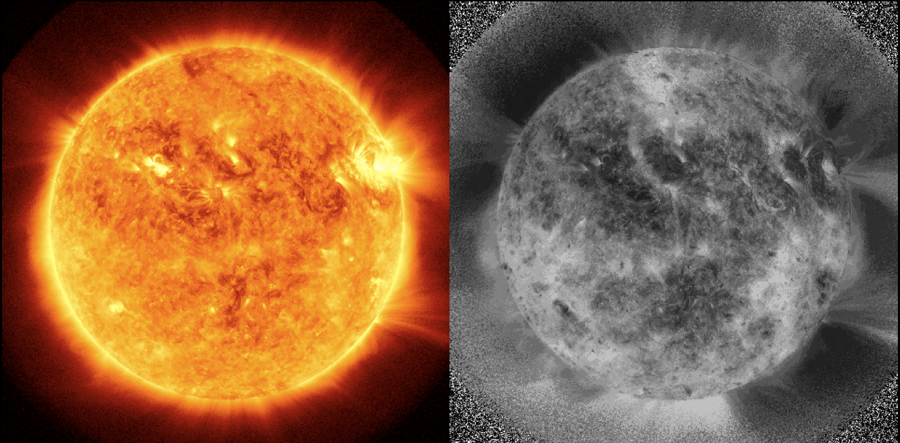
SDO/AIA 2010 Oct 2 18:43

Slide 38
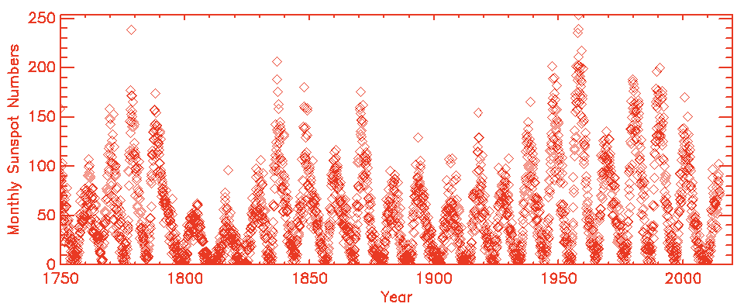
Sunspots: Cycle
Yaming Yu / David Stenning
amplitude(next) ∼ 4.1 + 3.9 (amplitude / fall time)
time to maximum(next) ∼ 8.5 – 0.43 amplitude(next)
fall time(next) ∼ 4.3 + 0.43 amplitude(next)
Yu, Y., et al. 2012, “A Bayesian Analysis of the Correlations Among Sunspot Cycles”, Solar Physics, 281, 847
Stenning, D., et al. 2014, “A Bayesian Analysis of the Solar Cycle Using Multiple Proxy Variables”, Current Trends in Bayesian Methodology with Applications, Editors: S. Upadhyay, D.K. Dey, U. Singh and A. Loganathan, Chapman & Hall/CRC Press, in press

Slide 39
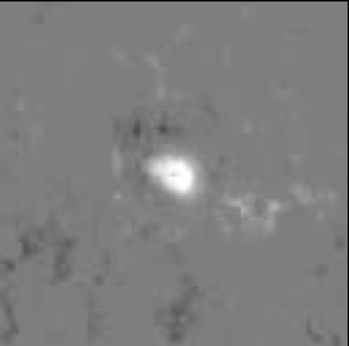
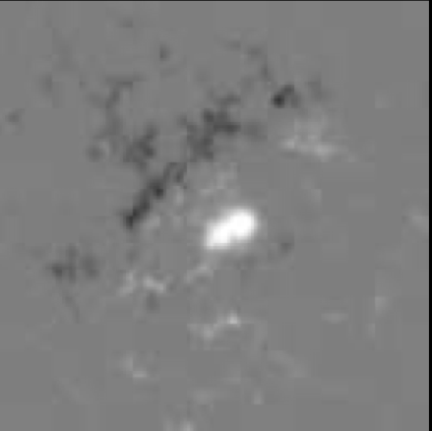
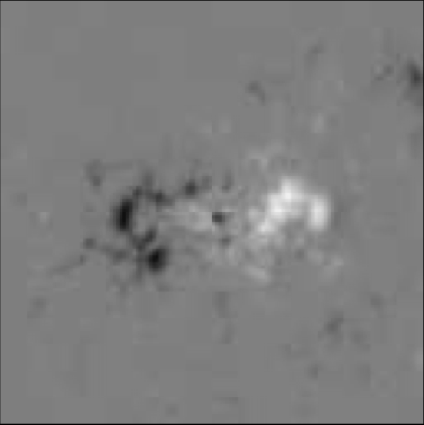
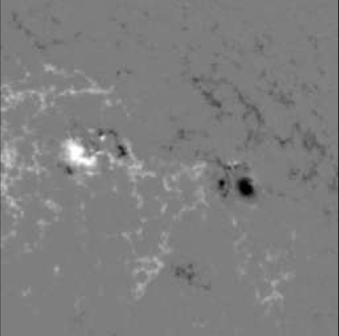
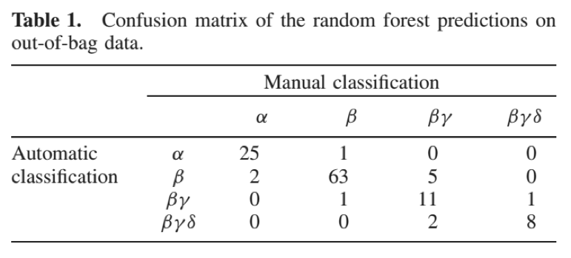
Sunspots: Classification
David Stenning
α
β
β-γ
β-γ-δ
Extract scatter for both polarities, relative strength, curvature of separator, and penumbral polarity overlaps
Stenning, D., et al. 2012, “Morphological Image Analysis and its Application to Sunspot Classification”, Statistical Challenges in Modern Astronomy V (Editors: G.J. Babu and E.D. Feigelson), Springer Verlag, New York, 2012
Stenning, D., et al., 2013, “Morphological feature extraction for statistical learning with applications to solar image data”, in Statistical Analysis and Data Mining, DOI: 10.1002/sam.11200

Slide 40
Color-Magnitude Diagrams
Paul Baines / Nathan Stein
Magnitude = –log(brightness) (relative to a standard)
Color = difference in Magnitudes at different wavelengths
http://sciencevault.net/ibphysics/astrophysics/pics/hrdiagram1.gif

Slide 41
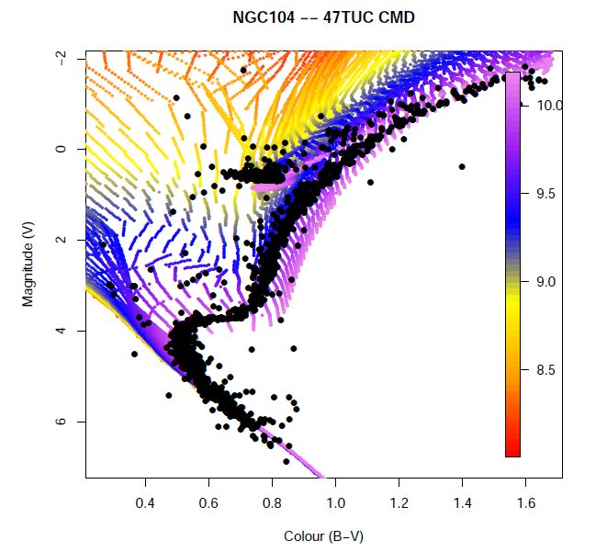
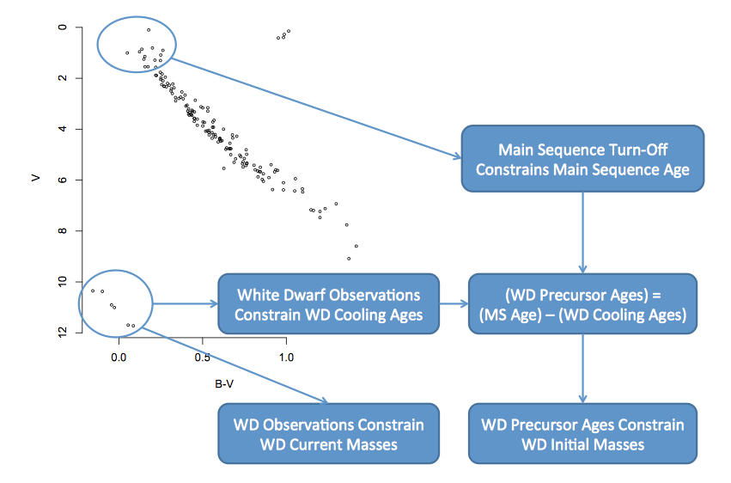
Color-Magnitude Diagrams
Paul Baines / Nathan Stein
DeGennaro, S., et al. 2008, “Inverting Color-Magnitude Diagrams to Access Precise Star Cluster Parameters: A New White Dwarf Age for the Hyades”, ApJ, 696, 12
van Dyk, D.A., et al. 2009, “Statistical Analysis of Stellar Evolution”, Annals of Applied Statistics, 3, 117
Jeffery, E.J., et al., 2011, “The White Dwarf Age of NGC 2477”, ApJ, 730, 35
Stein, N.M., et al. 2013, “Combining Computer Models to Account for Mass Loss in Stellar Evolution”, Statistical Analysis and Data Mining, 6, 34

Slide 42
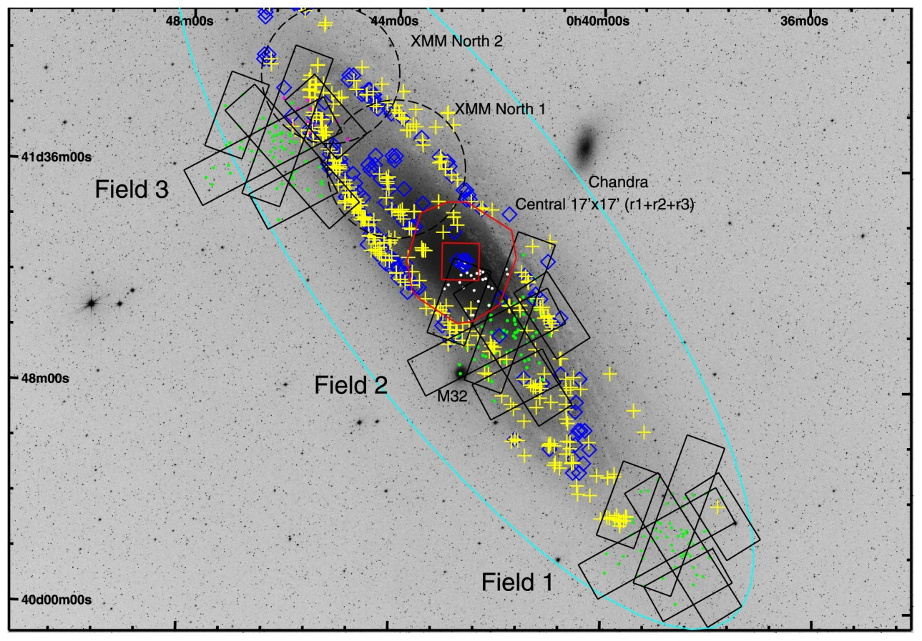


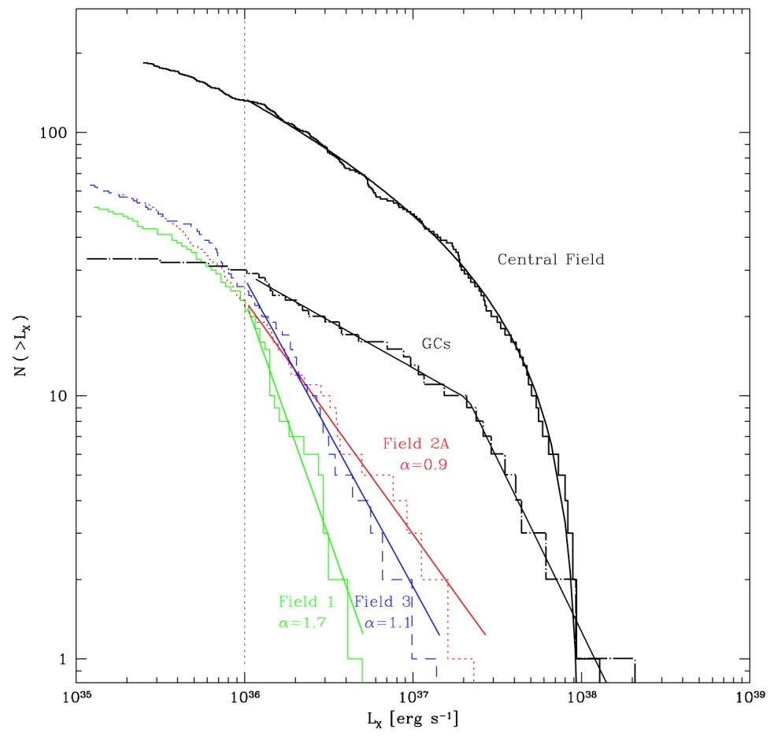
logN-logS
Nondas Sourlas / Paul Baines / Irina Udaltsova / Raymond Wong
Some recent capabilities:
ability to determine number of segments
hierarchical Bayesian modeling
allow for detection efficiency
multiple-Pareto models
posterior predictive p-value checks
base sensitivity limit
Wong, R., et al. 2014, "Automatic Estimation of Flux Distributions of Astrophysical Source Populations”, Annals of Applied Statistics, in press
Udaltsova, I., et al., 2011, “log(N)-log(S): A Measuring Stick for the Universe”, SCMA V
Udaltsova, I., et al., 2014a,b, in preparation
Kong et al. 2003, via A. Zezas
Kong et al, 2003

Slide 43

Luminosity Functions
Alex Blocker
Blocker et al. 2009, X-ray Stacking for the Analysis of Faint Sources: A Bayesian Alternative,
Proceedings of the conference held 22-25 September, 2009 in Boston, Chandra

Slide 44

Luminosity Functions
Lazhi Wang
∃ independently derived catalogs of sources (from optical/IR/radio observations)
Question: Can we bypass X-ray detection process to infer properties of the underlying luminosity function? Are detectable X-ray sources representative of the whole sample?
Wang, L., et al. 2014, “Catalog-based X-ray Population Modeling”, in preparation

Slide 46


Slide 47

Luminosity Functions
Lazhi Wang
Wang, L., et al. 2014, “Catalog-based X-ray Population Modeling”, in preparation

Slide 48

Spatio-Spectral Disentangling
David Jones
Orion Nebula Cluster
ObsID 1522
Jones, D., et al. 2014, “Disentangling Overlapping Astronomical Sources Using Spatial and Spectral Information”, in preparation

Slide 49

Spatio-Spectral Source Disentangling
David Jones
Orion Nebula Cluster
ObsID 1522
Jones, D., et al. 2014, “Disentangling Overlapping Astronomical Sources Using Spatial and Spectral Information”, in preparation

Slide 50


Spectro-temporal Partitioning
Raymond Wong
With high resolution available in both spectral and temporal regimes, compute a 2D Bayesian Blocks like partitioning of the data. Segment data at points where both intensity and spectral shape change significantly. Fit lines+continuum model to spectra in small time bins, compute likelihood that fitted spectra are different, group time bins with similar spectra.
Wong, R., et al. 2014, “Detecting Abrupt Changes in the Spectra of High-Energy Astrophysical Sources”, in preparation

Slide 51





Event Detection in Time Series
Alex Blocker
Multi-stage analysis, first with simpler tools, then with model checking and uncertainty assessment.
Separate medium-frequency “candidates” from low-frequency trends and high-frequency noise via wavelet-based statistical fitting.
Blocker, A., and Protopapas, P., 2013, “Semi-parametric Robust Event Detection for Massive Time-Domain Databases”, SCMA V, Springer-Verlag, p177; http://arxiv.org/abs/1301.3027

Slide 52





Real-time Light Curve Classification
Dan Cervone

Slide 53

Real-time Light Curve Classification
Dan Cervone
Eclipsing Binary

Slide 54

Real-time Light Curve Classification
Dan Cervone
Cepheids

Slide 55

Real-time Light Curve Classification
Dan Cervone
All types

Slide 56
Challenges
Banff Higgs
Paul Edlefsen
Introduction. This article addresses the problem of estimating a Poisson rate in the presence of additive and multiplicative noise, when additional measurements provide data for estimating the nuisance parameters. The problem of estimating rates from noisy or censored Poisson counting data arises in various subdisciplines of physics. In astrophysics, for example, the counts are photons emitted from a distant source. In particle accelerator experiments, the counts are indirect measurements of the number of particles produced by a high-energy collision. In such contexts the observed counts typically include some additive background noise, such as ambient particles. In many cases there is also multiplicative noise, caused, for example, by photon censoring or particle decay, which further complicates the process of estimating the rate of interest.
n ∼ Pois(ε ⋅ s + b)
y ∼ Pois(t ⋅ b)
z ∼ Pois(u ⋅ ε)
Edlefsen Liu, Dempster, “Estimating Limits from Poisson counting data using Dempster–Shafer analysis”, 2009 The Annals of Applied Statistics, Vol.3, 764, astro-ph 0812.1690

Slide 57


Challenges
Strong Lens Time Delay Challenge
Hyungsuk Tak
Tak et al 2014 Bayesian Approach to Time Delay Estimation

