Slide 1
Unaccounted Uncertainties: Commentary
Joshua S. Speagle
Statistical Sciences, Astronomy & Astrophysics, Dunlap Institute
University of Toronto

Slide 2
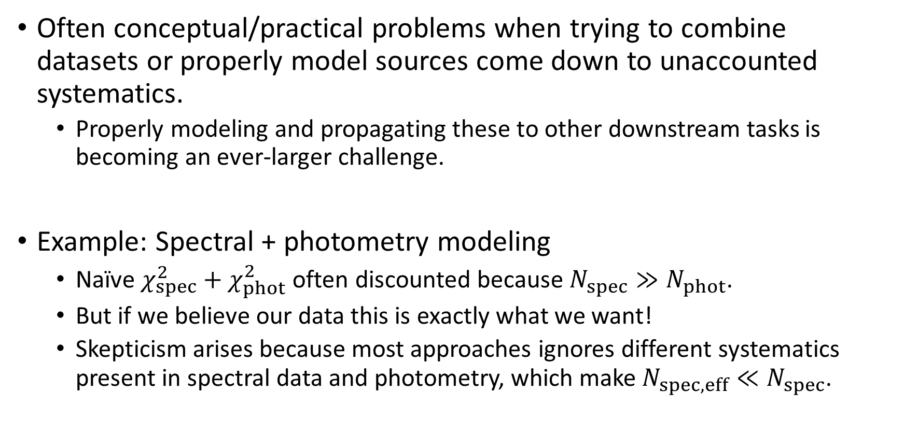
A Complementary Perspective
Often conceptual/practical problems when trying to combine datasets or properly model sources come down to unaccounted systematics.
Properly modeling and propagating these to other downstream tasks is becoming an ever-larger challenge.
Example: Spectral + photometry modeling
Naïve $χ_{spec}^{2}+χ_{phot}^{2}$ often discounted because $N_{spec}≫N_{phot}$.
But if we believe our data this is exactly what we want!
Skepticism arises because most approaches ignores different systematics present in spectral data and photometry, which make $N_{spec,eff}≪N_{spec}$.

Slide 3
Uncovering Systematics
What tools have you found that are very useful in discovering deficiencies (unknown systematics) present in the modeling?
Examples: quantile-quantile plots, posterior predictive plots, p-value checks, simulation tests, etc.

Slide 4
Role of Bayesian vs Frequentist Approaches
Both approaches presented rely on priors and marginalization over nuisance parameters.
Is moving in this direction the path forward, or are there frequentist methods that can be useful?

Slide 5
Outliers
How can we find a balance between ignoring (some) outliers and/or using them to drive our systematics modeling?

Slide 6
Prior Influence on Systematics Models
How much influence can/should the prior have over the final outcome?
What guidance should there be in setting this?
How can we look into quantifying this?
How can we diagnose and/or account for mismatches between priors and data (likelihood)?

Slide 7
Point Estimate → Samples
What are some of the challenges moving from single point estimates to samples?
Statistical (modeling, degeneracies, convergence, effective sample size, etc.)
Computational (additional compute time, redoing pipelines, etc.)
Science (data sharing, downstream error propagation, interpretation, etc.)
How will these procedures work without access to analytic underlying models (and associated gradients)?

Slide 8
Role of Machine Learning
How will machine learning techniques help us approach some of these problems, both within and outside of traditional statistical modeling frameworks?

