Slide 1
Astrophysical Jets with Astrostatistics: Using X-ray/Radio structural differences to understand their X-ray emission
Karthik Reddy (UMBC & CfA), Markos Georganopoulos (UMBC/GSFC), Eileen T. Meyer (UMBC), Vinay Kashyap (CfA), Aneta Siemiginowska (CfA)
CHASC Talk | 11/16/21
Notes:
Introduce the talk—An interesting problem about extragalactic jets—Their X-ray emission, and we don't know how they are produced in the powerful kind—Besides spectral analyses, I'll talk about how we can use their structure to further constrain their X-ray emission mechanism.

Slide 2
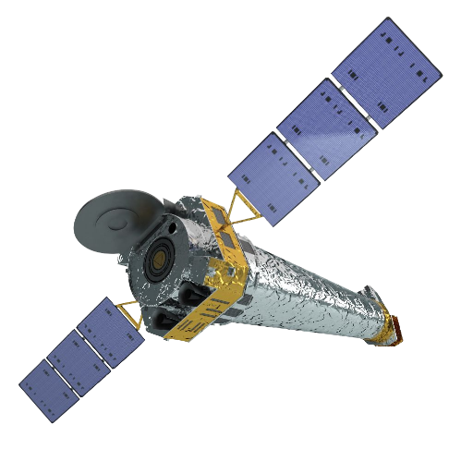
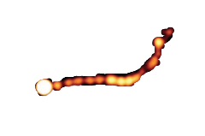

X-rays from kpc-scale AGN Jets
The Chandra era
Chandra X-ray Observatory
Launched in 1999
PKS 0637-752
ATCA Radio Image
(Goodfrey et al. 2012)
PKS 0637-752
Chandra X-ray Image
(NASA/CXC/SAO)
Notes:
Brief history of [resolved] X-ray jets with Chandra—Launched in 1999—Ground team wanted to calibrate it's optics using a distant quasar PKS 0637-752—Using what they expected to be a point source—Unexpectedly found a bright 100 kpc long X-ray jet

Slide 3
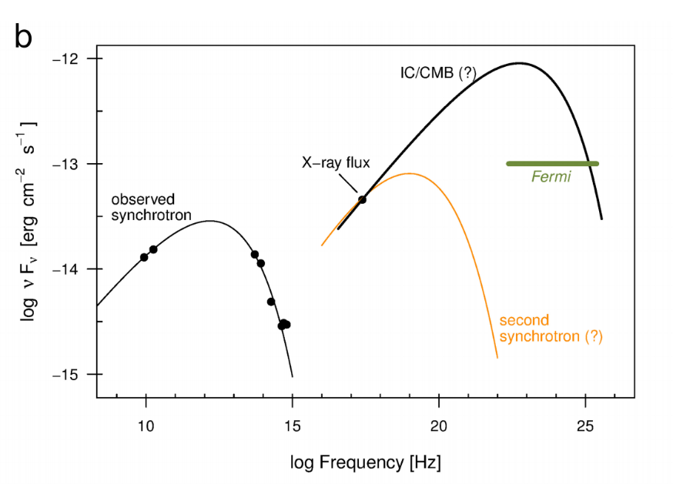

X-ray emission mechanism
IC/CMB or Synchrotron?
IC/CMB
Inverse Compton Scattering the CMB
$$Γ∼large \\ θ∼small$$
Synchrotron emission
from a second electron population
X-rays
(Meyer et al. 2015)
Notes:
Why unexpected?—This jet emits in the radio through IR, and this low-energy part of the spectrum is generally explained by a single synchrotron component
—An extension into the X-rays indicates no detectable flux—But X-ray bright in reality
—Chandra has detected about 200 X-rays jets—several such powerful jets require a second spectral component
—Other low power jets also exist with a single spectral component sufficient to explain radio-through-X-ray spectrum—not the focus of the talk
—Until recently IC/CMB model (briefly explain)—Requires highly relativistic and closely aligned jets—However, radio data indicates only a mildly relativistc jet.
—Alternative—Synchrotron radiation—but why a second electron population?
—Although both can explain the observed X-ray emission—They predict large differences in the jet power that is fed back into host
—Diagnostics—For example, Fermi limits shown by our group
--Problem with synchrotron—why a second electron population?
--Besides spectral diagnostics—X-ray/radio structure offers another clue

Slide 4
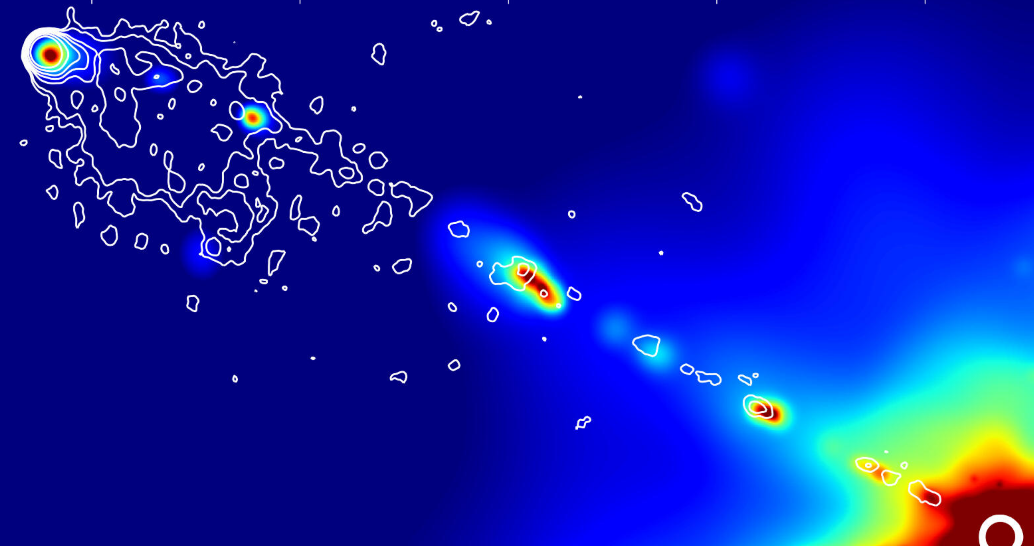
One-zone or multi-zone?
X-ray/radio positional offsets
Synchrotron
IC/CMB
One-zone
3C 111; VLA radio contours/Chandra
(Clautice et al. 2016)
Notes:
--Typical image of a high power X-ray jet. Point to knots and hotspots
--spectral models unaware of the structure in the jet
--most common assumption for IC/CMB—one-zone emission
--Only in a few cases, structure has been involved while applying synchrotron mode of emission
--Problem with applying one-zone modes of emission->offsets

Slide 5
One-zone or multi-zone?
X-ray/radio positional offsets
One-zone models predict
X-ray/Radio spatial-coincidence
Notes:
--The X-rays peak and decay before the radio in this knot
--These offsets question the applicability of one-zone models.
--That means offsets provide another set of important constraints on the X-ray emission mechanism
--What do these offsets mean? What produces them? Can they tell us anything about the structure of the jet and in turn its X-ray mechanism?
--First step-> collect statistics->what type of knots have offsets?
--Look of offsets in a sample of nearly all X-ray jets detected by Chandra

Slide 6
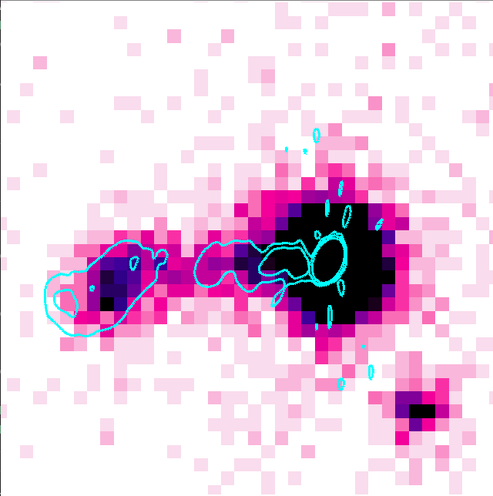
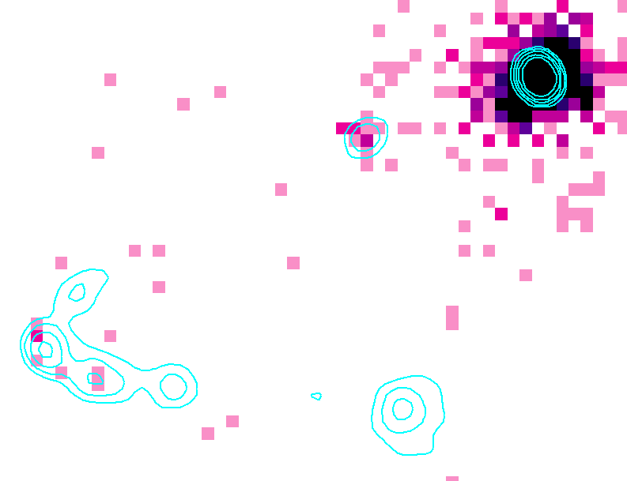

Detecting and Measuring the Offsets
Low-count regime
A high-count jet
A low-count jet
PKS 0605-08
VLA radio contours / Chandra
3C 17
VLA radio contours / Chandra

Slide 7
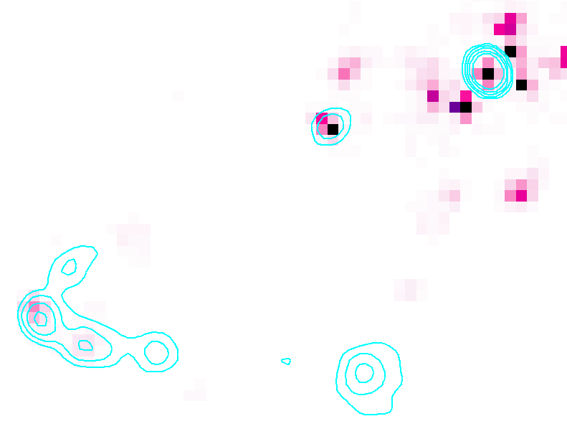



Low-Count Image Reconstruction and Analysis
=
*
Baseline
Added
PSF
Observation
(LIRA; Esch et al. 2004, Stein et al. 2015, see also McKeough et al. 2017)

Slide 8



Low-Count Image Reconstruction and Analysis
Observation
Baseline
.
.
.
$$ξ=\frac{τ_{1}}{τ_{1}+τ_{0}}$$
(McKeough et al. 2017)

Slide 9
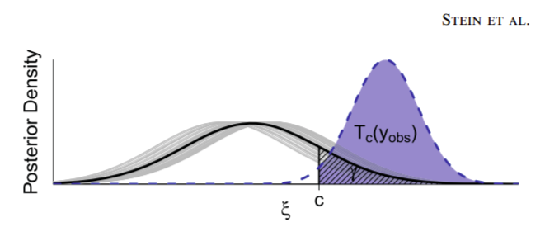
Low-Count Image Reconstruction and Analysis
Estimating the statistical significance of structures
(Stein et al. 2015)

Slide 10

Low-Count Image Reconstruction and Analysis
A low-count jet
Averaged Added Component
$$p−value≤0.008$$

Slide 11
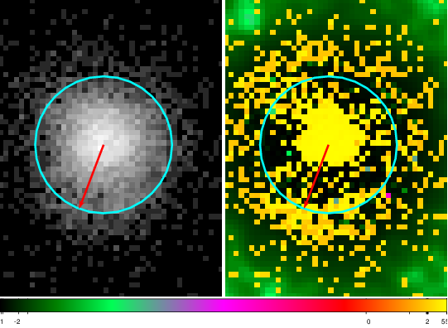
Low-Count Image Reconstruction and Analysis
Chandra PSF Asymmetry
Tau CMa
https://cxc.harvard.edu/cal/Hrc/PSF/acis_psf_2010oct.html
$$p−value≤0.008$$

Slide 12
Low-Count Image Reconstruction and Analysis
A low-count jet
Averaged Added Component
<0.08’’
$$p−value≤0.008$$

Slide 13
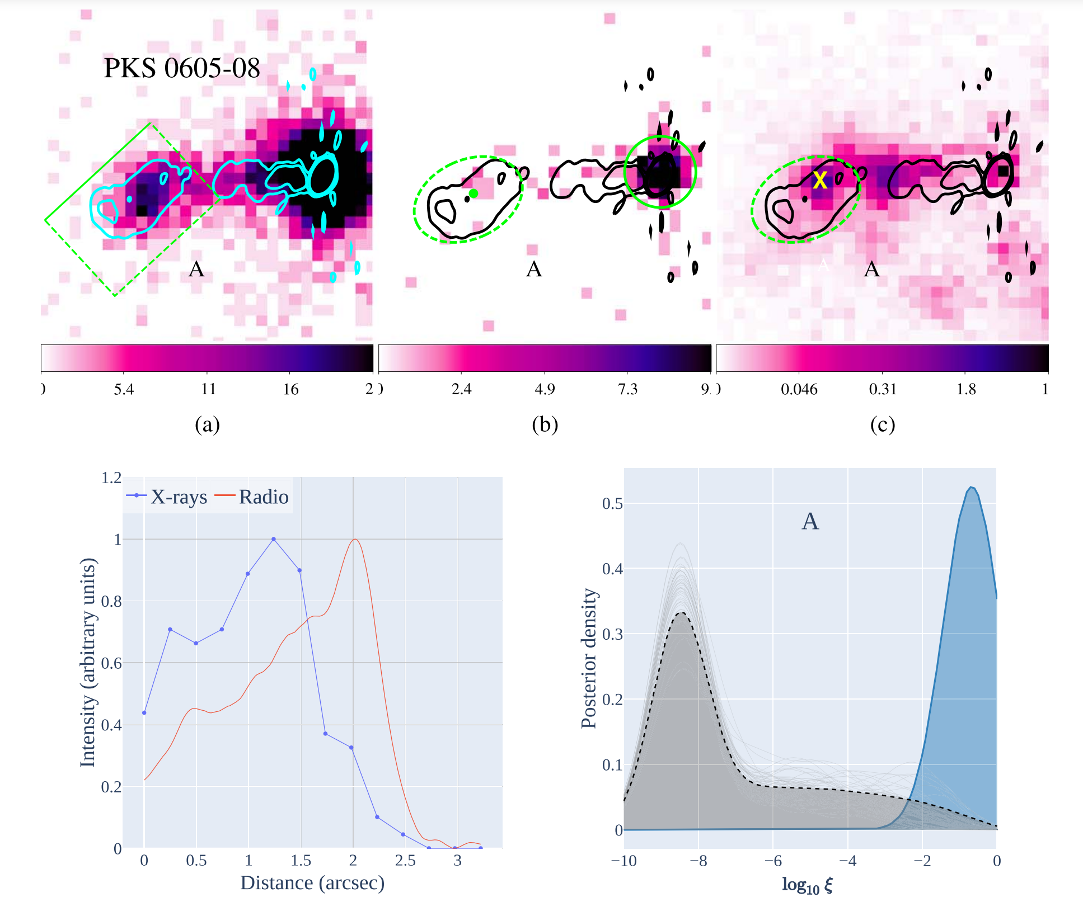
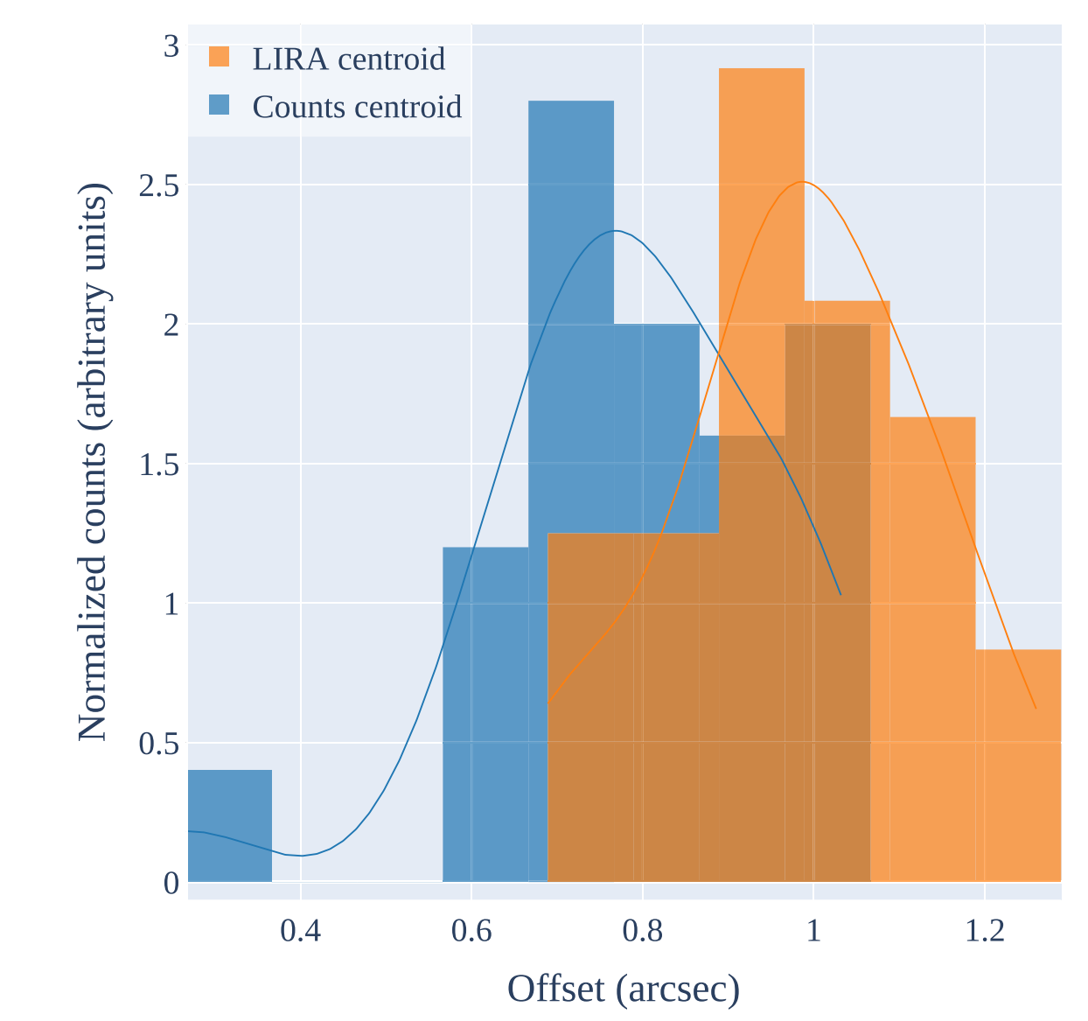
Example offset
(Reddy et al. 2021, ApJS 253 37)

Slide 14
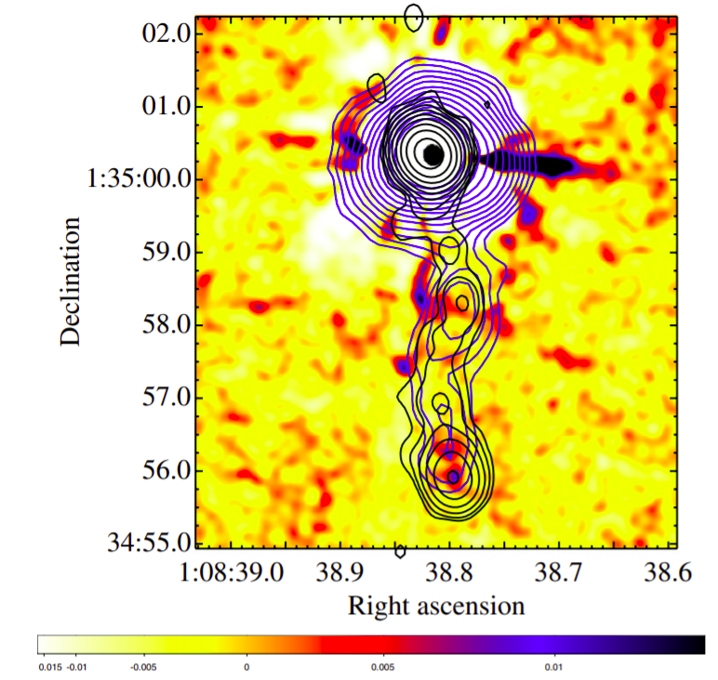
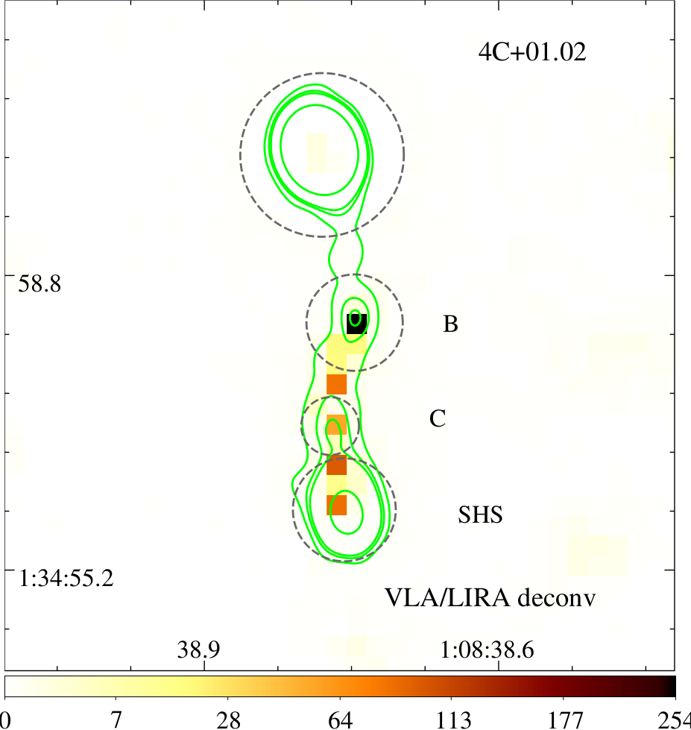
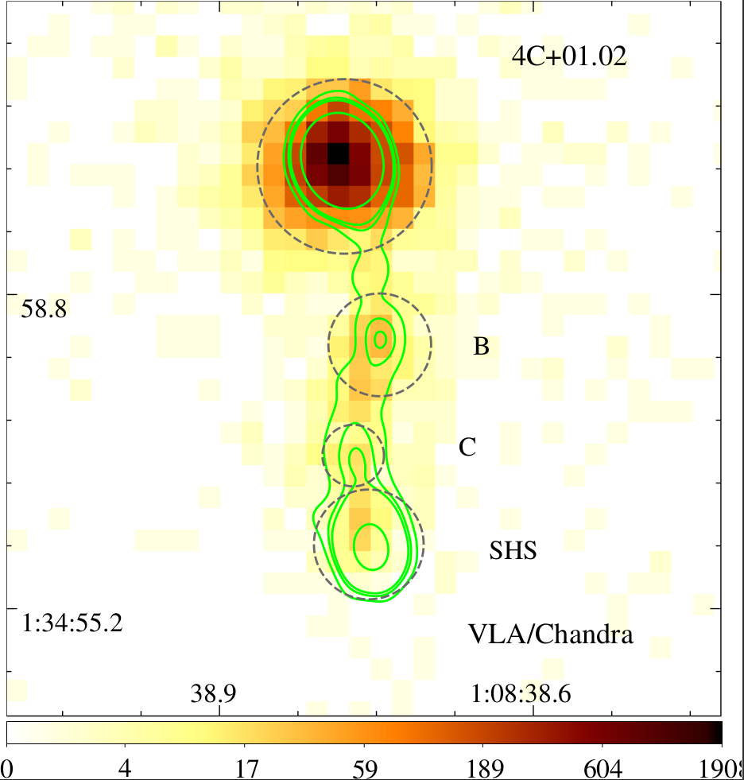
Measuring the offsets
High-count regime
Kharb et al. 2012
Notes:
--Offsets are Straightforward to measure—compare longitudinal brightness profiles—jets may not be straight—centroid differences—good SNR is not guaranteed
--Hence deconvolution with LIRA—offers a distribution of offsets
--Deconvolution reveals a knotty structure in this particular image—SHS has a double peak structure previously only seen in HST images.

Slide 15
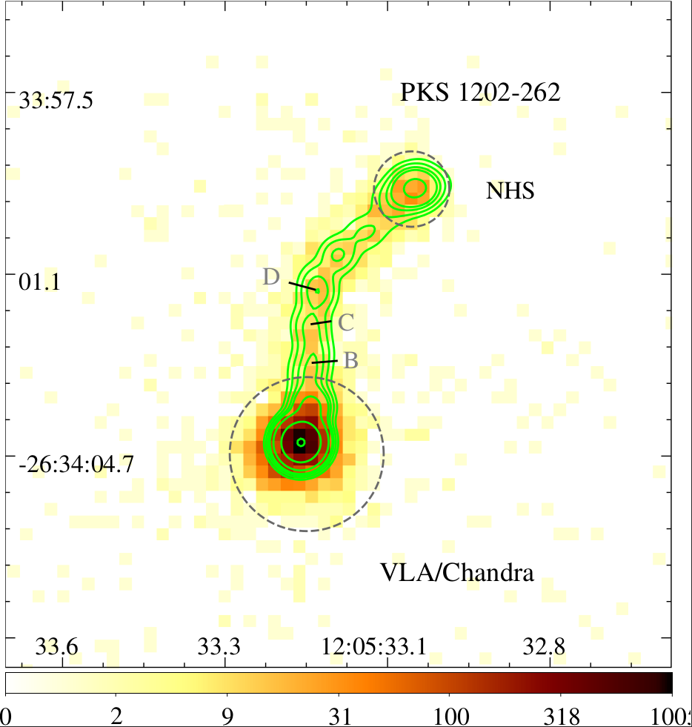
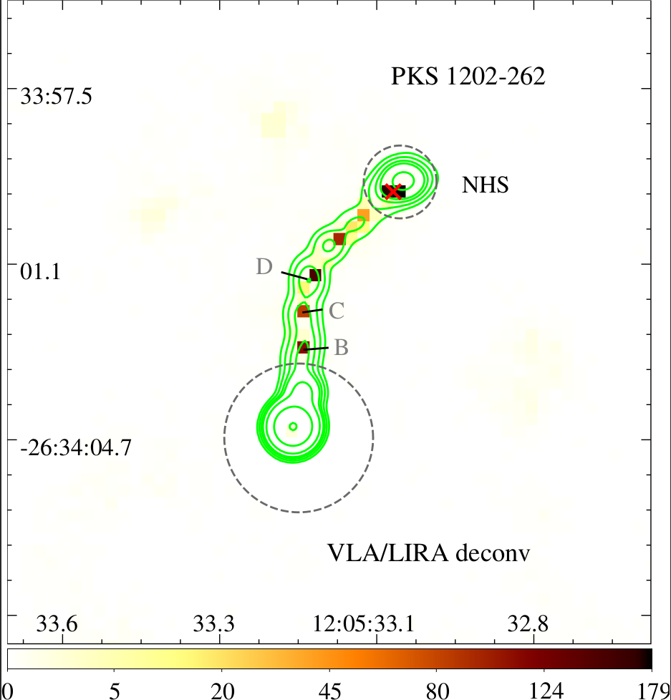
Measuring the offsets
High-count regime
Notes:
-Deconvolution also reveals a knotty strtcutre that is otherwise impossible to infer from longitudinal brightness profiles.

Slide 16
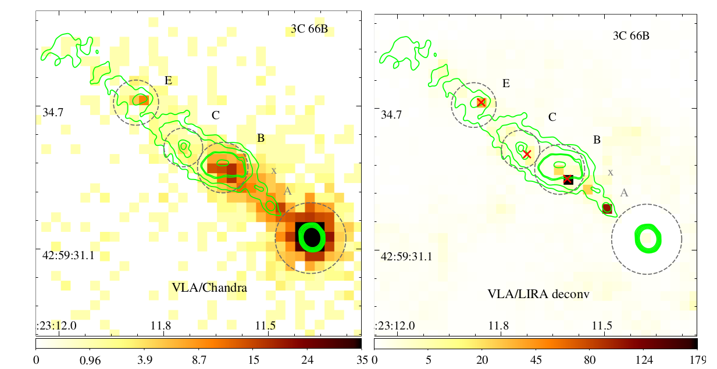
Measuring the offsets
High-count regime
Notes:
-Deconvolution also reveals a knotty strtcutre that is otherwise impossible to infer from longitudinal brightness profiles.

Slide 17
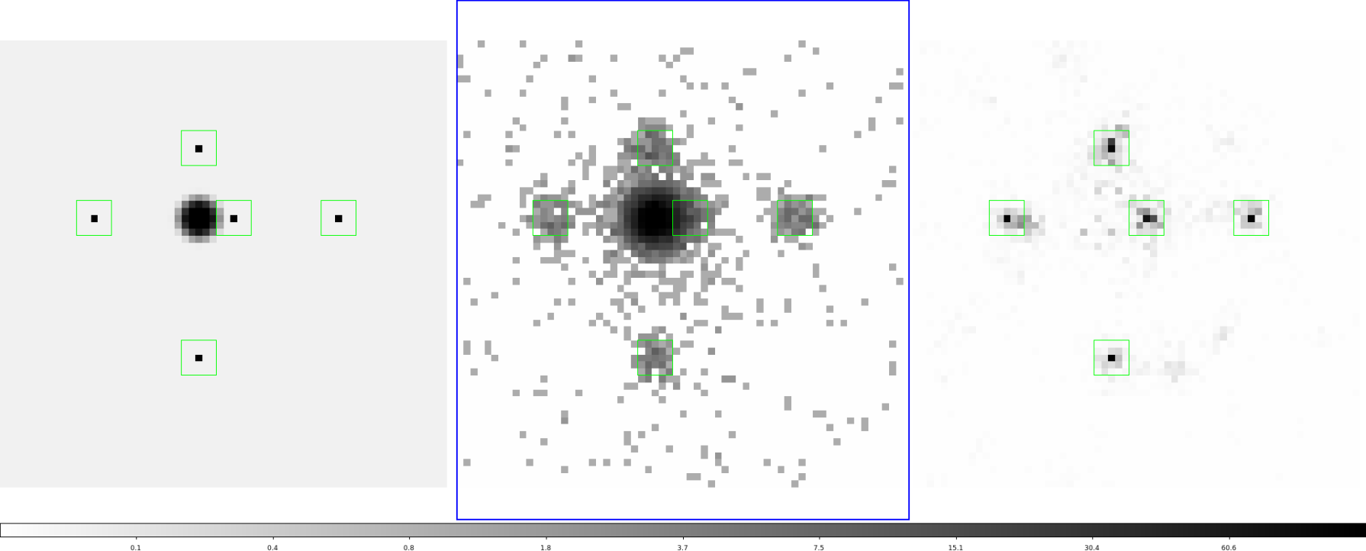
Systematic uncertainties
Deconvolving simulated images
Notes:
--Half of the knots show offsets while half doesn't
--The Co-s-type knots may also have offsets—but distance and projection effetcs are reducing them

Slide 18
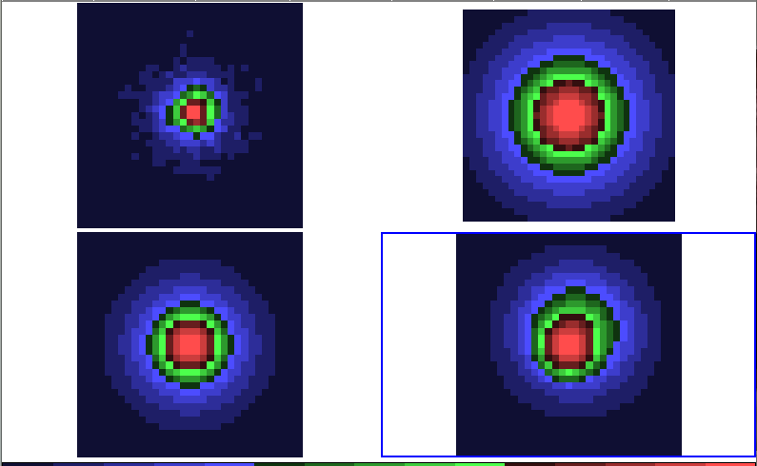
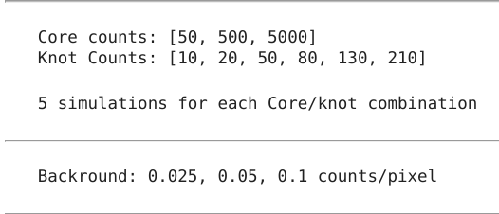
Systematic uncertainties
Deconvolving simulated images
Notes:
--Half of the knots show offsets while half doesn't
--The Co-s-type knots may also have offsets—but distance and projection effetcs are reducing them

Slide 19
Systematic uncertainties
Deconvolving simulated images
Core: 5000 counts
Knots : 130 counts ea.
Notes:
--Half of the knots show offsets while half doesn't
--The Co-s-type knots may also have offsets—but distance and projection effetcs are reducing them

Slide 20
Systematic uncertainties
Deconvolving simulated images
Notes:
--Half of the knots show offsets while half doesn't
--The Co-s-type knots may also have offsets—but distance and projection effetcs are reducing them

Slide 21
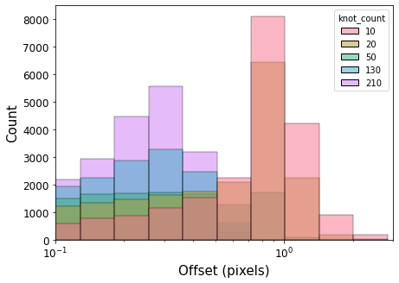
Systematic uncertainties
Deconvolving simulated images
Notes:
--Half of the knots show offsets while half doesn't
--The Co-s-type knots may also have offsets—but distance and projection effetcs are reducing them

Slide 22
Offset Statistics
Similar number of knots with and without offsets
Notes:
--Half of the knots show offsets while half doesn't
--The Co-s-type knots may also have offsets—but distance and projection effetcs are reducing them

Slide 23
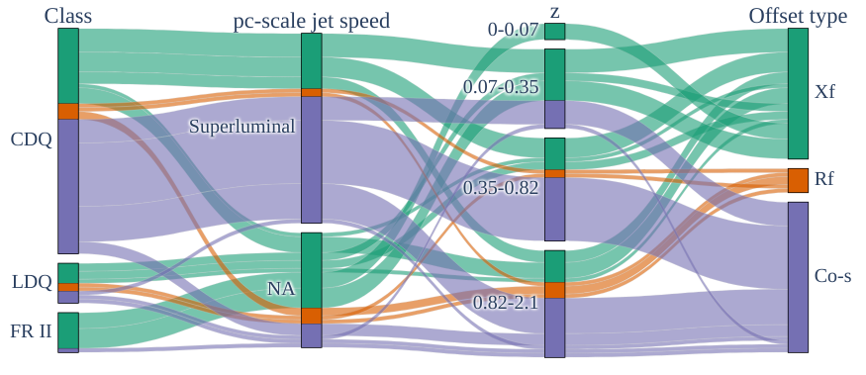
Offset Statistics
Do Co-spatial knots have intrinsic offsets?
No differences in the X-ray/radio flux ratios or spectral indices
Categorical parallel-coordinates plot-
Notes:
--majority of the co-s offsets are from CDQ knots—they are closely aligned as indicated by their parsec scale jet speeds—and are also at a high redshift.
--Tests for difference between Xf-type and Co-s-type knots reveal no difference.
--That means all knots probably have offsets!

Slide 24
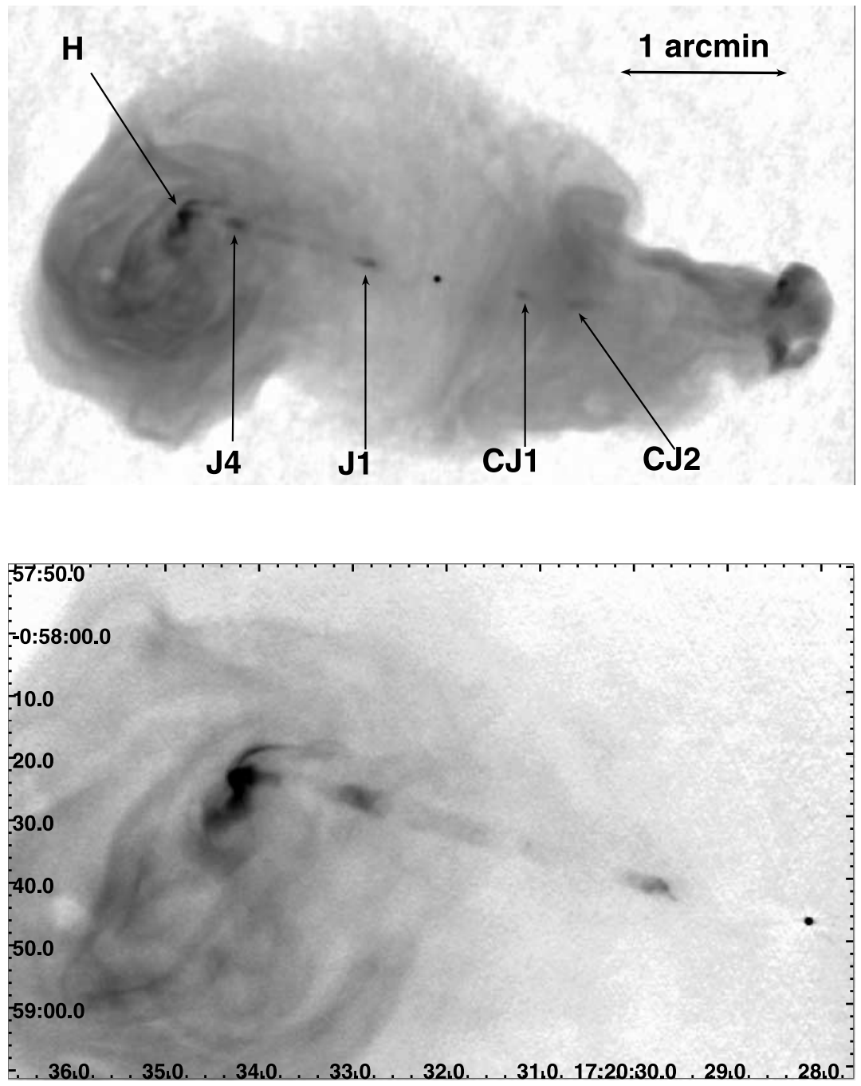
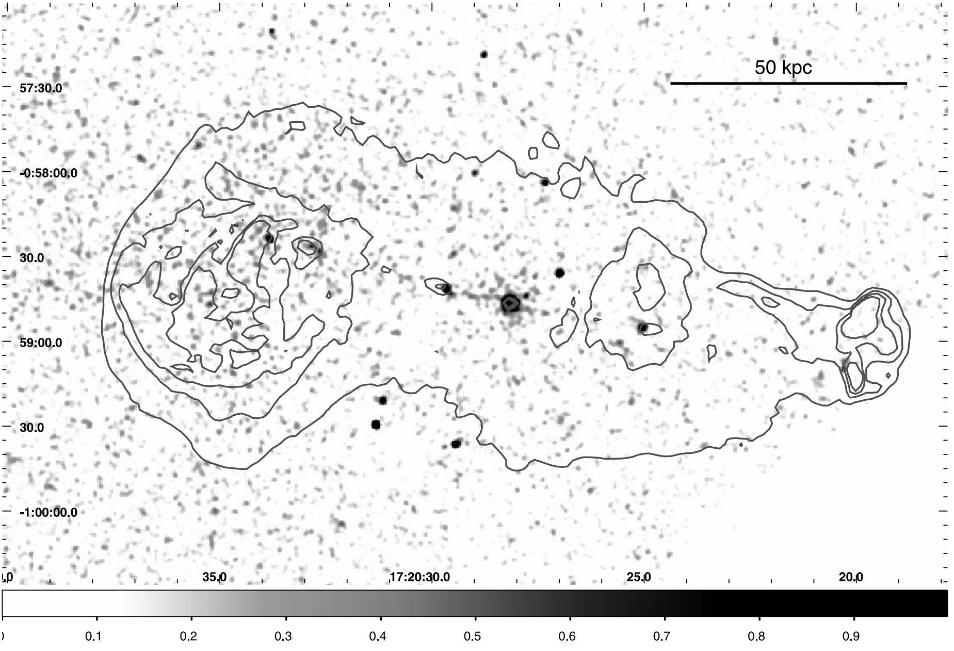
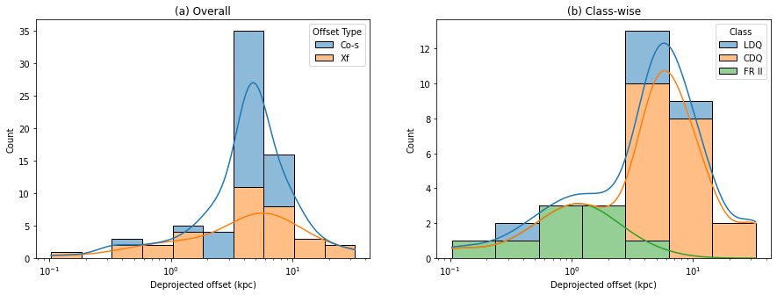
Offset Statistics
De-projected offsets are similar to low-redshift knot-sizes
Notes:
--Spectral class based schema for angles to deproject the offsets
--Larger offsets in CDQs and LDQs compared to FR II—revisit this in a moment
--Nearby radio knots are resolved at least along the jet and appear extended. While almost no such extension is seen in the X-ray maps-—indicating a compact emission region for the X-rays while much larger regions for the radio
--Offsets similar to the sizes of knots irrespective of whether the knots are resolved or not—That means all knots have similar structures and are probably produced by the same process.

Slide 25
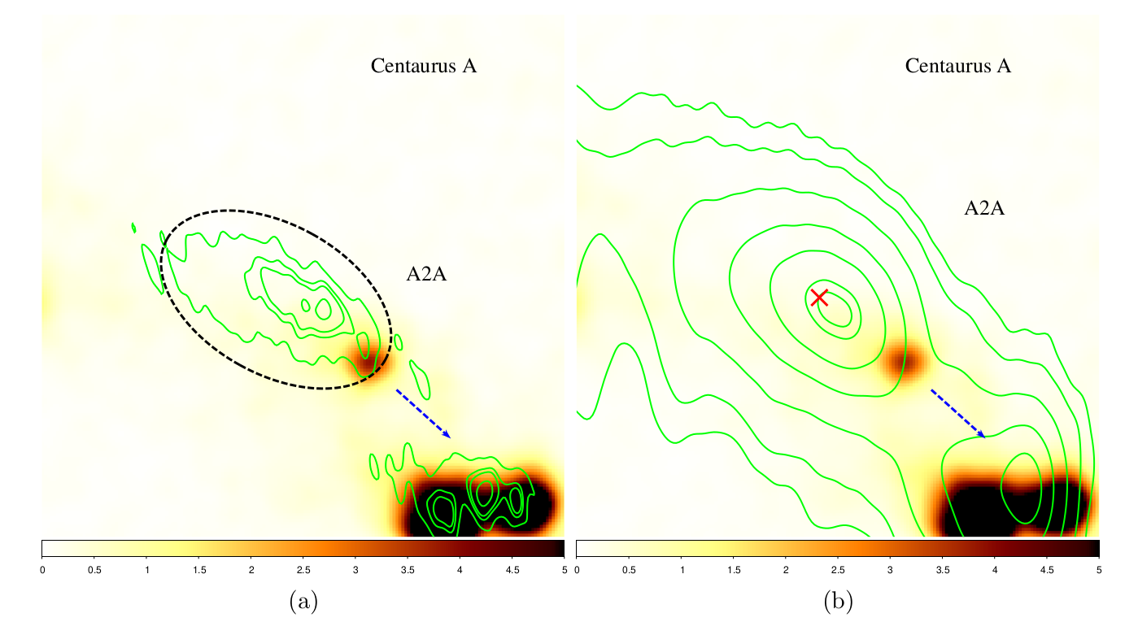
Offset Statistics
De-projected offsets are similar to knot-sizes at low-redshift
Knot A2A in Centaurus A. 8.4 GHz radio images overlaid on Chandra X-ray images
Notes:
--Example knot from Centaurus A—8 GHz radio contours are overlaid on the X-ray image.
--Knots when unresolved, create an offset whose magnitude sets a lower-limit on the knot size. Hence similar offsets would indicate similar structures.
--The X-ray emitting electrons in IC/CMB have much larger lifetimes compared to their GHz emitting counterparts—But compact X-ray and extended radio morphologies are a problem for IC/CMB mode
--But structure can be easily explained by synchrotron as the X-ray emitting electrons have much shorter lifetimes. Now what is producing this structure?

Slide 26
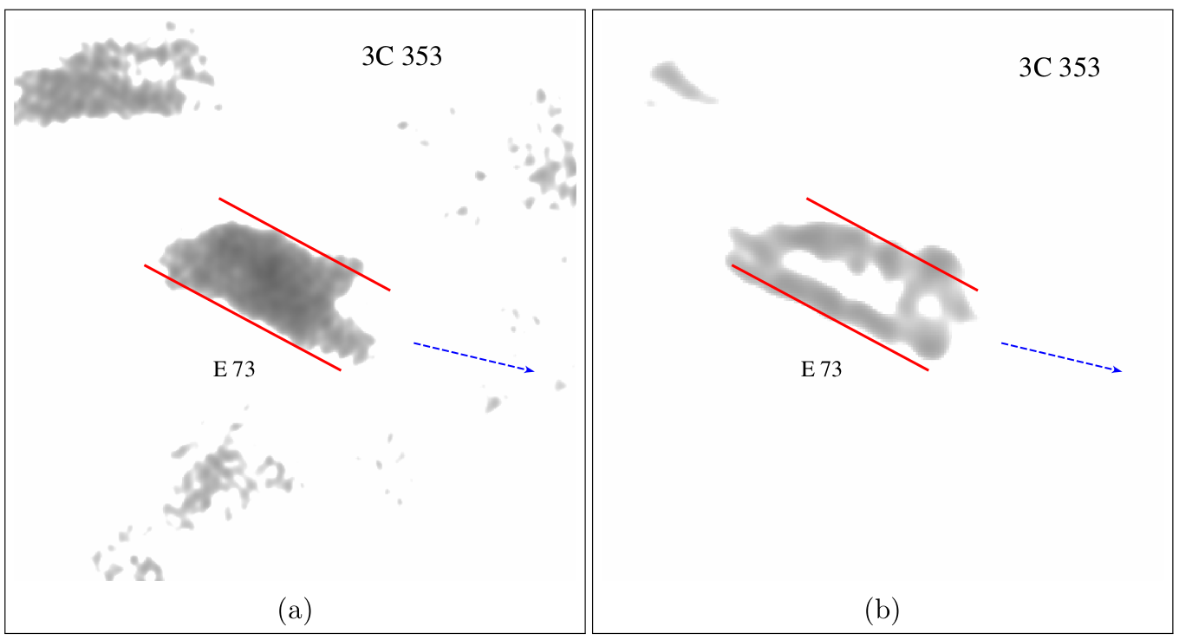
Structure of a knot
Is it a heavier slow-moving obstacle embedded in a lighter faster jet flow?
Moving knots:
Stawarz et al. (2004)
Clarke et al (1992)
Bridle et al (1986, 1989)
.
.
.
Kataoka et al (2008)
3C 353; 4.8 GHz radio images
Notes:
--Based on the frequency-dependent profiles of knots and their near periodic spacing, several authors suggested that these knots are separate moving portions of the jet produced by intermittent activity in the central engine.
--Based on these suggestions Kataoka et al explained these knots as heavier blobs with the upstream shock producing synchrotron electrons.
--But it cannot explain the why the magnetic inferred from radio images are parallel to the jet.
--A slight modification would be the energized electrons cool while flowing around the obstacle forming a shear layer or they diffuse into an actual shear layer.
--Explains Xf-tye offsets, extended radio regions, compact X-ray regions, radio emission coming from a shear layer and hence a parallel B-field
--If a forward shock is produced, it can, in principle, produce optical emission—in an ongoing project in our group we are currently finding that even the radio optical emission requires two spectral components—turn over at ALMA frequencies!

Slide 27


Offset Statistics
De-projected offsets are similar to low-redshift knot-sizes atedshift
$$d_{deproj=}\frac{d_{proj}}{δ×sin{θ}} (where δ=\frac{\sqrt{1−β^{2}}}{1−β\cos{θ}})$$
For moving knots:
$Γ<3$ (3C 273, Meyer et al 2016)
Notes:
--If the knots are moving, the de-projected values are over-estimated by a factor of delta.
--HST proper motions of knots in a nearby jet indicate gamma<3
--use this gamma to re-estimate the de-projected offsets

Slide 28
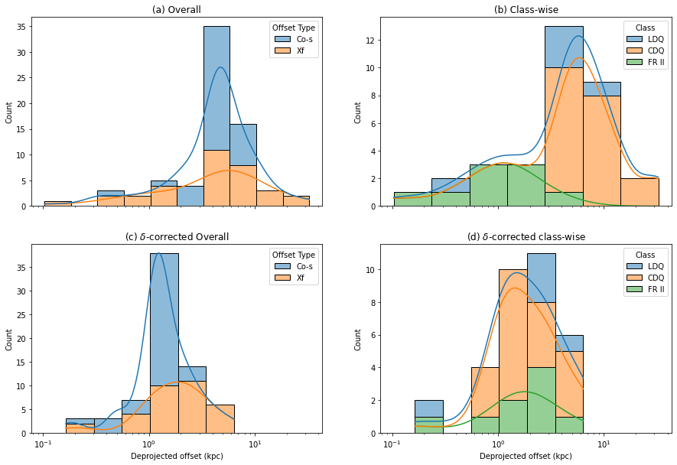
Offset Statistics
De-projected offsets are similar to knot-sizes at low-redshift
Notes:
--delta corrected offsets indicates values which are better estimates for lower-limit on knot sizes
--if knots are produced by intermittent activity, the distances between them would indicate a certain time scale.

Slide 29
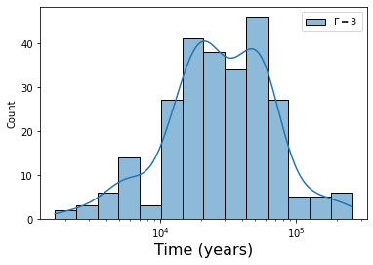
Production of knots
Could they be produced my intermittent activity in the central engine?
T~3 x 10⁴ yrs
Intermittent activity time scales: T> 10⁵ yrs
Reynolds & Begelman (1997)
Siemiginowska & Elvis (1997)
Notes:
The measured time period is slightly smaller than the estimated time scales of intermittent activity ~10^5 years--Perhaps the angles are underestimated

Slide 30
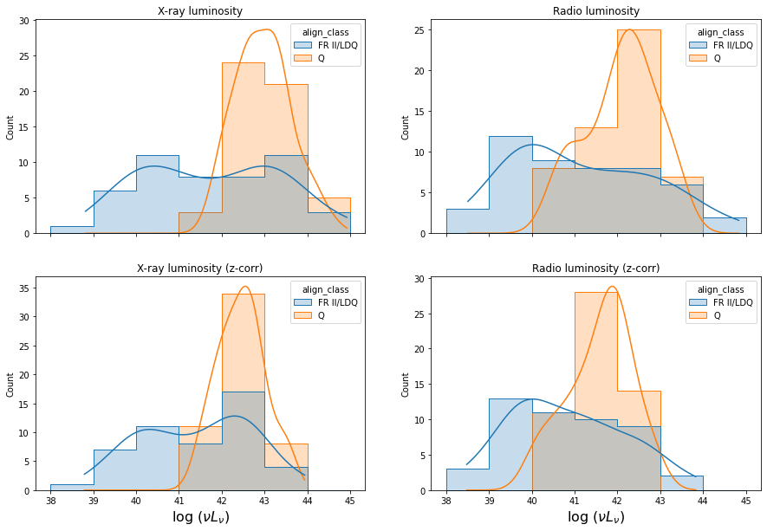
X-ray and Radio luminosities
No evidence for a faster spine and a slower sheath
Notes:
--In a few contexts, a faster spine and a slower sheath has been suggested to provide different speeds for X-ray and radio emitting plasmas
--If such a difference exists it may manifest itself in differences between luminosity distributions for aligned and misaligned sources. The radio and X-ray distributions only show small differences.
--Intrinsic scatter in the luminosities can reduce any observable effect

Slide 31
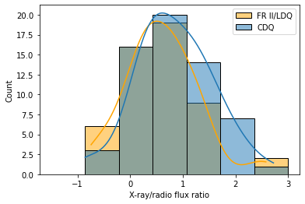
X-ray/Radio Flux Ratios
No difference between aligned and mis-aligned jets
Beaming for small angles
IC/CMB >> Synchrotron
But statistical power too low to conclude!
Notes:
--Another way to test for IC/CMB is to look at flux ratio distributions
--Expect differences between aligned and misaligned sources due to differences in beaming patterns
--nothing found so far

Slide 32
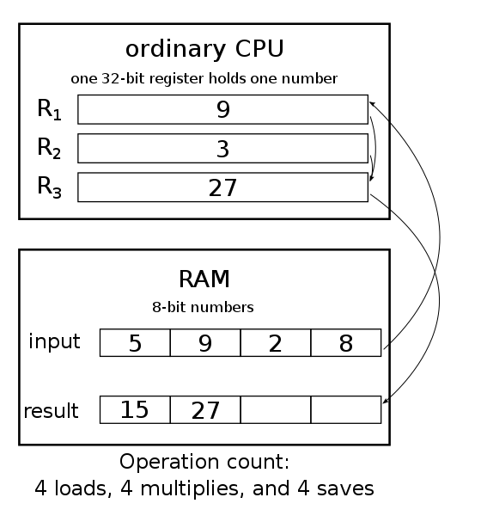
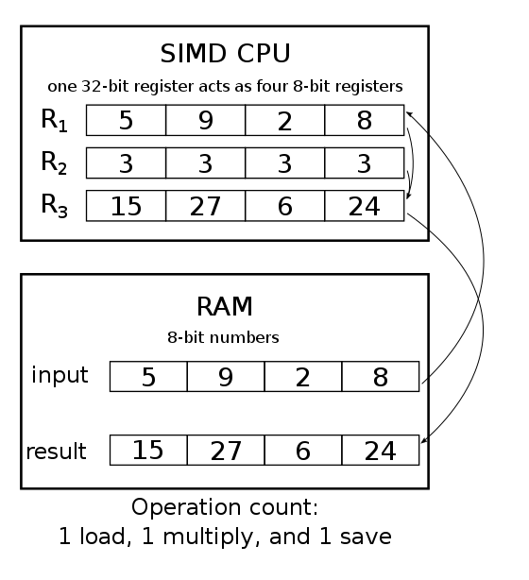
Optimizing LIRA code
Single Instruction Multiple Data (SIMD)
3-4x faster
github: pylira_simd
Notes:
--Half of the knots show offsets while half doesn't
--The Co-s-type knots may also have offsets—but distance and projection effetcs are reducing them

Slide 33
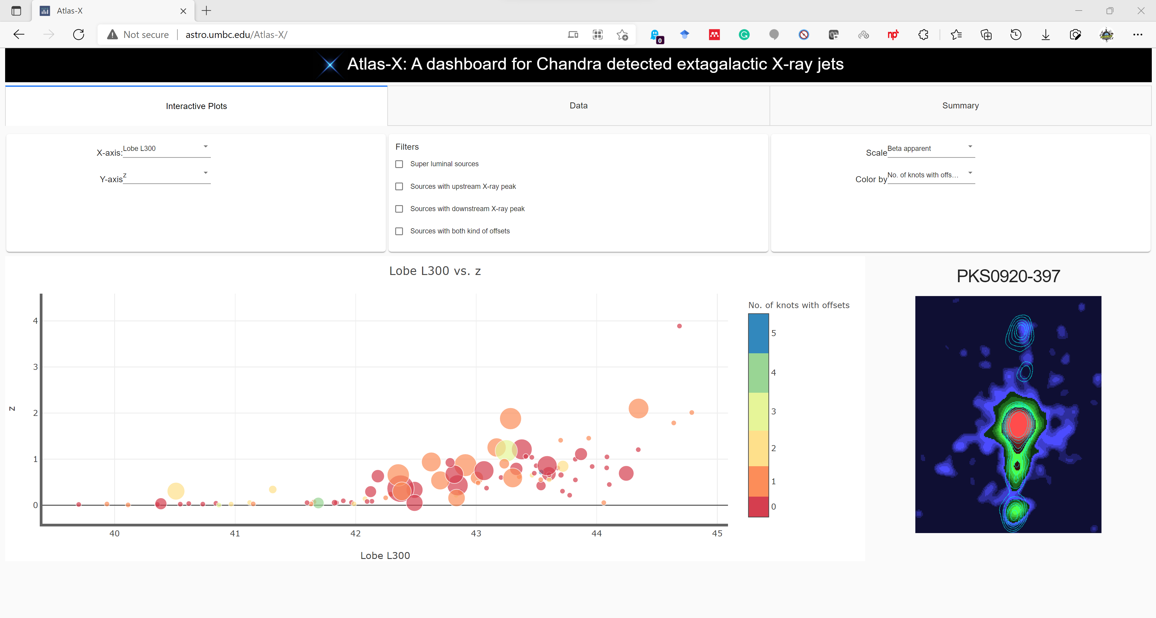
Dashboard for X-ray jets: Atlas-X
http://astro.umbc.edu/Atlas-X
Notes:
--Half of the knots show offsets while half doesn't
--The Co-s-type knots may also have offsets—but distance and projection effetcs are reducing them

Slide 34
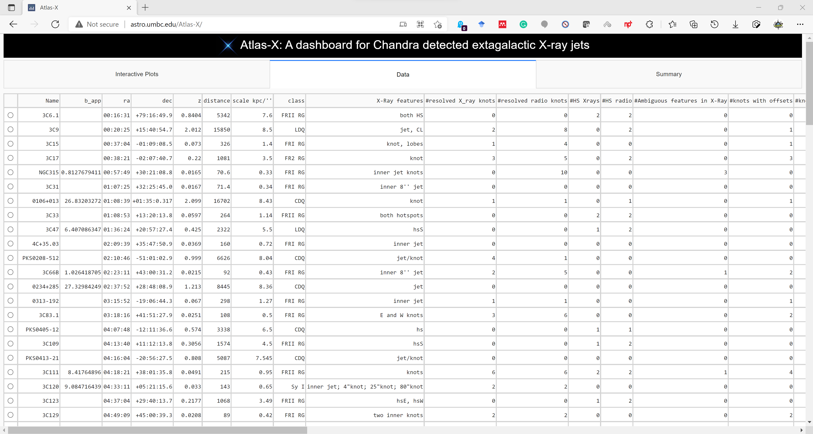
Dashboard for X-ray jets: Atlas-X
Notes:
--Half of the knots show offsets while half doesn't
--The Co-s-type knots may also have offsets—but distance and projection effetcs are reducing them

Slide 35
Summary
Several knots have offsets, and probably all, if they could be measured.
The offsets question the applicability of one-zone models.
Similarity of offsets suggests a similar structure, presumably produced by the same mechanism.
No statistically significant evidence for one-zone IC/CMB in the current data.
Konts in large scale jets could be produced by moving obstacles in the jet flow.

