Slide 1

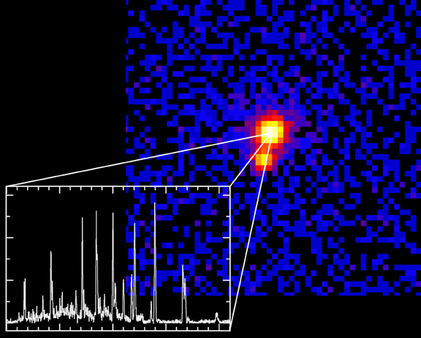
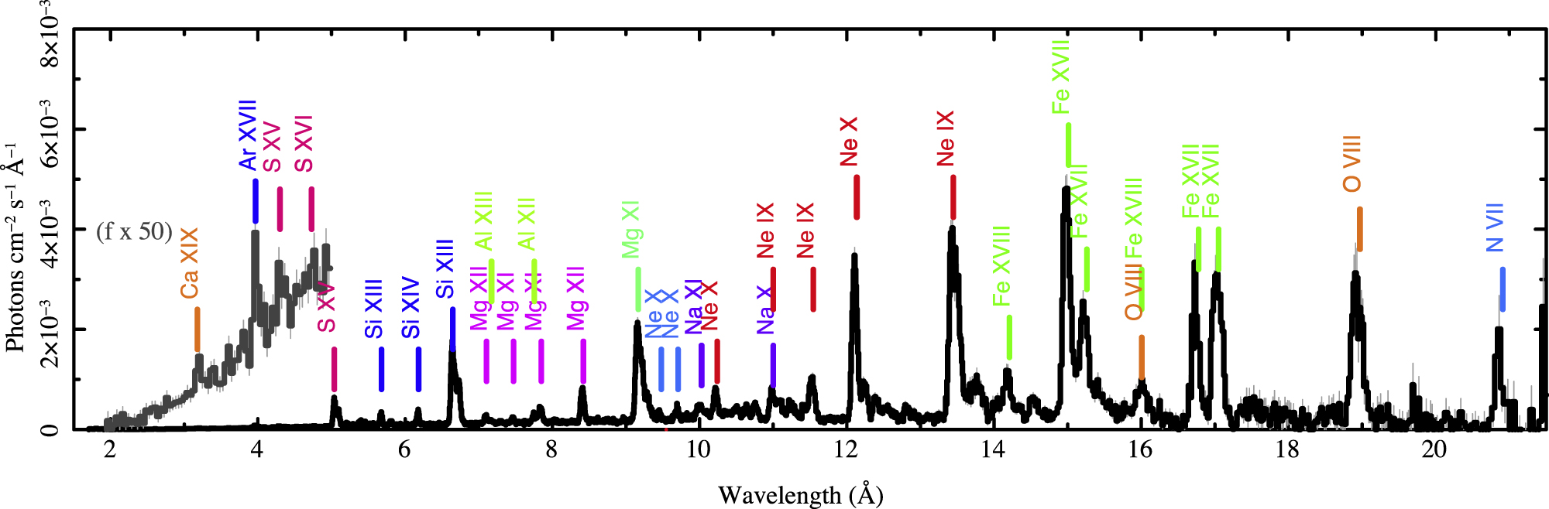
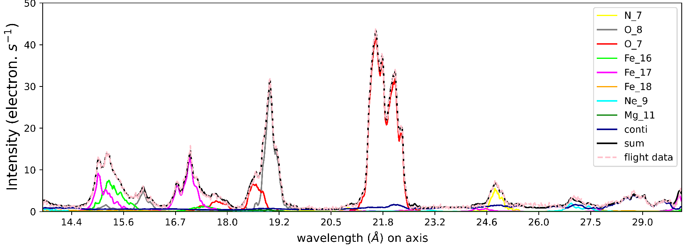
Unfolding Spectroheliogram
MaGIXS*
P. S. Athiray, Amy Winebarger, MaGIXS team
University of Alabama in Huntsville
NASA MSFC
Chandra (O-type supergiant)
MaGIXS (Solar coronal structures)
O VII
OVIII, VII
Fe XVII, VIII
N VII
Ne IX
Nichols et al 2021
Savage et al 2023
*The Marshall Grazing Incidence X-ray Spectrometer – First Working Slitless Solar X-ray Imaging Spectrometer
Notes:
Add an image of sun and chandra

Slide 2
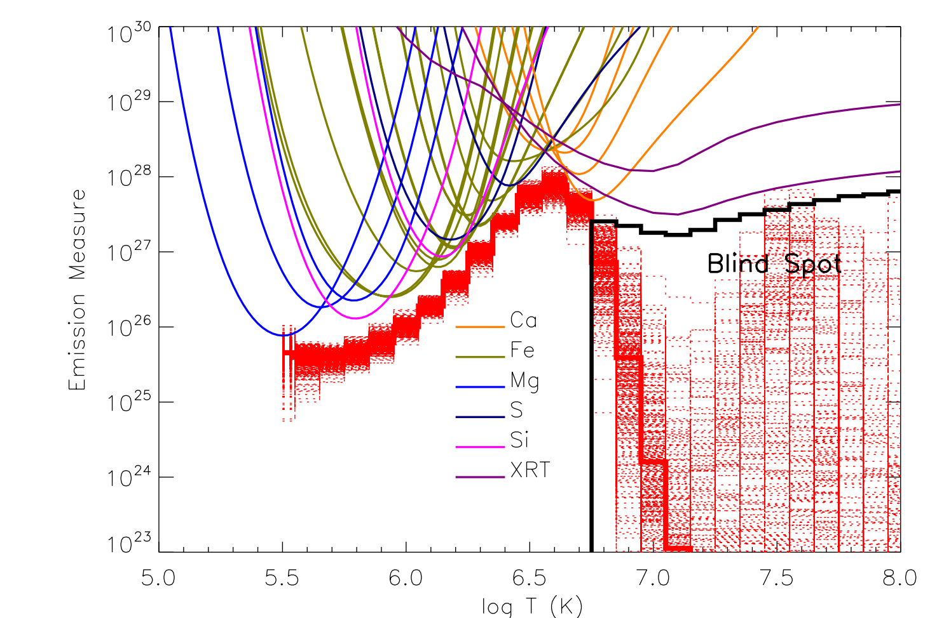
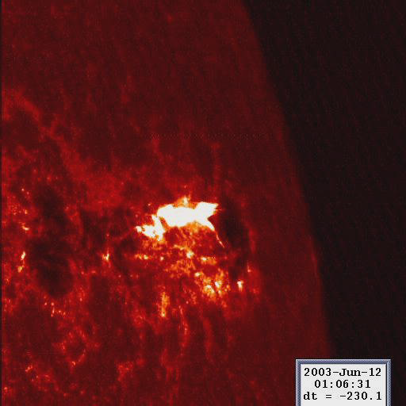
Objective
Observable
Characteristics of plasma heating in the solar corona
Emission Measure Distribution (EMD)
Y-pixel
Plasma Diagnostics – Holy Grail Data
Temperature, Density, Abundance, Emission Measure, Thermal/Ionization Equilibrium
X-pixel

Slide 3
Culhane & Acton, 1974 “The Solar X-ray Spectrum”, ARAA, 12, 359
“... it is usually impossible to provide a single instrument with an acceptable combination of spatial, spectral, and time resolution to study flare events ...”
Is this still true? How to overcome?

Slide 4
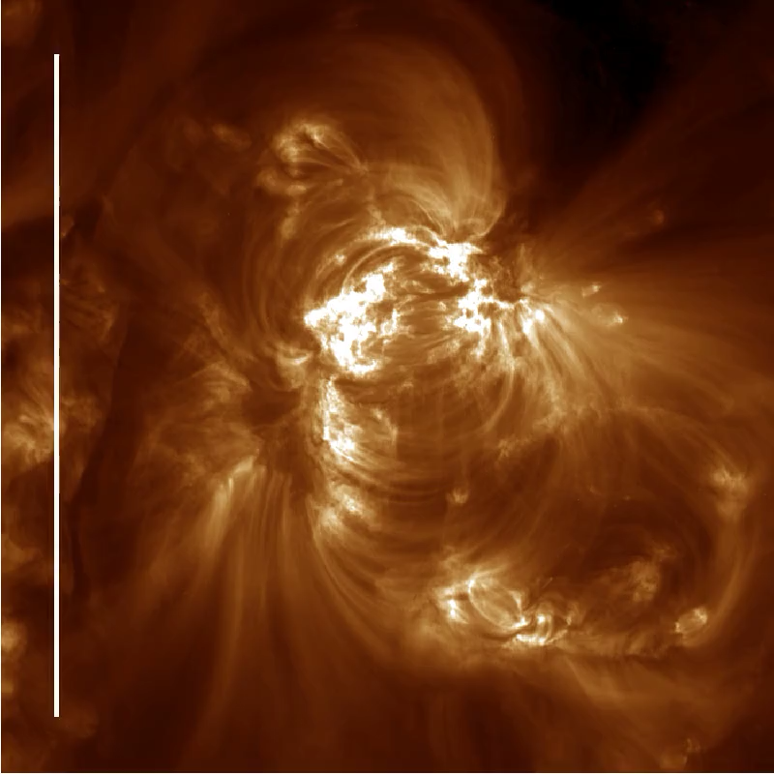
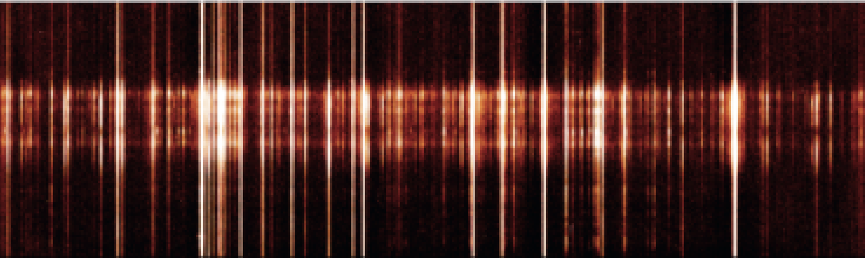
Slit imaging spectroscopy
Diffraction (prism, grating…)
Wavelength
Notes:
Now if we remove the slit, here is what we get:

Slide 5
Slitless imaging spectroscopy
Diffraction (prism, grating…)
Notes:
The full extended source is now dispersed and it is now a bit harder to tell the origin of a photon that hit the detector, especially on the overlapping regions.

Slide 6
Diffraction (prism, grating…)
SPECTRALLY PURE IMAGES
Notes:
The role of the inversion is precisely to unfold that spectroheliogram by creating spectrally pure image from every emission line.

Slide 7

Slit → Slitless imaging spectroscopy
Each detector pixel contains a linear combination of line intensities from several ions from different points on the Sun
Line intensity (Ph/pix) from a point on the Sun can be directly read off from detector pixels
Off–axis - 1
On–axis
p0 | p1 | p2
Off–axis + 1
Detector Pixels
Goal : Precisely determine the number of photons in every pixel from all observed emission lines

Slide 8
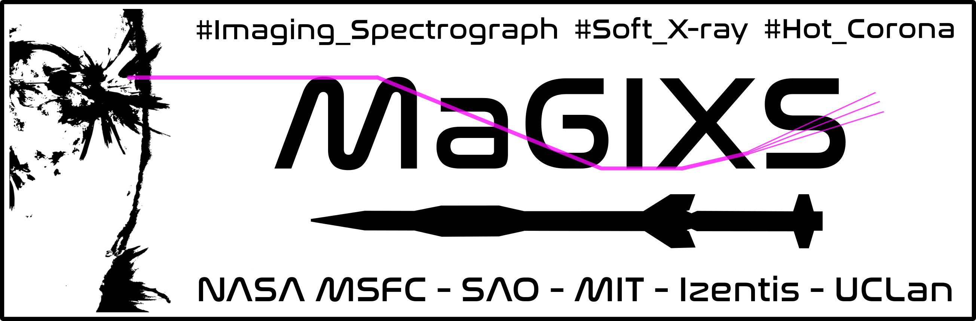
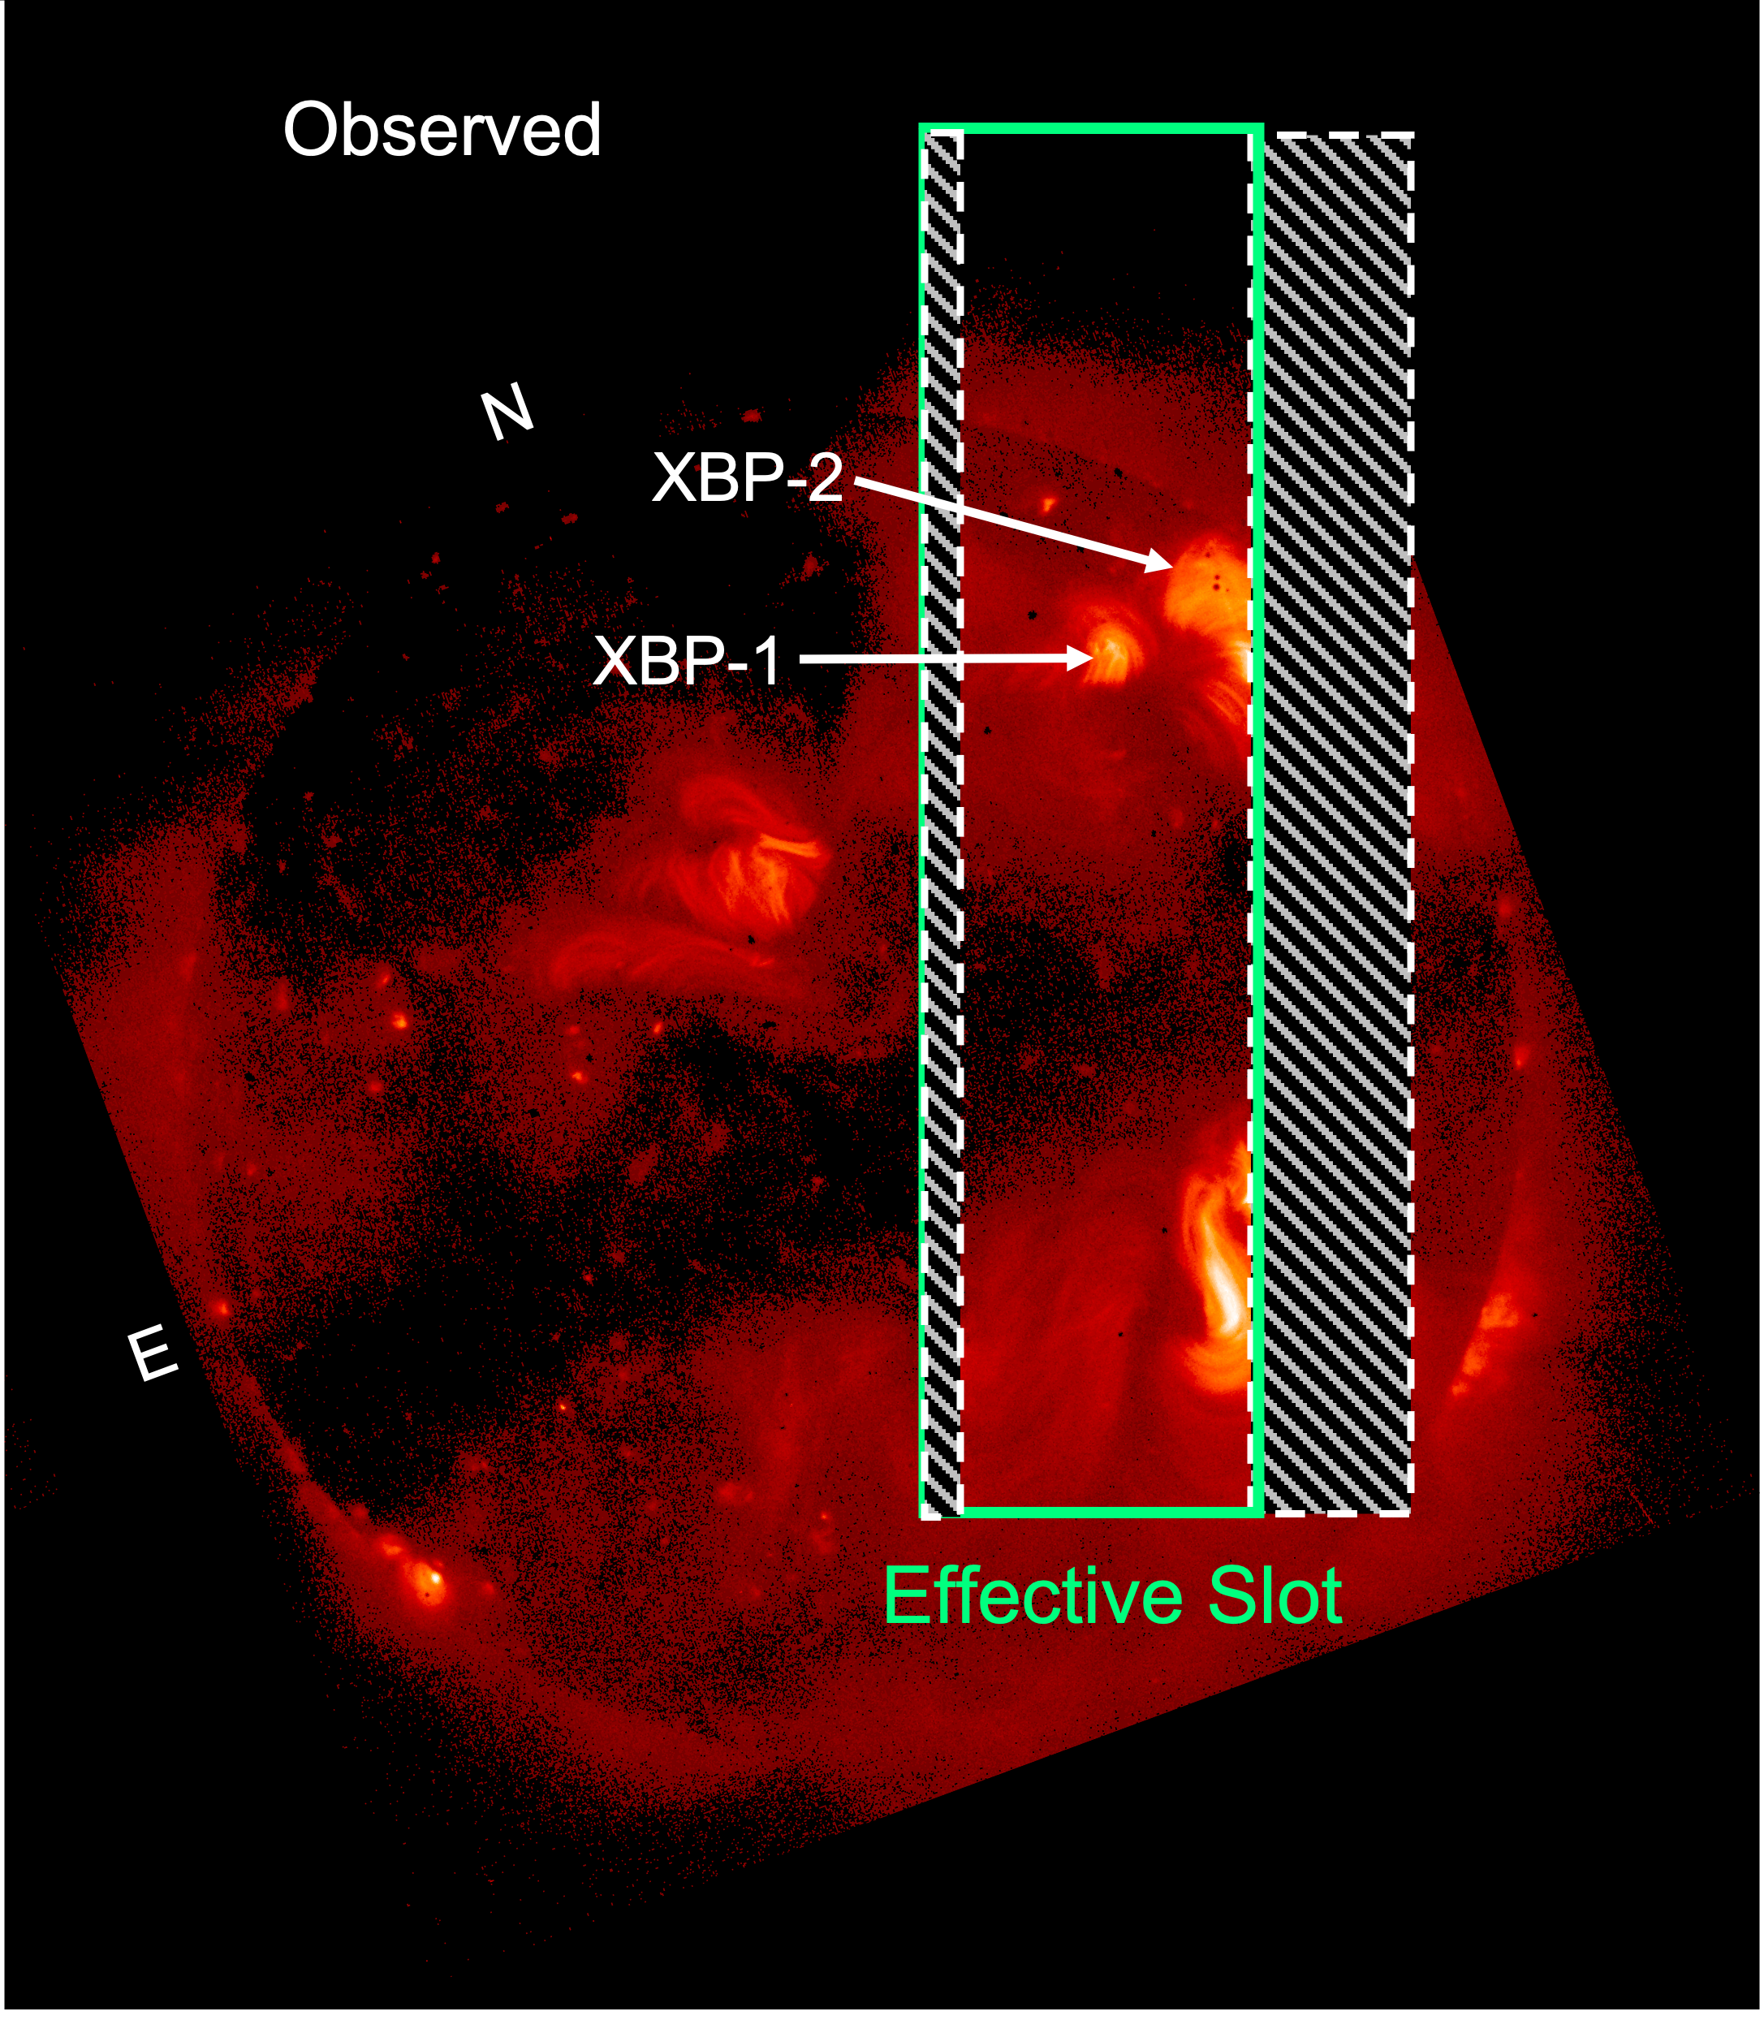
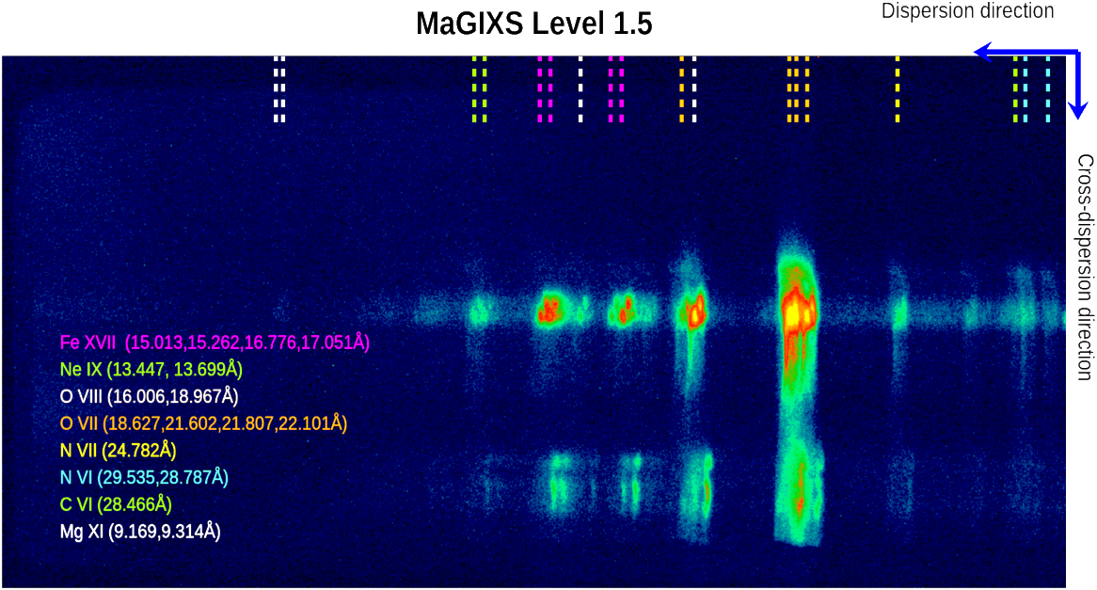
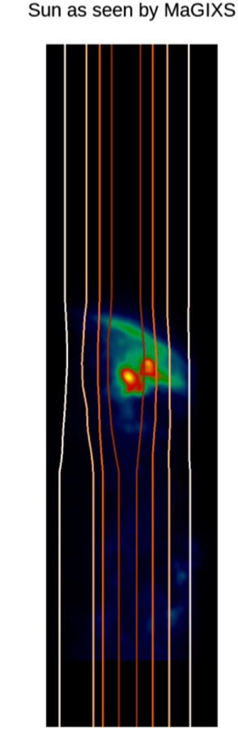
MaGIXS
MaGIXS data are ”overlappograms”
Observed several warm emission lines 1 to 5 MK plasma
30 July 2021, ~18:20 UT
~296 s science data
Multiple copies of same ions at different wavelengths offer constraints

Slide 9
Unfolding method
Write a set of linear equations:
Observation = Response Matrix # EM
y = Mx
Response Matrix includes:
  Atomic data – How does the solar plasma radiate?
  Instrument response – How does the instrument measure the radiation?

Slide 10
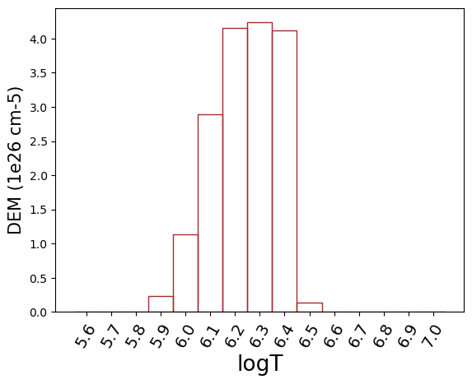
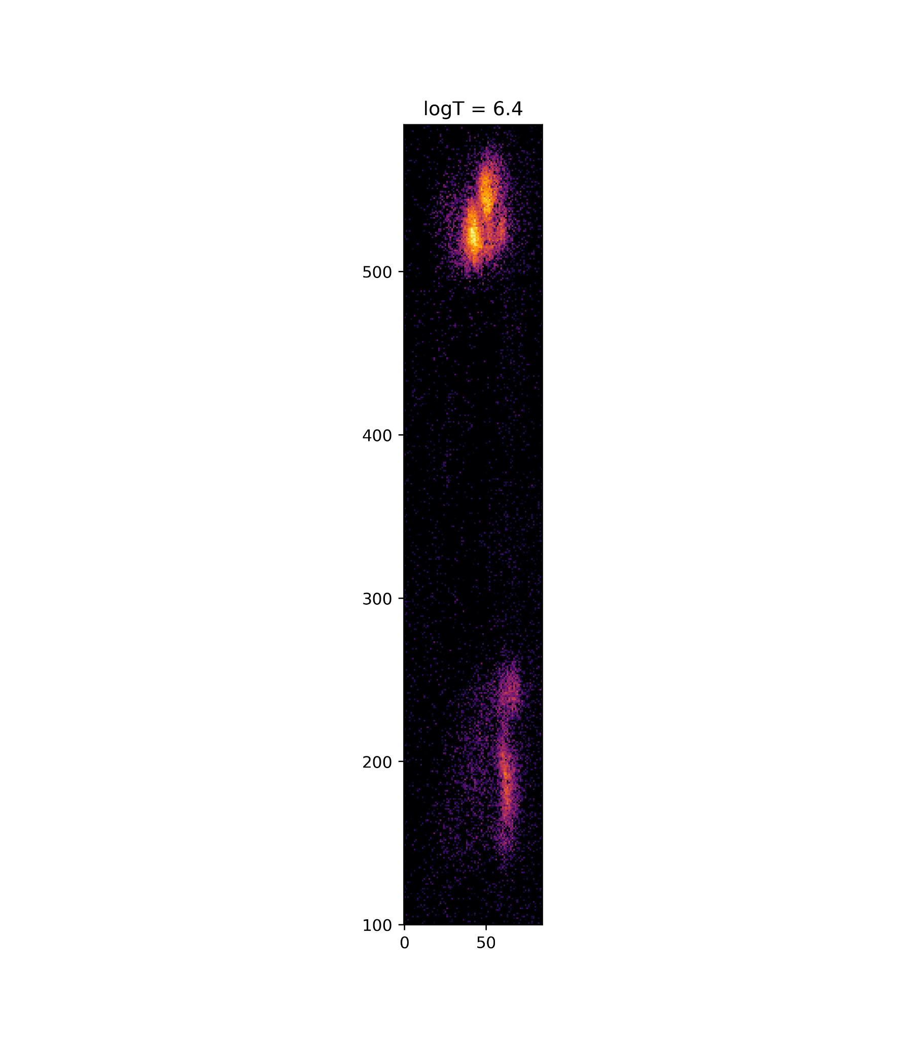
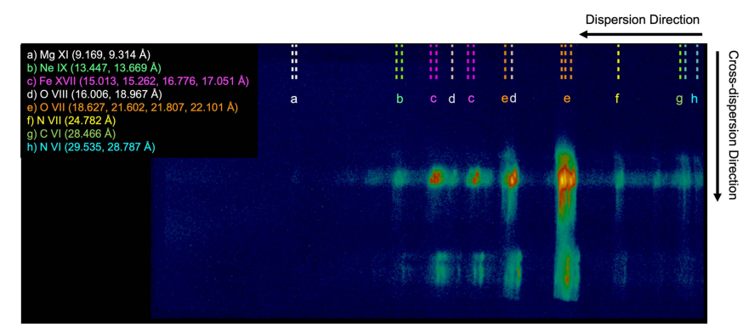
Sun EM: x₀
Observation: y = Mx₀
M
Response matrix
pixel size:
2.8’’
Δθx2.8’’
Notes:
The sun that we observed has a certain emission measure. We can represent that emission measure with a 3D matrix ‘x’. To create that matrix, we slice the field of view into a large amount of pixels (there are more pixels than what I show here). And each of these boxes has a dem distribution. Basically that matrix tells you how much plasma you can find at a given position and a given temperature.
That plasma is going to emit X rays and these X rays will go into the instrument to create the observed data. As Athiray showed you, that process can simply be represented by a simple matrix multiplication equation: y=Mx

Slide 11
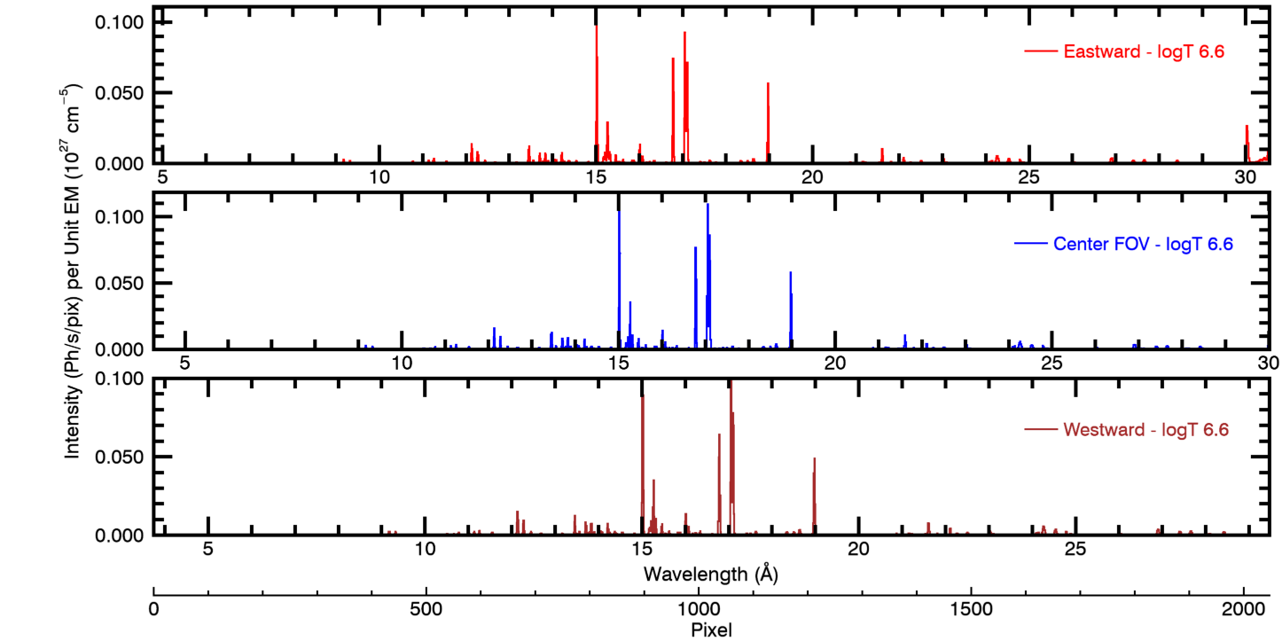
Response Matrix
Atomic data – How does the solar plasma radiate?
Instrument response – How does the instrument measure the radiation?
Function of spectral pixels, spatial field angles, log T bins
Notes:
Remove the plot ion the right..

Slide 12
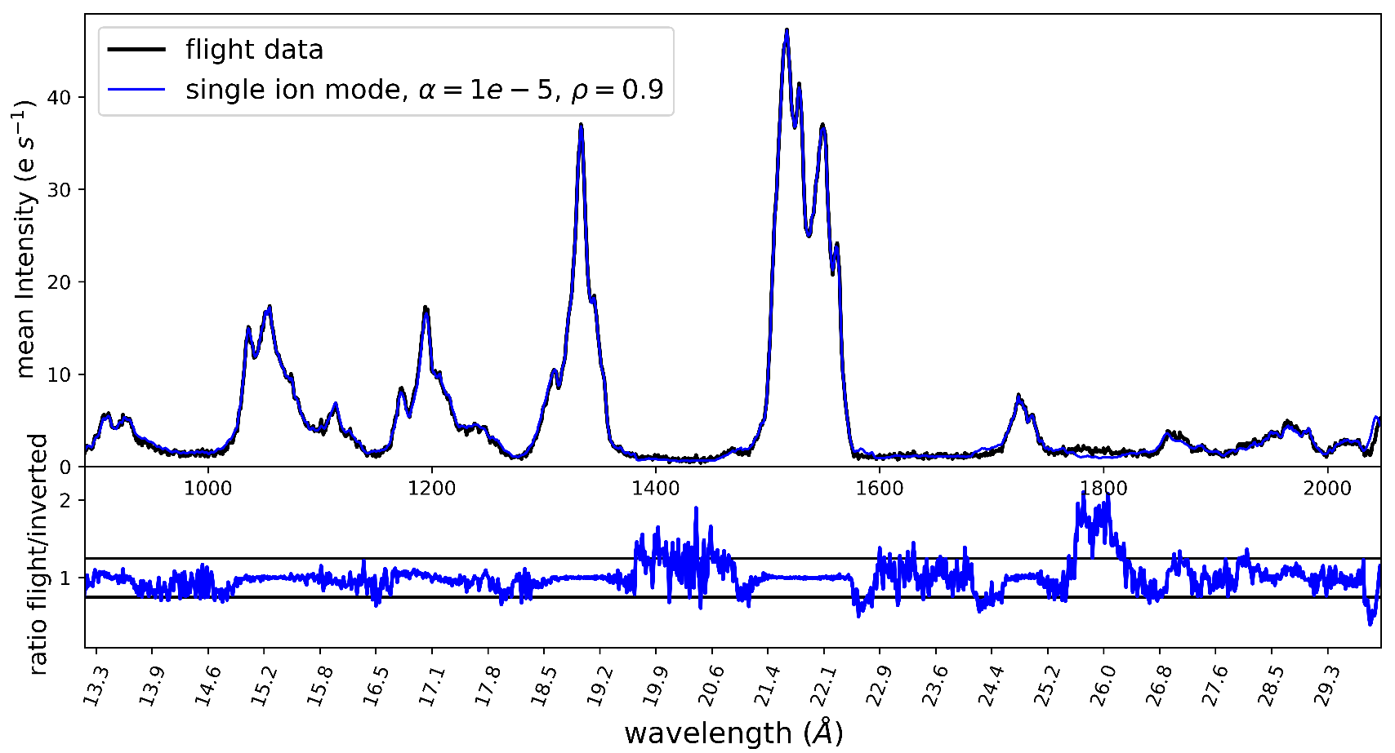
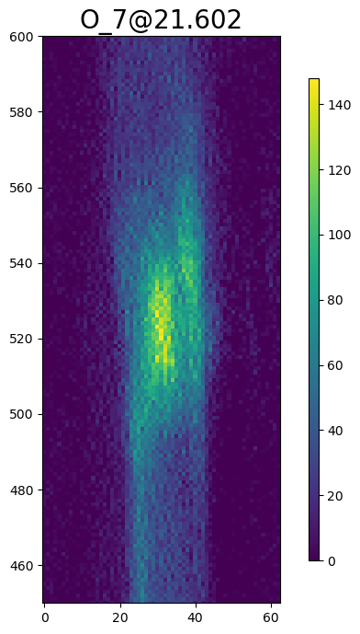
Supervised Machine Learning – Inversion
Flight data ‘y’
Response ‘M’
EM Cube
x# = argmin[ ‖y-Mx‖₂² + αρ‖x‖₁ + 0.5α(1-ρ)‖x‖₂² ]
Solve for x# to match y using the ElasticNet Regularization method
List of elementary spectra allowed by atomic physics convolved with instrument response

Slide 13
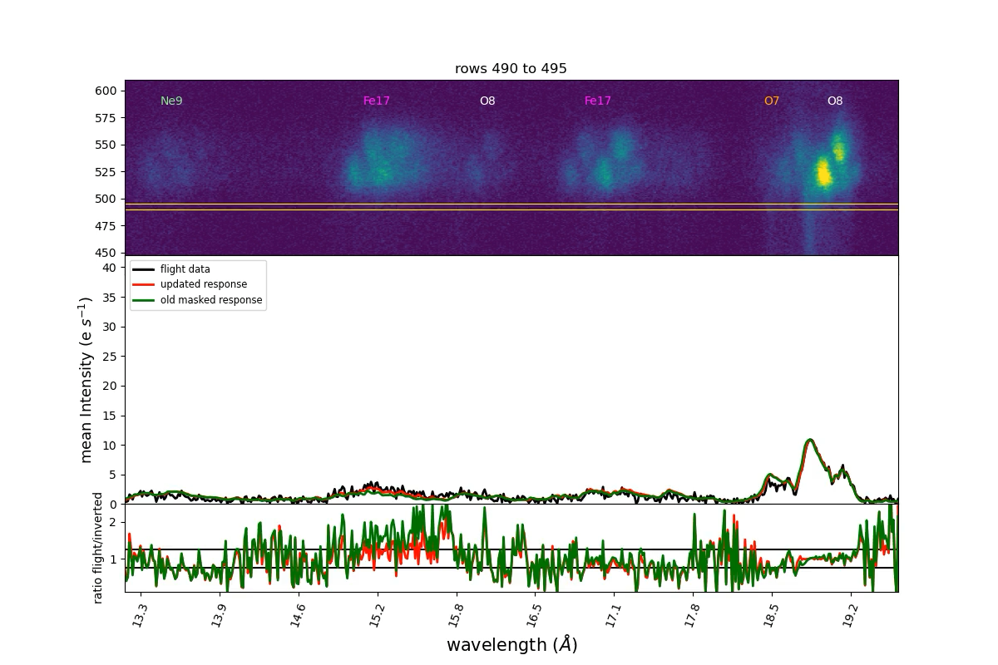

Slide 14
Questions

Slide 16

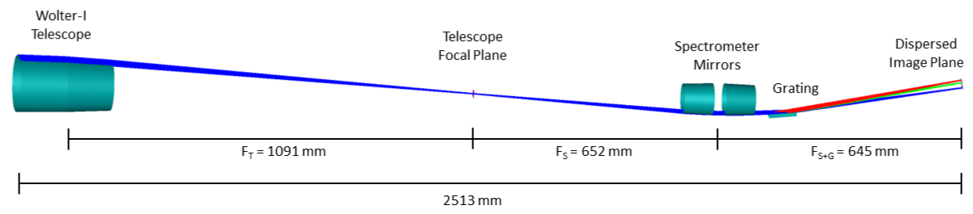
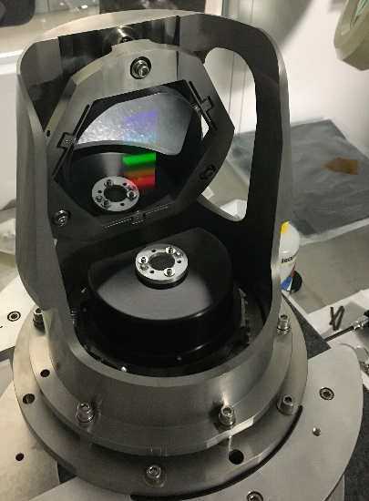
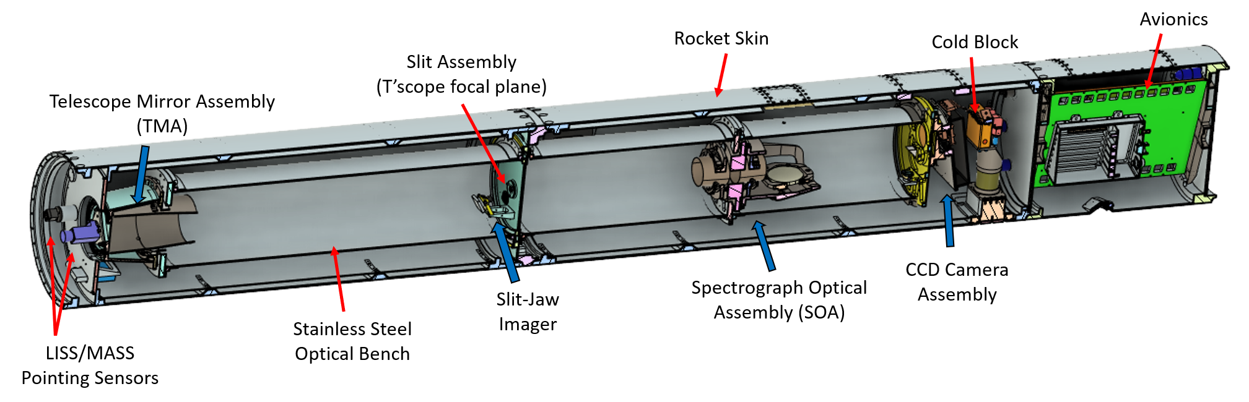
MaGIXS Instrument Design
Grating
Slot
Beam footprint subtends 34º
Telescope section
Spectrometer section
Camera section
First mission to use deterministic polished X-ray mirrors
Athiray et al 2020,2021; Champey et al 2022 JAI
Notes:
Initally it was a slit sp. Changed to slot , Bring a straw movie and aligning, them,

Slide 17
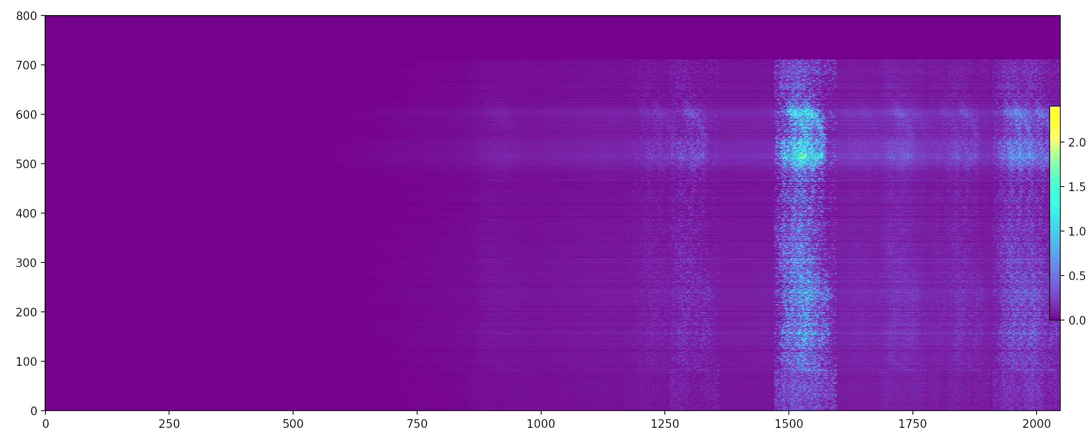
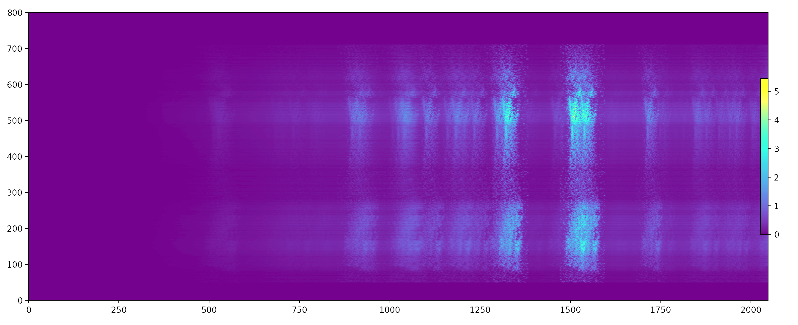
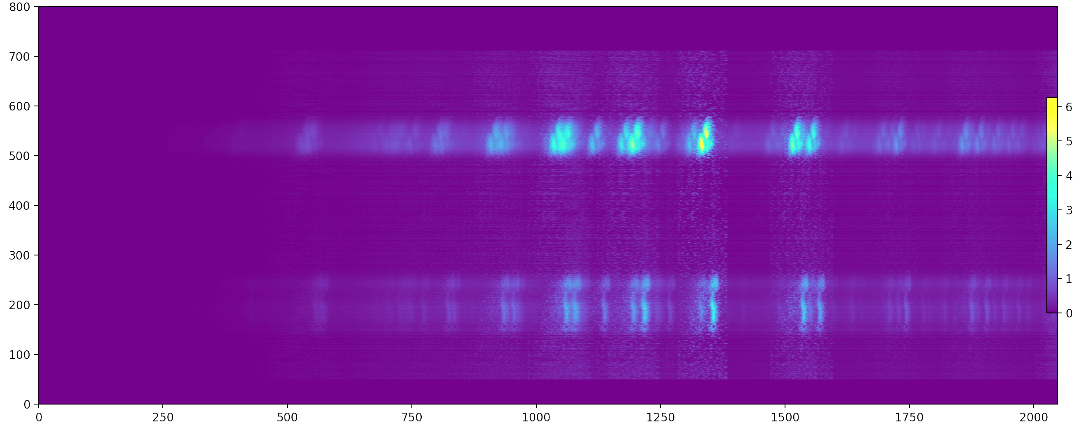
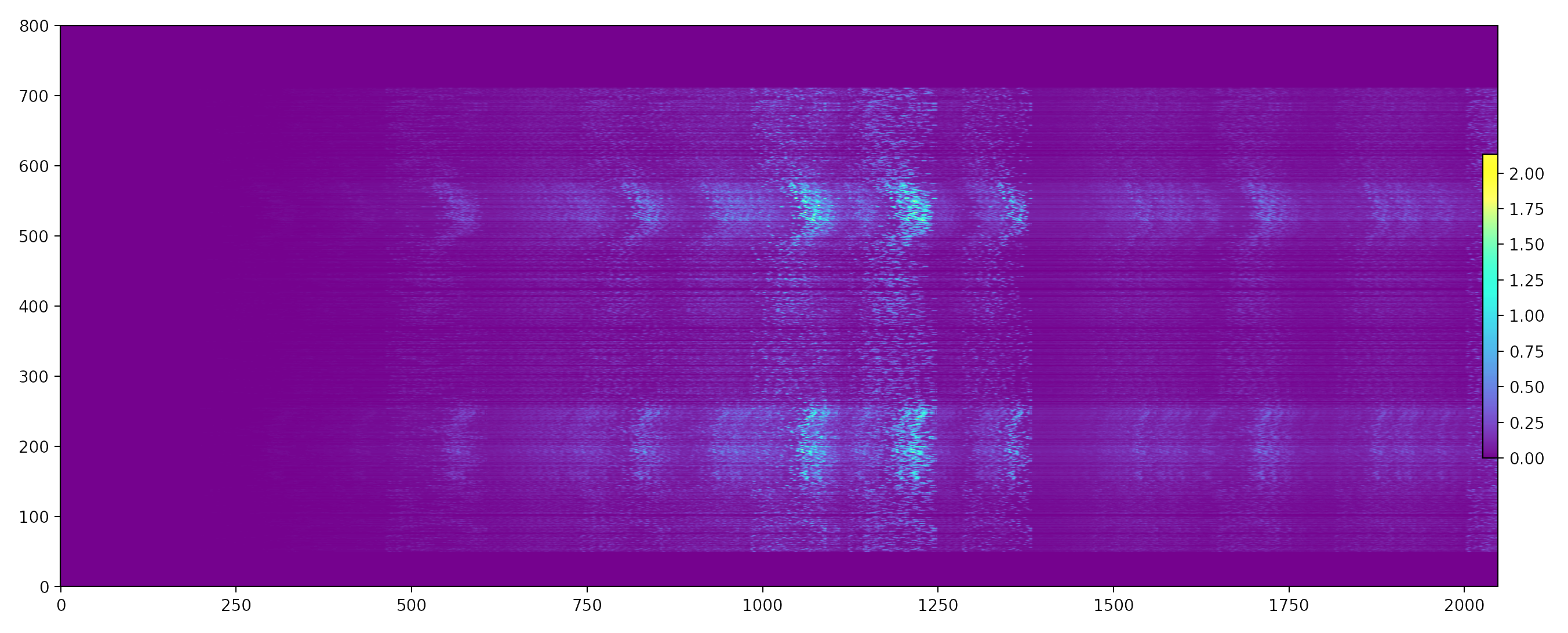
Why inversion works?
MaGIXS field
O VIII
O VII
N VII
C VI
O VIII
O VII
N VII
C VI
Ne IX
O VIII
Ne IX
Fe XVII
Fe XVII
335Å
logt 6.0
logt 6.3
Ne IX
O VIII
O VII
N VII
C VI
N VII
C VI
Mg XI
O VIII
Ne IX
Ne IX
O VIII
O VIII
O VII
Ne IX
Fe XVII
Fe XVII
Fe XVII
Mg XI
Fe XVII
Fe XVII
Fe XVII
logt 6.4
logt 6.6
Multiple copies of several ions observed at different wavelengths offer excellent temperature diagnostics
Notes:
Replace this with temperature slide

Slide 18
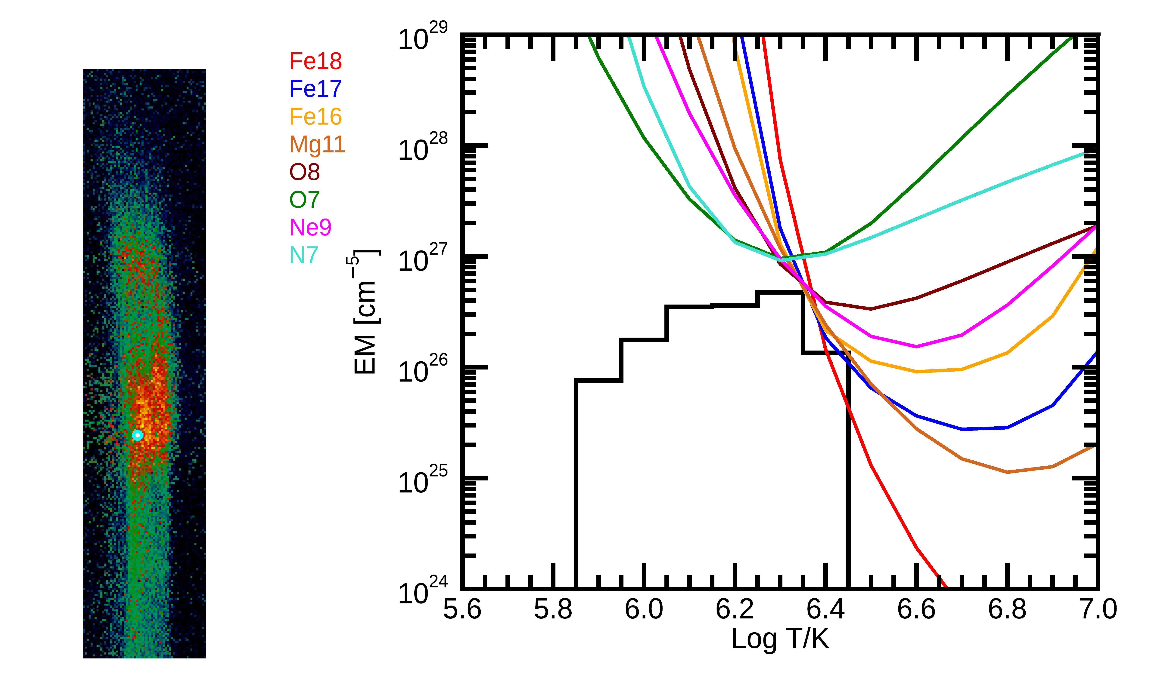
DEM inversion – EM cube
Inversion works!

