Slide 1
Accretion Lags in Black-Hole Binaries
Jack Steiner

Slide 2
Introduction
Stellar-Mass Black Holes

Slide 3
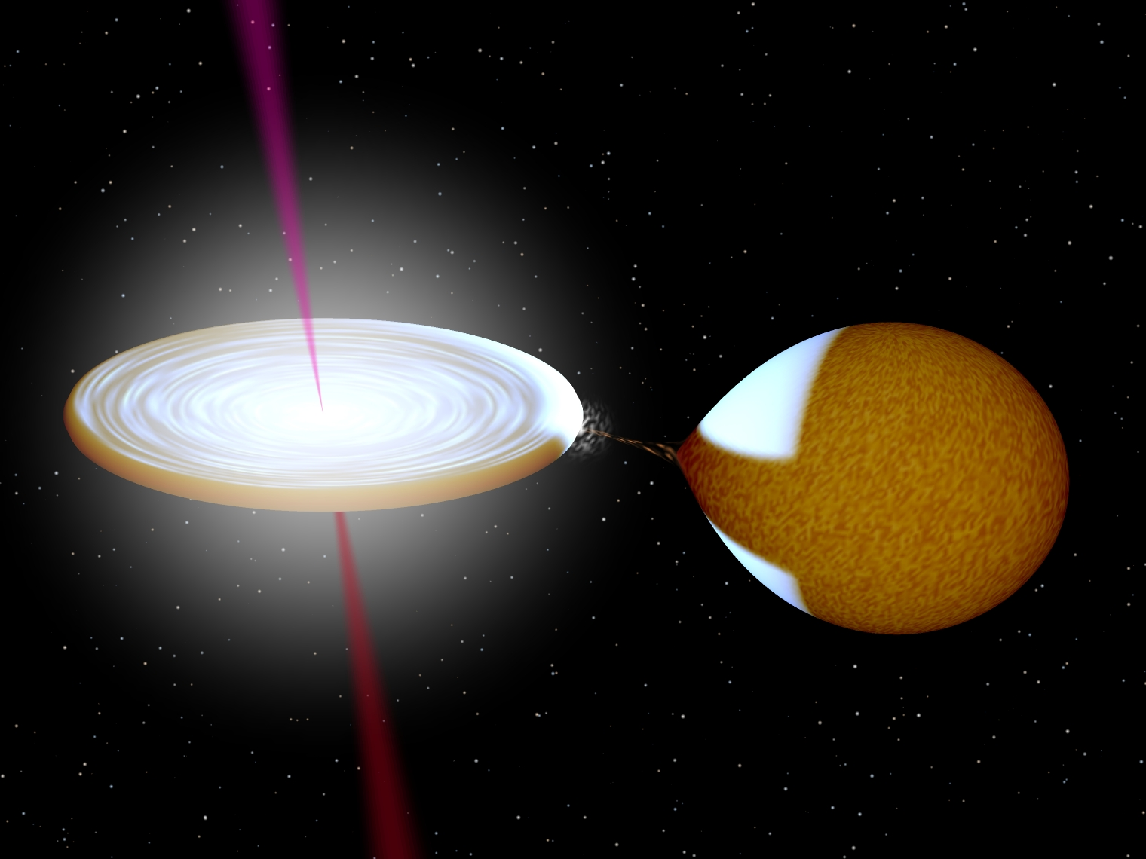
Black Hole X-ray Binary System
1,000,000 km
R. Hynes

Slide 4
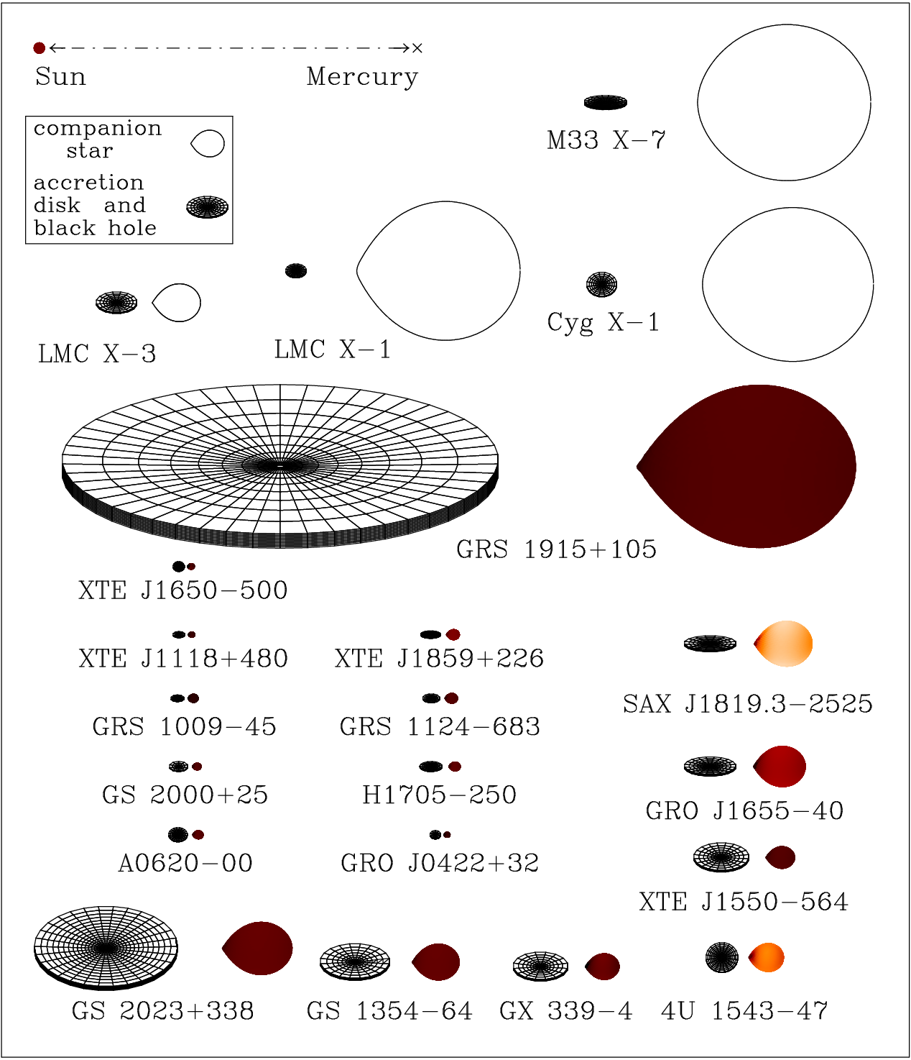
Persistent X-ray source
Highly variable
X-rays Dominated by disk
J. Orosz

Slide 5
Alpha Disks
Accretion disks transport angular momentum
… but viscosity produced with what mechanism?
The Shakura & Sunyaev “alpha” prescription:
→ Simple closed set of solutions with only weak alpha-dependence.

Slide 6
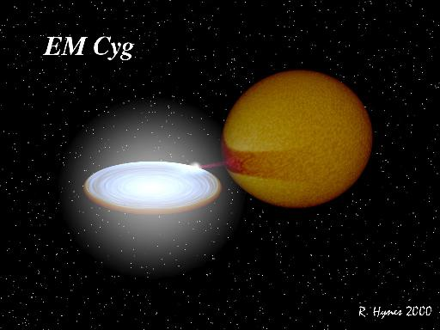

Slide 7
Optical, X-ray Light Curves
LMC X-3

Slide 8
X-ray-Optical Cross Correlations
15 day time lag

Slide 9
Why the broad peaks?
~20 day autocorrelation
Feedback?
Likely related to the viscous timescale from the outer disk

Slide 10
The Optical Model
Reprocessed X-rays
Elllipsoidal Stellar
Emission
Accretion Emission
(time-lagged from X-rays)

Slide 11
The Accretion Model
From SS73:
Then the viscous time is simply
From a given radius:

Slide 12
the accretion model (ctd)
In practice, the optical disk emission in band i is modeled using the X-ray light curve lagged by
The flux is taken as a combination of L and Ldot:
  where the dynamic term loosely accounts for (smoothly varying) interaction of the accreting rings

Slide 13
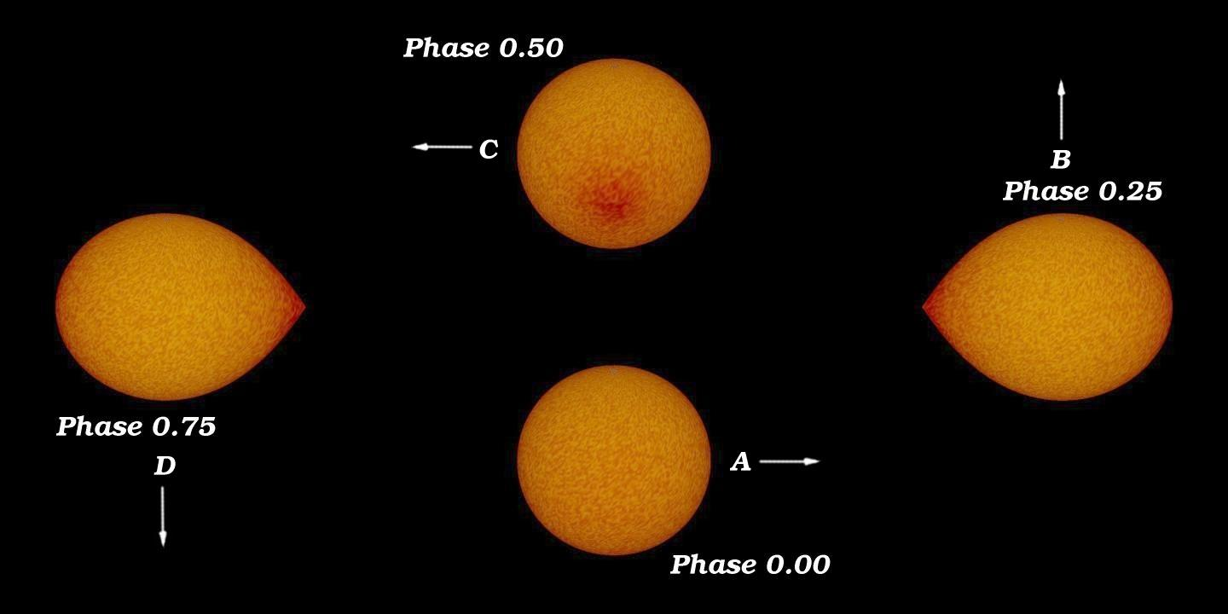
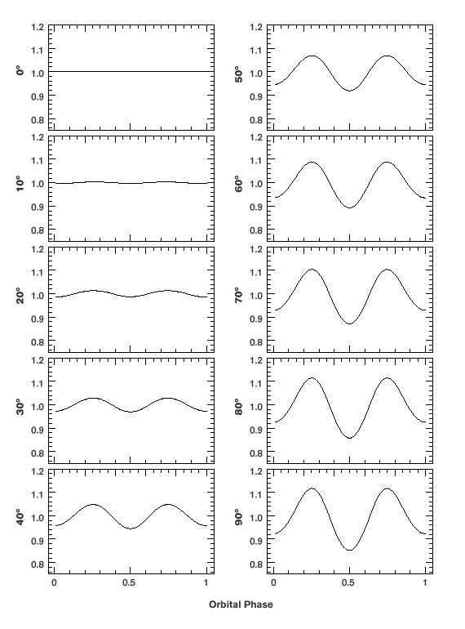
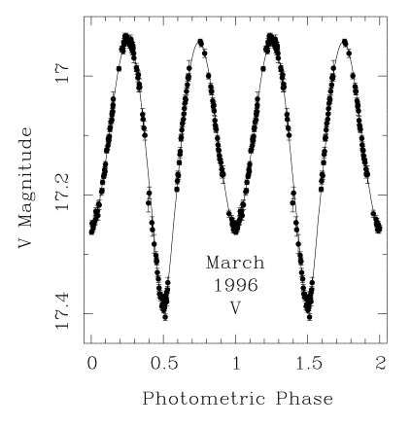
Ellipsoidal Light Curve
Image Credits: J. Casares, C. Bailyn
Orosz & Bailyn 96

Slide 14
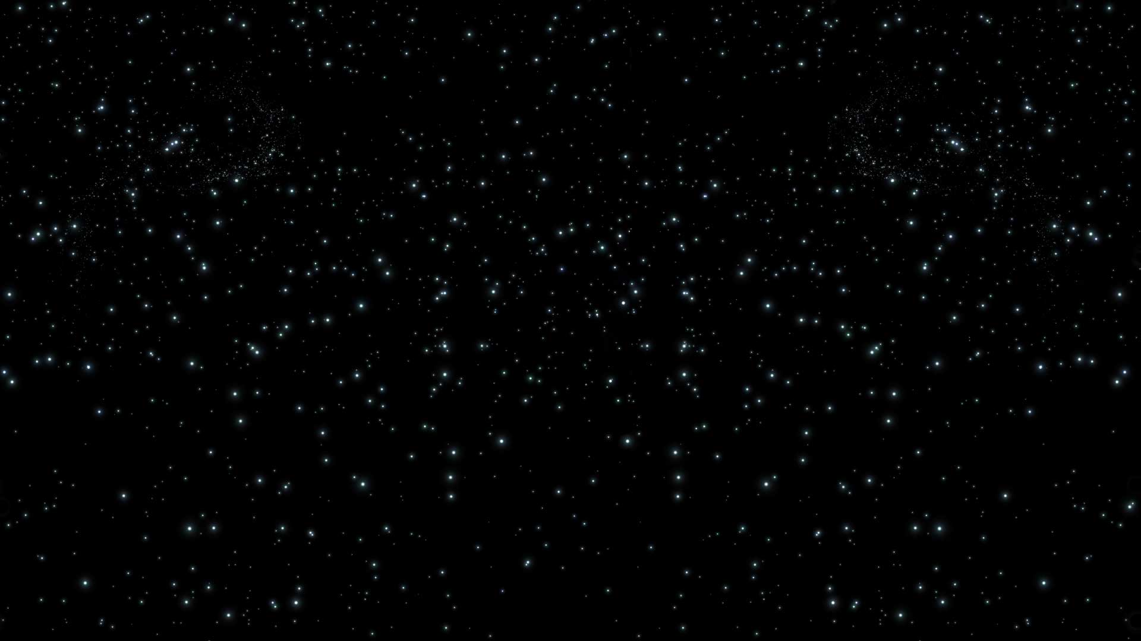
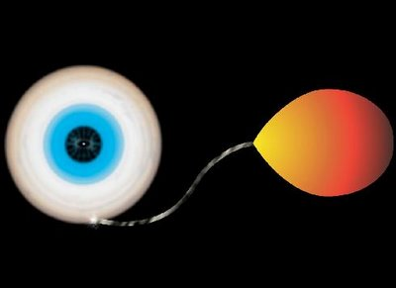
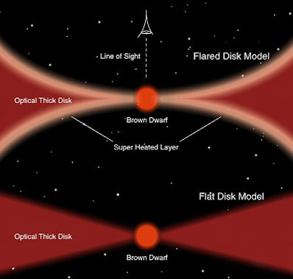
X-ray heating
Power law in X-ray brightness with a break / cutoff
Allow for modulation at the orbital period

Slide 15
Schema
Our optical “model” is a remapping of the X-rays but using an admixture of two different responses
One is time-shifted (and stretched) to represent accretion emission at a viscous time delay
The other is instantaneous and describes X-ray heating
X-ray
Optical
time

Slide 16
Confronting the Data

Slide 17
X-ray Heating
The X-ray heating is a strong function of the X-ray luminosity (scaling index = 2)
The break is quite sharp and occurs at ~40% Eddington, beyond which heating plummets to zero

Slide 18
The Emergent Picture
Disk’s shadow covers the
star by ~40% Eddington
Time lags independent of band,
indicating a common radius

Slide 19
Major Results
Punchline:
→

Slide 20
Additional Results

Slide 21
Optical Residuals

Slide 22
Period Hunting
Notes:
~5x10^-5 = 5s from raw LS without full model

Slide 23
J. Orosz
Transient Source
Recurrent Outbursts
Even more variable
Both hard and soft states
Jets and nonthermal emission

Slide 24
Light Curves
LMC X-3
GX 339-4

Slide 25
X-ray-Optical Cross Correlations
15 day time lag
~30 day lag
LMC X-3
GX 339

Slide 26
20 day autocorrelation
100 days
LMC X-3
GX 339
Feedback

Slide 27
GX 339-4

Slide 28
GX 339-4

Slide 29
GX 339-4’s period

Slide 30
Methodological Challenges, Questions
What is the most meaningful way to treat a noisy data set as a model? – Smoothing? Parametric (physical) model fitting?
  Mostly interested in disk emission – complicated for GX339-4
  Allow inclusion of multiple and varied X-ray data sets
Best means of optimizing over a highly structured parameter space (i.e., period searching, many aliases)?
What to do regarding highest frequency signals which are caused by variability faster than viscous delay – not in the model
How to assess the “goodness” of the fit

Slide 31
Conclusions
New technique using the X-rays data to model the optical in black hole binaries
We find and further, that alpha appears to decrease with increasing luminosity
Optical emission is dominated by a bright ring at the splash-down point of the gas stream
X-ray heating is powerful but cuts off when the star is eclipsed by the disk.
Method is promising for deriving periods and cleaning optical light curves for X-ray bright sources

Slide 33
