Slide 1
Searching for Vibronic Progressions in the Diffuse Interstellar Bands
Jane Huang
October 27, 2015

Slide 2
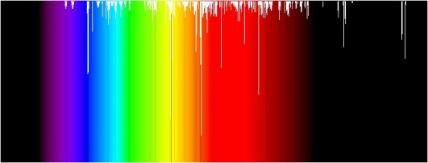
What are the Diffuse Interstellar Bands?
Hundreds of absorption bands observed toward numerous stars, primarily at visible wavelengths
Ascribed to electronic transitions of interstellar gas-phase molecules, but their origins largely remain a mystery

Slide 3
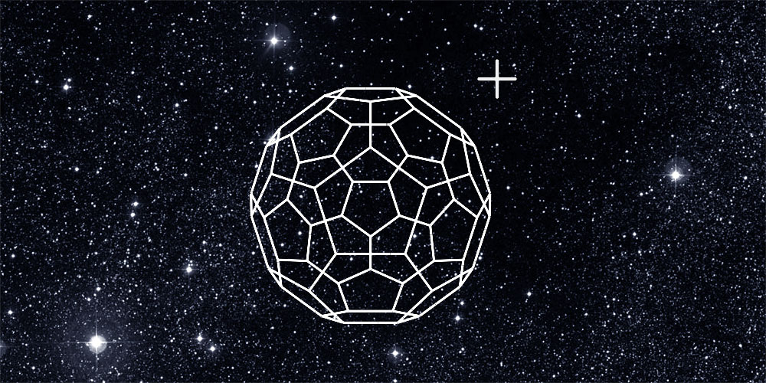
To date, only one DIB carrier has been identified
Gas-phase laboratory spectrum confirmed that C₆₀⁺ gave rise to bands at 9632 Å and 9577 Å (Campbell et al. 2015)
Image credit:
University of Basel

Slide 4
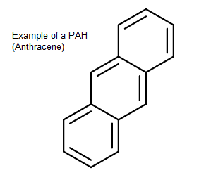
Hypotheses for other diffuse interstellar band carriers
  Fullerenes (Kroto 1989; Ehrenfreund & Foing 1996)
  Long carbon chains, i.e. C_{n,} C_{2n+1} , related anions and cations (Douglas 1977)
  Polycyclic aromatic hydrocarbons (van der Zwet & Allamandola 1985; Leger & D'Hendecourt 1985)

Slide 5
Motivations for identifying DIB carriers
About 150 circumstellar and interstellar molecules have been discovered so far; the hundreds of DIBs with unidentified carriers show gaps in our understanding of diffuse ISM chemistry
Most known interstellar molecules are small, while DIB carriers are thought to be large → can offer insight into formation pathways of complex organic molecules
DIB carriers are potentially connected to other ISM phenomena
  Unidentified infrared emission bands
  The Extended Red Emission of the Red Rectangle Nebula
  Anomalous Microwave Emission

Slide 6
Confirmation of a DIB carrier ultimately requires gas phase electronic spectroscopy…but how do we narrow down which molecules to investigate further?

Slide 7
Searching for vibronic progressions
Insight from Duley and Kuzmin (2010): Search DIBs for low-energy vibronic progressions, which are likely associated with torsional modes of large molecules
Duley and Kuzmin identified four progressions with spacings less than 40 cm⁻¹, BUT they also note
  “It is also likely that some of the fits are coincidental because of the density of spectral lines in the region of these bands.”

Slide 8
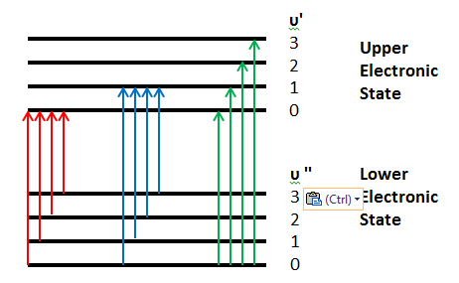
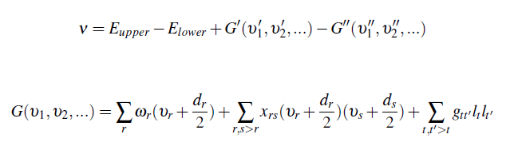
Vibronic Progressions
Vibronic transition: Changes both electronic and vibrational state of a molecule
For low-energy vibrational modes, progressions are harmonic (i.e., frequency differences between bands is constant)
Schematic of several vibronic progressions, grouped by color (not to scale)

Slide 9
Using agglomerative clustering methods to identify potential progressions
Searched for progressions in catalog of 414 DIBs toward HD 183143 from 3900 to 8100 angstroms (Hobbs et al. 2009)
  First, identified all pairs of DIBs with spacing between 5 and 40 cm⁻¹ as initial set of progressions
  Based on closest average spacing, recursively merged pairs of progressions sharing one overlapping band until meeting tolerance threshold (based on difference between spacing relative to spacing)

Slide 10
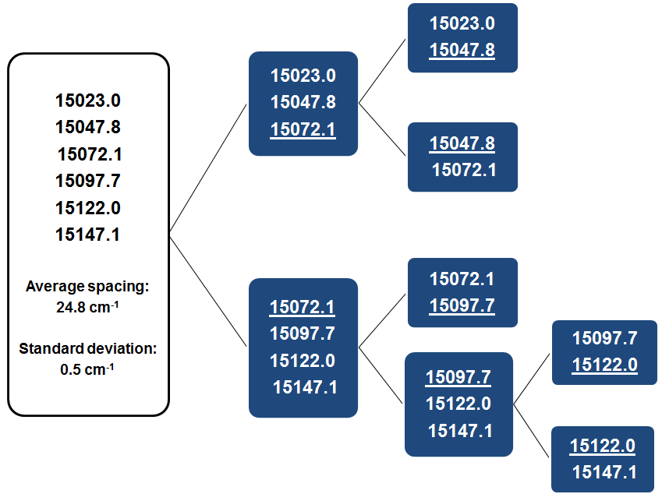
Schematic of progression-merging

Slide 11
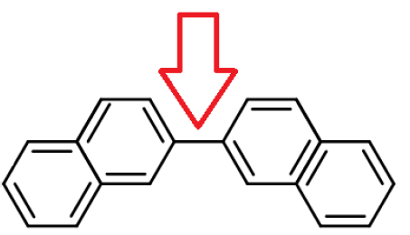
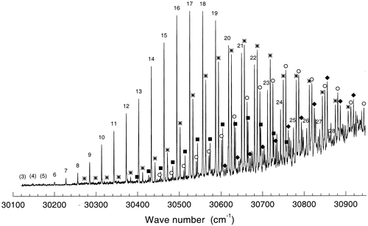
Initial check of clustering scheme
  Looked for known progressions in band positions of 2,2’-binaphthyl (Del Riccio et al. 2000)

Slide 12
υ_{tors}^{b} | prog. 1 origin | prog. 2 (★) +131 cm⁻¹ | prog. 3 (▪) +140 cm⁻¹ | prog. 4 (○) +200 cm⁻¹
3 | 30 123.3
4 | 30 148.1
5 | 30 173.5
6 | 30 200.3
7 | 30 227.6 | 30 354.2
8 | 30 255.9 | 30 383.1 | 30 398.5
9 | 30 264.6 | 30 412.2 | 30 426.6
10 | 30 313.4 | 30 441.8 | 30 455.3 | 30 510.7
11 | 30 342.9 | 30 471.5 | 30 484.3 | 30 540.6
12 | 30 372.6 | 30 501.9 | 30 513.7 | 30 570.7
13 | 30 402.7 | 30 532.5 | 30 543.5 | 30 601.1
14 | 30 433.1 | 30 563.2 | 30 573.5 | 30 631.9
15 | 30 463.6 | 30 593.9 | 30 603.8 | 30 662.6
16 | 30 494.1 | 30 625.0 | 30 634.4 | 30 693.6
17 | 30 525.0 | 30 656.1 | 30 665.0 | 30 724.9
18 | 30 556.0 | 30 687.2 | 30 695.7 | 30 756.0
19 | 30 586.9 | 30 718.6 | 30 726.8 | 30 787.0
20 | 30 618.1 | 30 749.9 | 30 757.5 | 30 818.6
21 | 30 649.4 | 30 781.0 | 30 788.8 | 30 849.8
22 | 30 680.5 | 30 812.4 |  | 30 880.7
23 | 30 711.9 | 30 843.7 |  | 30 912.4
24 | 30 743.4 | 30 874.9 |  | 30 943.9
25 | 30 774.4 | 30 905.9
26 | 30 806.1
27 | 30 837.3
28 | 30 868.7
29 | 30 899.5
Progressions identified for 2,2-Binaphthyl by del Riccio et al, plus results of agglomerative clustering search
Progression A
Progression B
Progression C
Progression D (+1 extra band misidentified)
Progression E

Slide 13
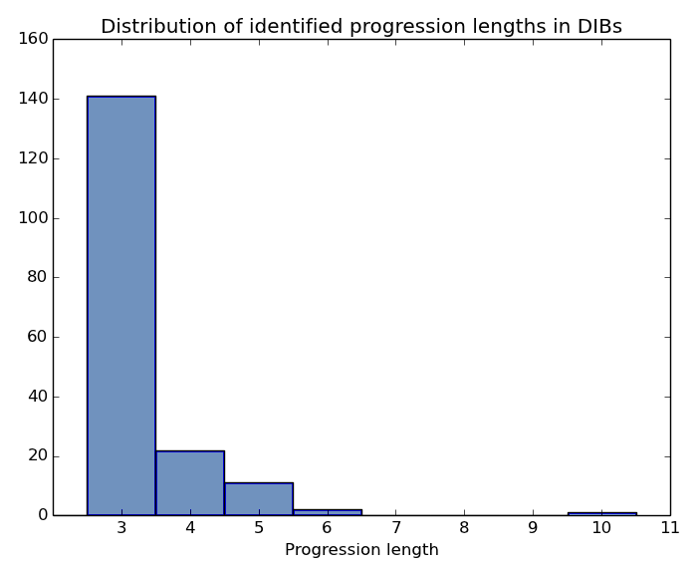
Results of vibronic progression search toward DIBs
Search separated DIBs into 177 progressions of length 3 and longer
Longest progression contained 10 bands

Slide 14
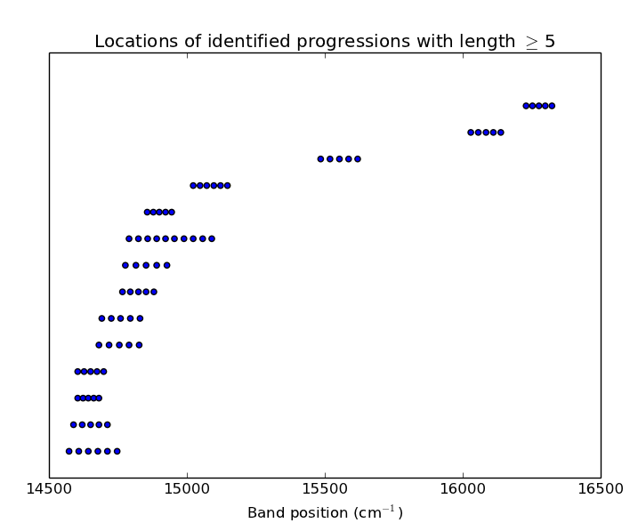
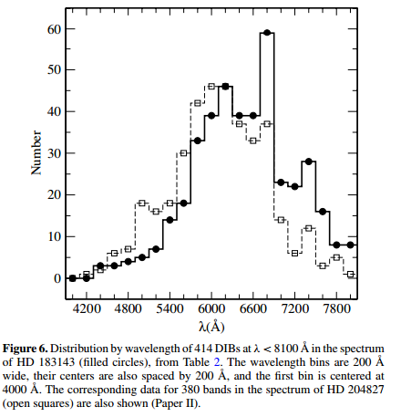
Most candidate progressions lie between 6895 to 6665 Å
Hobbs et al. (2009) remark that their catalog was more likely to have missed DIBs at wavelengths less than 5100 or greater than 6865 Å due to telluric/stellar lines + higher photon noise.

Slide 15
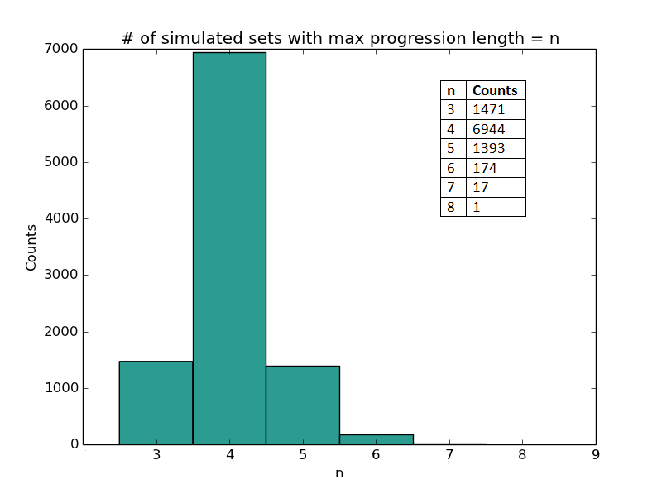
Estimating likelihood of coincidental occurrence of progressions
Created 10,000 sets of 414 randomly chosen positions (without replacement) between 12342 and 25633 cm⁻¹ (same range as DIBs catalog)
Applied same agglomerative method to identify chance progressions
In simulations, maximum chance progression length = 8, most common chance progression length = 4

Slide 16
The 10-band progression toward HD 183143
Five of these bands (6759.3, 6728.6, 6713.6, 6669.5, and 6624.9) were not identified in any of the earlier DIB surveys by Jenniskens and Desert (1994), Tuairisg
et al. (2000), Galazutdinov et al. (2000), or Weselak et al. (2000), which had lower S/N compared to Hobbs
et al. (2009)
Central Wavelength (air) [angstroms] | Vacuum wavenumber [cm] | [cm] (from previous band in progression)
6759.3 | 14790.4
6743.8 | 14824.4 | 34
6728.6 | 14857.9 | 33.5
6713.8 | 14890.6 | 32.7
6699.4 | 14922.7 | 32.1
6684.9 | 14954.9 | 32.2
6669.5 | 14989.5 | 34.6
6654.6 | 15023 | 33.5
6639.4 | 15057.4 | 34.4
6624.9 | 15090.3 | 32.9

Slide 17
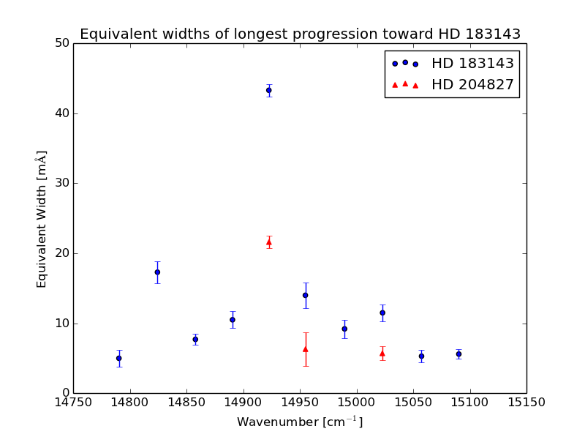

Slide 18
Summary
Agglomerative clustering was used to identify possible vibronic progressions in DIBs
For randomly distributed band positions, coincidental progressions of up to length 6 arise relatively frequently
Identified one length-10 progression in DIBs spectrum, starting at 14790 cm⁻¹ with bands spaced apart by ~33.3 cm ⁻¹ (standard deviation in spacing of 0.85 cm ⁻¹ standard)
We also identify retrieve the progression [6860.1, 6843.6, 6827.5, 6811.3, 6795.3, 6779.0 angstroms], originally identified by Herbig (1988)
DIB spectrum shows evidence that some bands are due to the torsional modes of large molecules, but high S/N spectra of multiple sightlines are necessary to investigate further

Slide 19
References
Cami, J., Sonnentrucker, P., Ehrenfreund, P., & Foing, B. H. 1997, A&A, 326, 822
Campbell, E. K., Holz, M., Gerlich, D., & Maier, J. P., Nature, 523, 322
Del Riccio, J. L., Zhang, F., Lacey, A. R., Kable, S. H., 2000, J. Chem. Phys. A, 104, 7442
Douglas, A. E. 1977, Nature, 269, 130
Duley, W. W., & Kuzmin, S. 2010, ApJL, 712, L165
Ehrenfreund, P., & Foing, B. H. 1996, A&A, 307, L25
Galazutdinov, G. A., Musaev, F. A., Krełowski, J., & Walker, G. A. H. 2000, PASP, 112, 648
Herbig, G. H. 1988, ApJ, 331, 999
Hobbs, L. M., York, D. G., Thorburn, J. A., et al. 2009, ApJ, 705, 32
Jenniskens, P., & Desert, F.-X. 1994, A&AS, 106, 39Kroto, H. W. 1989, Annales de Physique, 14, 169
Leger, A., & D'Hendecourt, L. 1985, A&A, 146, 81
Tuairisg, S. Ó., Cami, J., Foing, B. H., Sonnentrucker, P., & Ehrenfreund, P. 2000, A&AS, 142, 225
van der Zwet, G. P., & Allamandola, L. J. 1985, A&A, 146, 76
Weselak, T., Schmidt, M., & Kre³owski, J. 2000, A&AS, 142, 239

Slide 20
Acknowledgments
Thank you to Vinay Kashyap and Aneta Siemiginowska for helpful discussions related to this project, Dr. W. W. Duley for answering questions about his paper on vibronic progressions, and Lew Hobbs and Donald York for answering questions about their DIB catalog

