Slide 1
Commentary on Time Series in High Energy Astrophysics
Brandon C. Kelly
Harvard-Smithsonian Center for Astrophysics

Slide 2
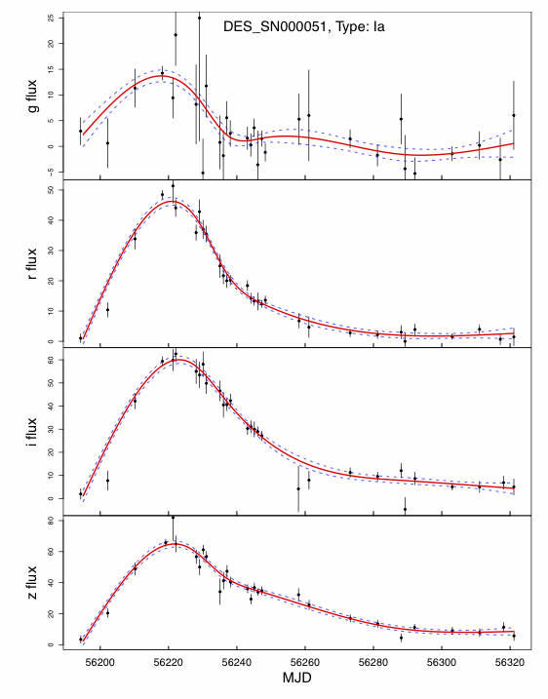
Trends
Lightcurve shape determined by time and parameters
Examples: SNe, γ-ray bursts
Can use parameteric methods to characterize shape
  E.g., Rise and decay time scale of a pulse
Can use non-parameteric methods to characterize shape
  Joey: Projected spline fits of LC onto diffusion map space
  Ashish: Used dm/dt to obtain simple parameterization of trends for sparse LC
Spline fits to SNe LCs in multiple bands
(Richards+, 2011)

Slide 3
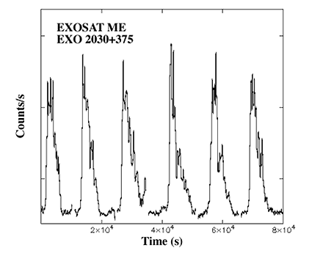
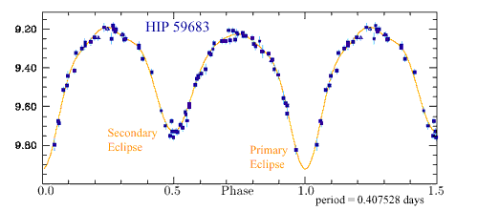
Periodic Behavior
LC shape determined by time and parameters, repeats regularly
Examples: Eclipsing binaries, Pulsars
Characterized by period, shape of pulse
  Pavlos: Described methods for estimating periods in noisy and irregularly sampled time series
  Eric: Use H-test on photon arrival times to find periods, regularly sampled time series
Pulsar
Eclipsing Binary
Credit: ESA

Slide 4
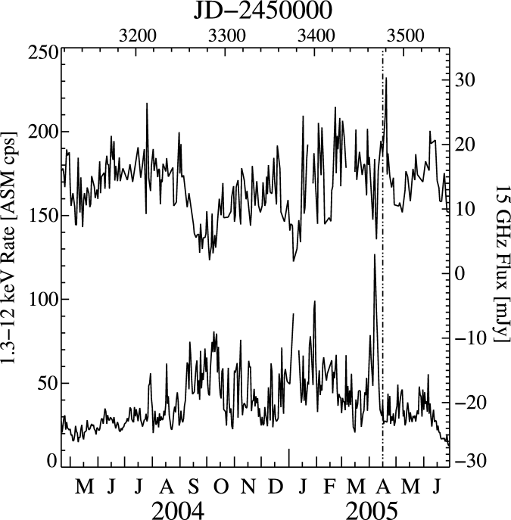
Stochastic Variations
Cygnus X-1
Stochastic Process: LC depends stochastically on previous values of LC and time between observations
Examples: Random-walk behavior, accretion flows, jets
Joey: Used parameters that summarize stochastic fluctuations for classification
Radio
X-ray
Wilms+ (2007)

Slide 5
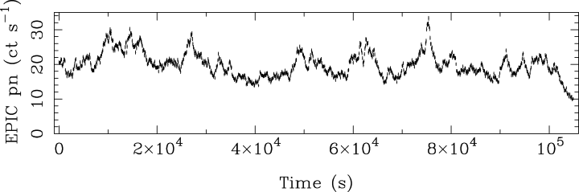
Characterizing Stochastic Processes
Mrk 766, Vaughan & Fabian (2003)
What similarities exist
between these two
segments?

Slide 6
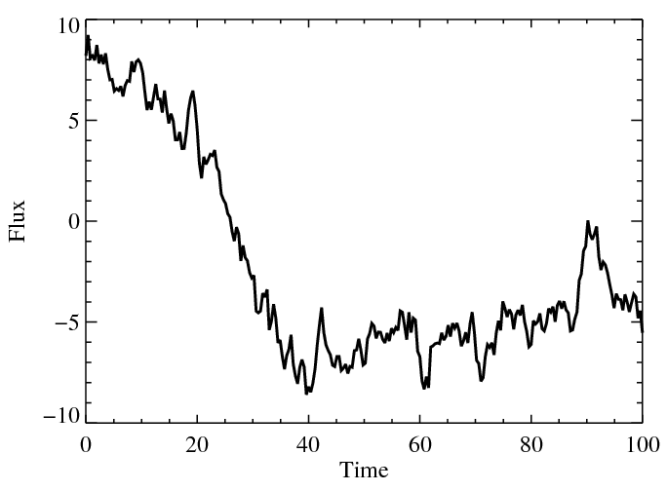
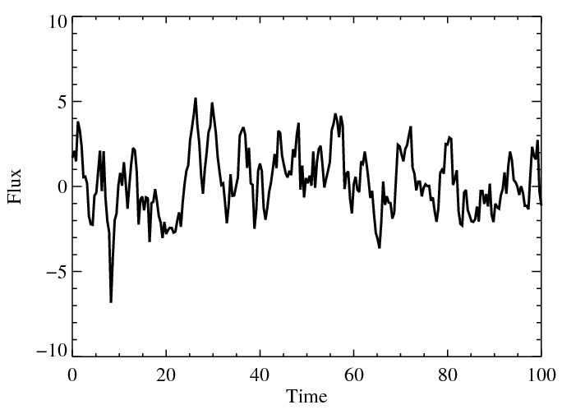
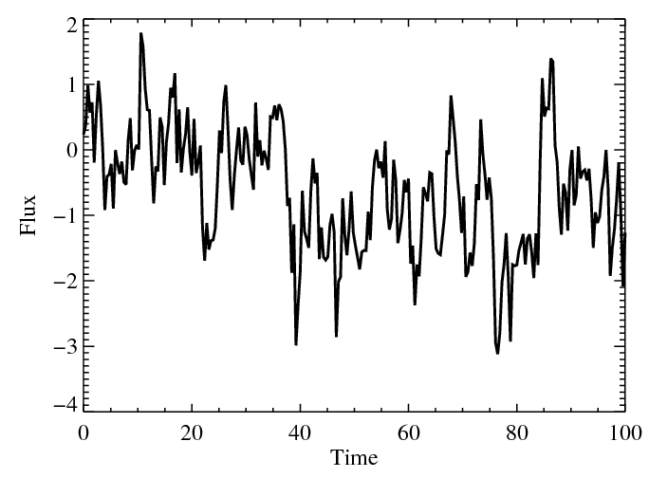
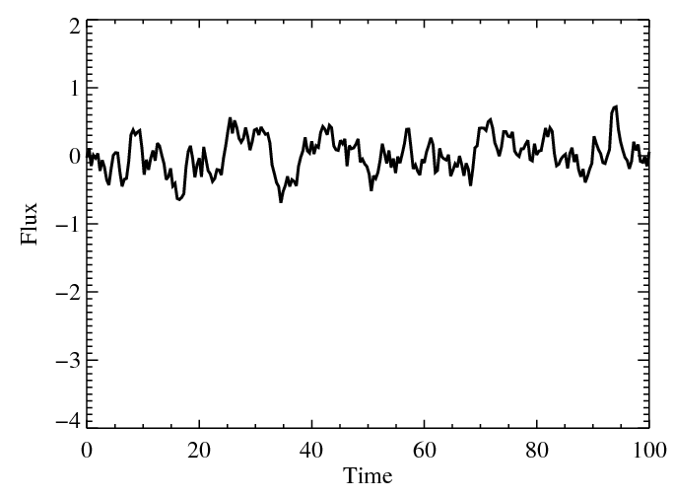
How to quantify features of stochastic processes?
Compare to
More variable on
long timescales
More variable on
short timescales
Compare to
Lower Variability
Higher Variability

Slide 7
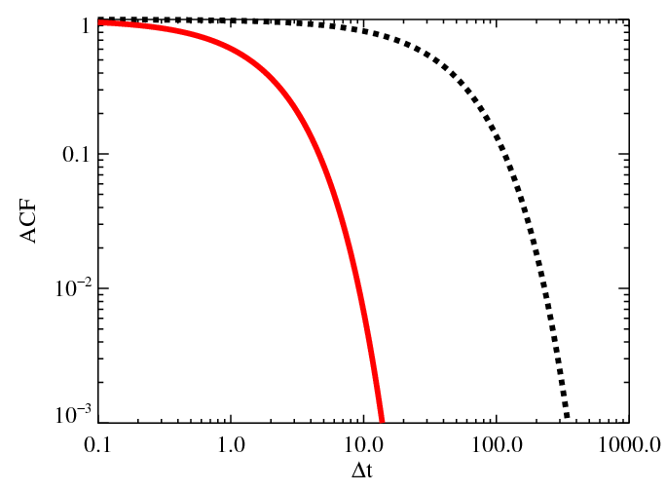
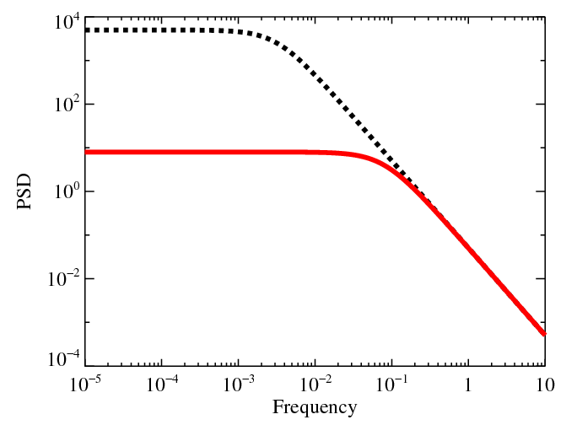
Characterizing Variability of Stochastic Processes
Use features in the autocorrelation function (ACF) and power spectral density (PSD)
  ACF: Correlation of variations in time series as a function of Δt
  PSD: Variability power per frequency interval
  ACF and PSD are Fourier transforms of each other (modulo a normalization factor)
Weak Stationarity: Mean and ACF of do not change with time
Variability power concentrated
on longer time scales
Variability power concentrated
on shorter time scales

Slide 8
Parameteric Modeling of Stochastic Processes
Non-parameteric methods (e.g., periodogram) require high-quality data
  No Assumptions about functional form of PSD or ACF
  Noisy
  Suffer biases from sampling pattern
Parameteric modeling of PSD possible through monte-carlo methods (e.g., Uttley+ 2002)
  Can fit arbitrary PSDs for any sampling pattern
  Computationally expensive
  Not most efficient use of information in data
Parameteric modeling in time domain
  Use a parameteric model for time-evolution of stochastic process
  Fitting is done via maximum-likelihood or Bayesian methods
  Computationally cheap for many models

Slide 9
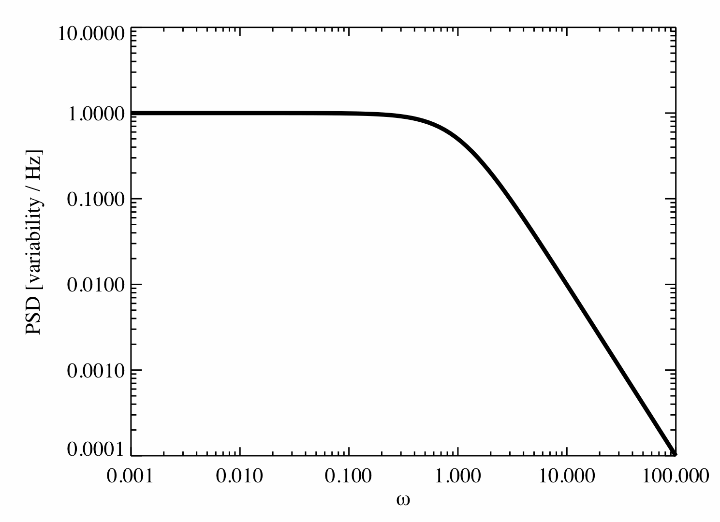
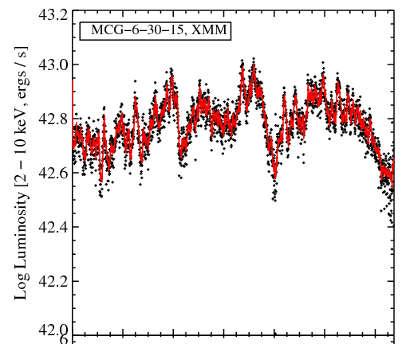
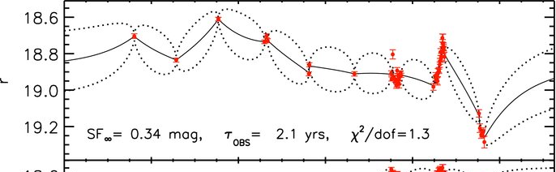
Example: Ornstein-Uhlenbeck Process (i.e., Damped Random Walk)
AGN optical and X-ray LCs well described by one or more OU processes (Kelly+2009,2011, MacLeod+2010):
Likelihood function derived from solution
PSD
Frequency
Time, MacLeod+ 2010
Time, Kelly+ 2011

Slide 10
Classifying Variable Sources
Use the various variability metrics (parameters) for classification
Classification of variables (Joey):
  Improve source selection/classification based on color and other quantities
  Find new classes of objects
Identification of short-lived (transient) phenomena (Ashish)
  Time-sensitive, so classification must be done in real time with sparse time series
Can use variability + other info to identify best strategy for follow-up observations (Joey, Ashish)

Slide 11
Directions for Future Work
Improve modeling of stochastic processes in time-domain (e.g., through Stoch. Diff. Eq.)
  Incorporate multi-wavelength correlations, lags
  Include stochastic flaring activity
  Develop time-domain models for arbitrary PSDs
Improved computational methods/strategies (Eric)
  Future massive data sets will either require efficient programs and efficient use of memory or analyzing a subset of the data
Improvement in handling of differences between training and test sets for classification (Joey)

